Slide 1
Notes:
Chapters 40 – 48 primarily focused on the Jews’ rescue from physical captivity and the excitement this was to produce in them, but it ended on a stark note in chapter 48. Despite their inevitable rescue, the problem of sin would continue, trapping them in a spiritual captivity that needed addressing. Chapters 49 – 58 provide the solution to that problem. God would send a Servant as a sacrifice to provide atonement. This coming will produce a posterity, descendants who will take His message to a lost world who is hungry for something better. So, that solves all the problems, right? Not quite. This 9-chapter section ends on a stark note in much the same way chapters 40 – 48 did. Despite the Servant doing His part, the grim reality is that not everyone will accept what He offers, and that is the focus of the last piece of this section, which is primarily a judgment section. “But I thought chapters 1 – 39 were the judgment passages?” For that reason, not as much attention is given to this section, and many are confused by its connection to the previous verses.
Why the shift in tone? Because despite the glorious future God has provided for His people through the Servant, He still expects righteous conduct - Rom 6:1-2 – “What shall we say then? Are we to continue in sin so that grace may increase? May it never be! How shall we who died to sin still live in it?”
This study will be divided up into 2 oracles: 56:9-12 talks about the self-serving leadership who do nothing for the people they are supposed to lead, but simply seek after pleasure. And then 57:1-21 is going to address the tension between the righteous and rebellious. As we’re studying this last piece of 49 – 57, be on the lookout for all the contrasts/similarities to chapter 55.

Slide 2
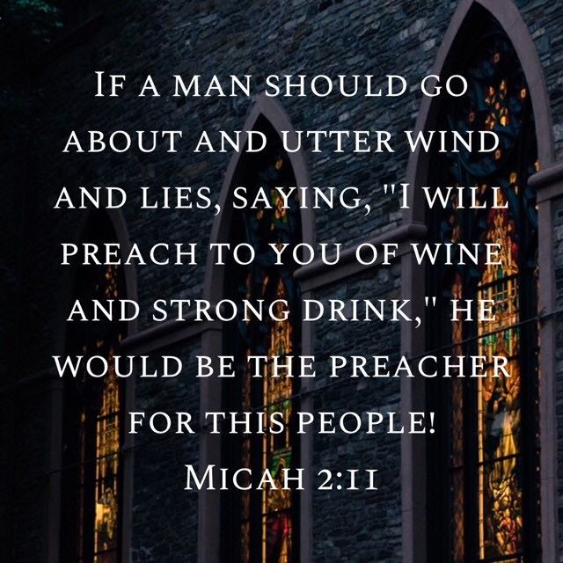
Condemnation of the Wicked
Failure of Leadership
Isa 56:9-12 – “⁹All you beasts of the field, all you beasts in the forest, come to eat. ¹⁰His watchmen are blind, all of them know nothing. All of them are mute dogs unable to bark, dreamers lying down, who love to slumber; ¹¹and the dogs are greedy, they are not satisfied. And they are shepherds who have no understanding; they have all turned to their own way, each one to his unjust gain, to the last one. ¹²‘Come,’ they say, ‘let us get wine, and let us drink heavily of strong drink; and tomorrow will be like today, only more so.’”
Notes:
56:9-12 focuses on the failure of Israelite leadership – Isa 56:9-12.
Did you notice the similarity to how chapter 55 begins? In chapter 55, an invitation was extended to the “poor/thirsty” to “come” eat and drink w/o cost (55:1). 56:9 is a parody of that invitation. God’s people are inundated w/self-serving leadership who have abandoned the law and abandoned their duty to those under their trust. As a result, they leave themselves open to destruction by these “beasts” of the field/forest. Who are the “beasts”? Keep in mind passages like Dan 7 and Rev 13. It is not likely referring to any one thing, rather it’s one of God’s common means of judgment on this planet toward rebellious people, that being external invasion. The idea is that unless we come to feast on what the Lord is offering in Isa 55, He will send “beasts” to feast on us.
Now, how do these “beasts” get in? Because of the failure of leadership, which he identifies as “watchmen” and shepherds”. Watchmen are responsible for watching for external danger, but these “watch dogs” are not “barking” at danger, but rather falling asleep on the job. Shepherds are supposed to care for internal spiritual need, but these have no discernment, no sensitivity to the needs of the flock. And what drives this apathy? Unbridled self-absorption, seeking their own gain, turning to their own way of doing things. And when leadership is not doing its job, as we saw back in 9:14-17, the commoner’s fall is not far behind.
Notice how alcohol always seems to pop up in these scenarios. Why? Because I suspect they’ve made themselves so miserable by their sin, seeing as it never satisfies, they turn to depressants to dull the pain. Why does our government want to make us miserable? Because they’re miserable. You cannot lead this kind of wicked life w/o it turning into a downward spiral toward spiritual in its grossest form. And if texts like this makes us uncomfortable, then good – the well-being of God’s people rests on “leaders” like this.

Slide 3
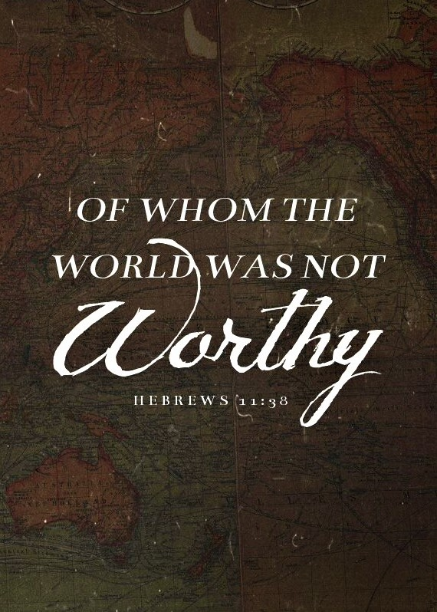
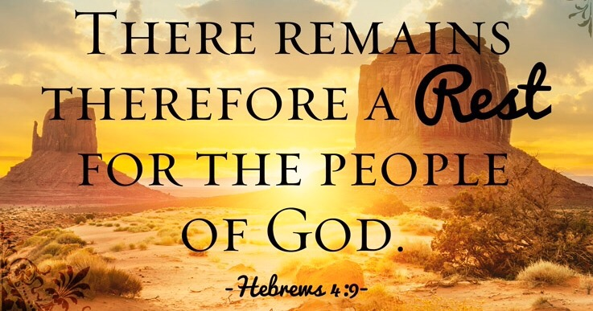
Condemnation of the Wicked
Destination of the Righteous
Isa 57:1-2 – “¹The righteous man perishes, and no man takes it to heart; and devout men are taken away, while no one understands. For the righteous man is taken away from evil, ²he enters into peace; they rest in their beds, each one who walked in his upright way.”
Notes:
So, 9:14-17 mentions that when leaders fall, those whom they lead fall w/them. Jesus even spoke of how when the blind lead the blind, they both fall in the ditch. But what about the righteous? The irony is that while these wicked leaders are blind to their responsibilities, they are also blind to the disappearance of the righteous.
Isa 57:1a – This is so true. While bad leadership increases, something society needs less of, what society needs more of, righteous people, becomes less. The death of a celebrity is magnified. As soon as one dies, someone on social media, Christians no less, wax all sentimental about it. Yet the death of God’s righteous, of who Heb 11:38 tells us the world is not even worthy of, are rarely noticed. If noticed, it is nowhere near to the same degree celebrities are. Most celebrities are the epitome of self-indulgence and wickedness, but then there are “devout” men, which means men of “unfailing love”, something the world needs more of. But no one understands how terrible it is for the world to lose people like this. The phrase “no one understands” is the same phrase in 53:8 about the Servant and how “no one considered” why he was cut off from the land of the living. The idea is that the servants share this same nature w/the Servant; His experience becomes ours. We will likely not be appreciated on this planet for what we tried to do and who we tried to be.
So, of what benefit is there for removing the righteous from society? No benefit for this world, but it is God’s ways of extending mercy toward us – Isa 57:1b-2 – It’s hard to think about the loss of a loved one in this respect isn’t it? But it’s true that the righteous don’t “perish” so much as pass into peace. Our faithful loved ones lying on their death beds is a picture of the unbroken rest in which they’re about to enter. This is a blessing for the righteous, and a cause for mourning for this lost world. Because as the righteous enter into rest one-by-one, corrupt leaders seek increasing comfort and pleasure w/decreasing satisfaction. And as the righteous of society become less as they die in onscurity, could this be a signal that the beasts are approaching?

Slide 4
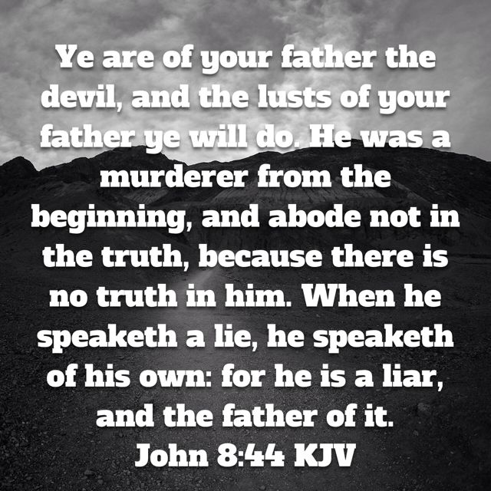
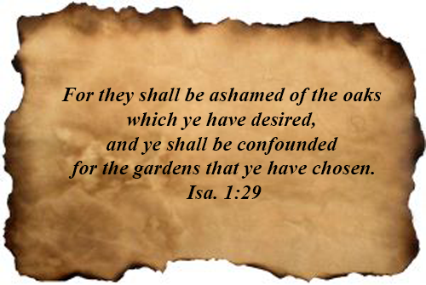
Condemnation of the Wicked
Spiritual Prostitution
Isa 57:3-5 – “³But come here, you sons of a sorceress, offspring of an adulterer and a prostitute. ⁴Against whom do you jest? Against whom do you open wide your mouth and stick out your tongue? Are you not children of rebellion, offspring of deceit, ⁵who inflame yourselves among the oaks, under every luxuriant tree, who slaughter the children in the ravines, under the clefts of the crags?”
Notes:
It’s not enough for the wicked to turn from God. They also dedicate their time and energy to pursuing other forms of worship to satisfy the craving of their empty hearts. Verse 3 begins w/a “but”, a contrast w/the prior 2 verses.
Isa 57:3-4a – Here we find a call for 3 people to stand. The sons of a “sorceress”, that being one who opens herself to being controlled by a spirit; the offspring of an “adulterer, “adultery” being used figuratively for the breaking of a pledge to God, and the offspring of a “prostitute”, the idea of entering into an illicit relationship of devotion to some lover other than God. It’s as if when God is looking for words to describe that generation of the wicked, He picks 3 of the worst sins imaginable to describe their scornful, dismissive rejection of God.
But rather than leaving it under the veil of symbolism, He now calls it like it is – Isa 57:4b-5 – Now, who is God ultimately addressing? The idolators, who while deliberating rebellious are also “born” from this behavior. Because notice what is stressed in these 3 verses: they are “sons”, “offspring”, and “children”. This was a theme of chapters 53 – 55 in which the Servant’s work will leave a posterity by way of His influence. But now the attention is to another posterity, people who are not the true children of Abraham, but as Jesus said in John 8:44 are of their father the devil. We are always the children of those we are most influenced by.
Vs. 5 covers two 2 aspects of idol worship: fertility worship, associated w/the evergreen tree which is a symbol of life (1:29), and human sacrifice, which was often associated w/the idol “Molech”. It’s almost as if Isaiah is deliberately covering the entire spectrum of offenses toward God, from life to death.

Slide 5
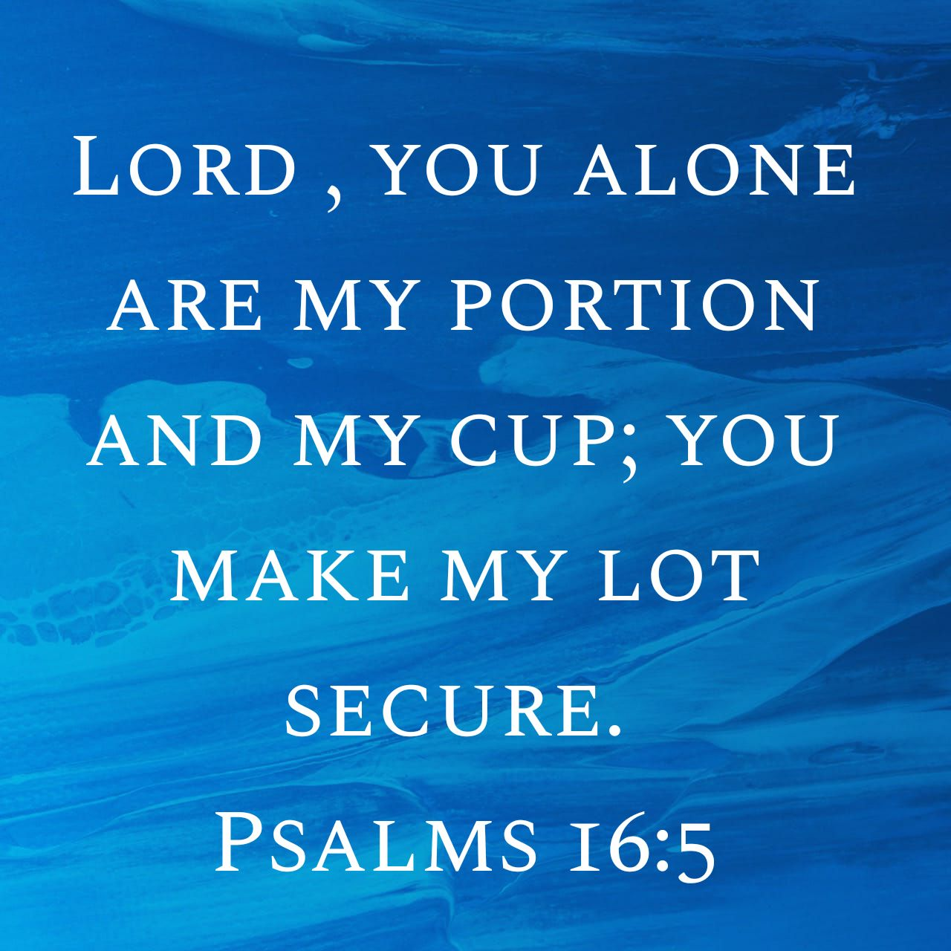
Condemnation of the Wicked
Spiritual Prostitution
Isa 57:6-10 – “⁶Among the smooth stones of the ravine is your portion, they are your lot; even to them you have poured out a drink offering, you have made a grain offering. Shall I relent concerning these things? ⁷Upon a high and lofty mountain you have made your bed. You also went up there to offer sacrifice. ⁸Behind the door and the doorpost you have set up your sign; indeed, far removed from Me, you have uncovered yourself, and have gone up and made your bed wide. And you have made an agreement for yourself with them, you have loved their bed, you have looked on their manhood. ⁹You have journeyed to the king with oil and increased your perfumes; you have sent your envoys a great distance and made them go down to Sheol. ¹⁰You were tired out by the length of your road, yet you did not say, ‘It is hopeless.’ You found renewed strength, therefore you did not faint.”
Notes:
Isa 57:6 – Those of the ancient world saw stones worn by water erosion into distinct shapes as evidence of some resident god at that spot. And so, every unusual geographic feature would inevitably become a site for worship. But there’s a poetic irony in this verse easily missed – the Hebrew word for “stone” can also be translated “slippery”, as in a place where one might slip and fall. The psalms often mention that the Lord was Israel’s portion, but they trade divinity for stones. The phrase “they are your lot” means “take your chance w/them”. If that’s what they want, that’s what they’ll get. And should the Lord take pleasure or vengeance in this?
Isaiah then goes from the depths of the valley to the heights of the mountain. Rather than the bed of peace for the righteous of vs. 2, we see the bed of idolatry for the wicked – Isa 57:7-8 – That it occurs on a hill represents blatant, open prostitution. Deut 6:9 required Jews to write God’s word on the doorposts of their house, but that was replaced by signs to pagan gods. Even in Gen 3 after Adam and Eve sinned, they hid themselves from God, attempting to cover themselves. Sin has become so blatant that they fully uncover themselves. The privacy of the bedroom comes into public view, making it wide enough for all who’d come and climb in. This language is uncomfortable to think about let alone talk about. What does it say about how God views sin that He would choose to describe it in language such as this?
Isaiah now moves to prostitution w/the nations’ idols – Isa 57:9-10 – Why would they seek out the nations’ idols? Likely to secure military alliances. We saw Ahaz do this w/Assyria, and also saw allusions to it w/Judah toward Egypt in chapters 28 – 35. Notice how they tired themselves doing this. But rather than saying, “It’s hopeless”, they just keep at it. This is what Isaiah meant in 55:2 when he said, “spending their money toward that which does not profit”. They simply got their second wind and continued to pursue faithlessness. The same issue exists today – rather than trusting God, many turn to error because it is exciting, which momentarily satisfies, but ends in doom. They rarely think, “this isn’t working…maybe I need to change and do something different?” Rather than learning from the school of hard knocks, they somehow find “renewed strength”. Even the young men from 40:30 faint and grow weary, but not these idolaters. See why the language is so strong?

Slide 6
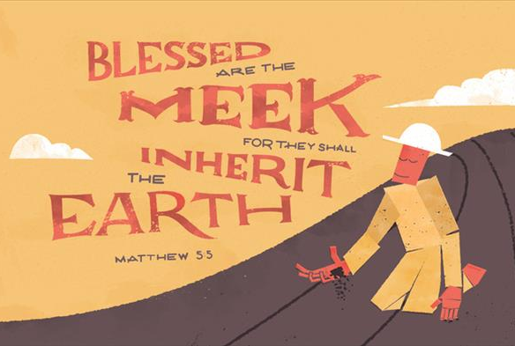
Condemnation of the Wicked
Spiritual Prostitution
Isa 57:11-13 – “¹¹Of whom were you worried and fearful when you lied, and did not remember Me nor give Me a thought? Was I not silent even for a long time so you do not fear Me? ¹²I will declare your righteousness and your deeds, but they will not profit you. ¹³When you cry out, let your collection of idols deliver you. But the wind will carry all of them up, and a breath will take them away. But he who takes refuge in Me will inherit the land and will possess My holy mountain.”
Notes:
Isa 57:11 – We can look at God’s silence in 2 ways: one way is what 2 Pet 3:9 says, that He is being patient w/us hoping we will come to repentance. Or, we can let it cause us to forget Him in which we’ll neither serve Him nor fear Him, and we might even mock Him. But over what period of time (since this text) could God be rightly accused of being silent? They should have been able to look back on a long line of prophetic warnings. But it seems His grace and mercy had caused people to take Him for granted.
And so – Isa 57:12 – Meaning, the time will come when He will not be silent, and who they’ve allowed themselves to become will be laid open and bare.
They’ll know God then – Isa 57:13a – Not “if”, but “when” – judgment is inevitable. And as it happens, they will cry out for God’s help. But His response will be much like Elijah’s on Mt. Carmel, “Why aren’t you getting help from your idols?” As substantial as the appearance of their idols may be, the mere wind will carry them away, proving they are like chaff and of no substance.
In contrast – Isa 57:13b – Meaning, it’s never too late to take “refuge” under the Rock. And those who do will be the true inheritors of His land and His mountain, meaning His inheritance and all the security and provision it brings.

Slide 7
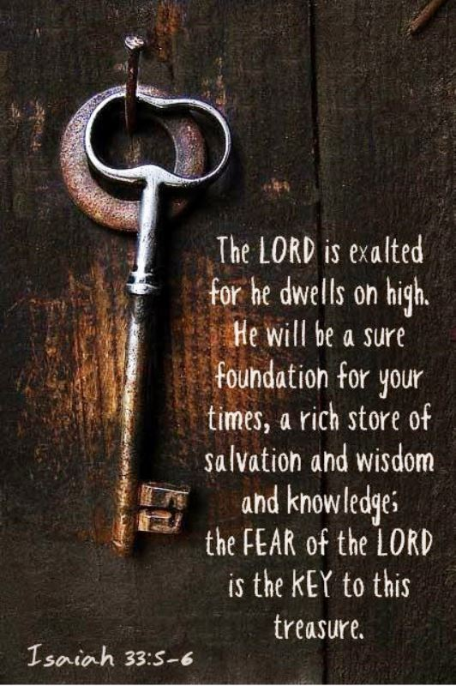
Condemnation of the Wicked
Promise of Healing & Peace
Isa 57:14-15 – “¹⁴And it will be said, ‘Build up, build up, prepare the way, remove every obstacle out of the way of My people.’ ¹⁵For thus says the high and exalted One who lives forever, whose name is Holy, ‘I dwell on a high and holy place, and also with the contrite and lowly of spirit in order to revive the spirit of the lowly and to revive the heart of the contrite.”
Notes:
So how do people like this, who God wants to save, get back to Him? How do they “take refuge” in Him?
Isa 57:14 – Said by who? We’re not told who the herald is, but this is very similar to 40:3 which we know ultimately applied to John the Baptist. And John the Baptists work was to help unclutter the means by which people can get to Jesus. The obstacles are many things. For the prodigal son, what caused him to demand his inheritance before it’s time? Likely his love for money. That was always going to be an obstacle that kept him from going on. What had to happen? That obstacle had to be removed. And after all the money was gone and he found himself in the pig pen, then he returned. To confess fault is an obstacle, isn’t it? It’s humiliating to admit, “I am wrong”, because that often means having to confess such to others, repay debts, etc. That hurts. But not as much as pride hurts us.
Because God is only going to accept a certain kind of people. Who? – Isa 57:15 – What causes God, who is the highest, most exalted Being of the cosmos, whose very presence in Isa 6 caused the foundations of the temple to shake and righteous Isaiah to fall to His knees, to dwell w/sinful people? Who would someone that great and holy and awesome and “other than” anyone else dare to share His dwelling place with? The contrite and lowly of spirit. And the icing on the cake is that He dwells w/people of this nature in order that He may revive their hearts. It’s amazing to think that anyone at all could partake of God’s dwelling while not compromising His nature or His dignity. But the one who dwells high above us also dwells w/the lowest of us.

Slide 8
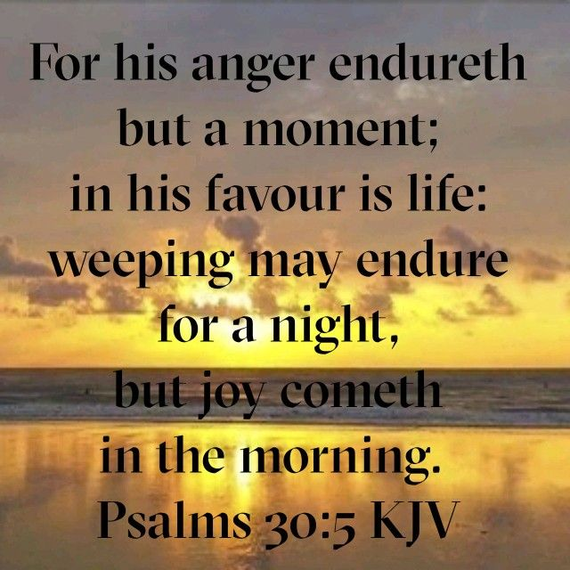
Condemnation of the Wicked
Promise of Healing & Peace
Isa 57:16-19 – “¹⁶‘For I will not contend forever, nor will I always be angry; for the spirit would grow faint before Me, and the breath of those whom I have made. ¹⁷Because of the iniquity of his unjust gain I was angry and struck him; I hid My face and was angry, and he went on turning away, in the way of his heart. ¹⁸I have seen his ways, but I will heal him; I will lead him and restore comfort to him and to his mourners, ¹⁹creating the praise of the lips. Peace, peace to him who is far and to him who is near’, says the Lord, ‘and I will heal him.’”
Notes:
How can our God, who has such an awesome nature, do this?
Isa 57:16-17 – How will God allow such lowly people to share in His dwelling? Through self-restraint of His own nature, refusing to allow His justified anger to reach capacity. This is a theme we’ve seen throughout Isaiah, that while God “becomes” angry, He “is” love. Our iniquity rightly activates His anger because He is a holy God; and so, He is justified in hiding His face from us because for many of us, we continued sinning even knowing the consequences of it. But God’s love and mercy prevailed over His anger, and because of the price paid for sin by the Servant, God can show us favor.
All the sudden, smiting turns to healing – Isa 57:18-19 – Because man has changed? No, “I have seen his ways”. Has He overlooked sin? No. But the Servant paid the price for our sins. Only through Him can the miseries man brings on himself from vs. 15 be turned to comfort and healing. And the final aspect of mankind’s healing is the peace it creates, and it is available for all those “far and near”. God creates the incentive for His praise and His worshippers gladly offer it. Paul understood this promise was realized specifically through Jesus (Eph 2:17; Acts 10:36).

Slide 9
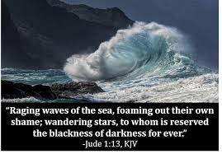
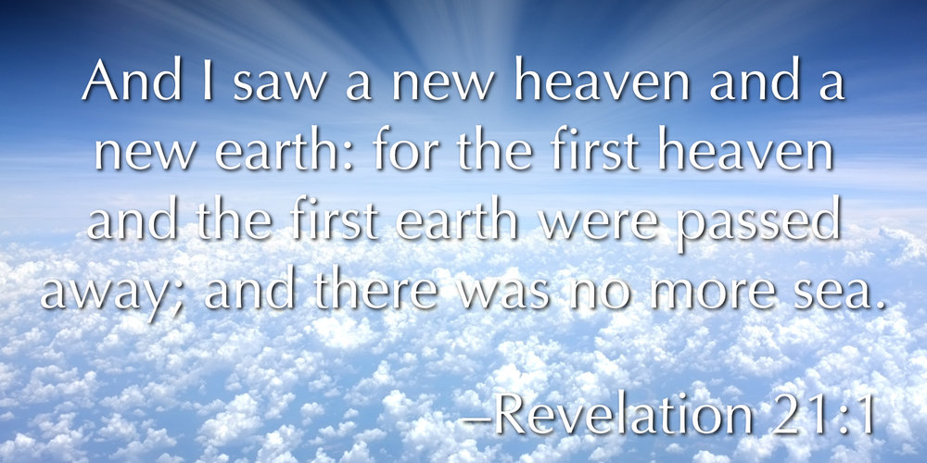
Condemnation of the Wicked
No Peace For The Wicked
Isa 57:20-21 – “²⁰But the wicked are like the tossing sea, for it cannot be quiet, and its waters toss up refuse and mud. ²¹‘There is no peace,’ says my God, ‘for the wicked.’”
Notes:
Now we find chapter 57 ending the same way chapter 48 did – Isa 57:20-21 – And so, the chapter opens w/the righteous and ends w/the wicked. The wicked are subject to forces that make them turbulent, unsettled, w/constant upheaval. To put it in laymen’s terms, wickedness leads to complete restlessness. By giving int constant lusts and passions, our spirit is constantly agitated and tormented. Even on the calmest day, our spirit is in constant motion throwing up the wreckage, all its muck driven out in the open; nothing good. It’s no wonder that the new heaven and new earth of Rev 21:1 has no more sea – theme alert for later. Beyond Jesus Christ, there is no peace for the wicked.

