Slide 2
The Ministry of Confrontation

Slide 3
Before You Confront Someone
Not every situation requires confrontation
Prov 11:12 – “He who despises his neighbor lacks sense, but a man of understanding keeps silent.”
Prov 18:13 – “He who gives an answer before he hears, it is folly and shame to him.”
Gal 6:2 – “Bear one another’s burdens, and thereby fulfill the law of Christ.”

Slide 4
Before You Confront Someone
Not every situation requires confrontation
Consider the consequences of confrontation
Prov 18:19a – “A brother offended is harder to be won than a strong city…”.
Prov 27:6 – “Faithful are the wounds of a friend, but deceitful are the kisses of an enemy.”
John 15:13 – “Greater love has no one than this, that one lay down his life for his friends.”
Prov 28:23 – “He who rebukes a man will afterward find more favor than he who flatters with the tongue.”

Slide 5
Before You Confront Someone
Not every situation requires confrontation
Consider the consequences of confrontation
Self-reflection: why do I think they need confronting?
Matt 18:15 – “If your brother sins, go and show him his fault in private; if he listens to you, you have won your brother.”
1 Cor 5:6 – “Your boasting is not good. Do you not know that a little leaven leavens the whole lump of dough?”

Slide 6
Before You Confront Someone
Not every situation requires confrontation
Consider the consequences of confrontation
Self-reflection: why do I think they need confronting?
Self-reflection: have I earned the right to confront them?
Heb 3:12-13 – “Take care, brethren, that there not be in any one of you an evil, unbelieving heart that falls away from the living God. But encourage one another day after day, as long as it is still called ‘Today’, so that none of you will be hardened by the deceitfulness of sin.”
Gal 6:1 – “Brethren, even if anyone is caught in any trespass, you who are spiritual, restore such a one in a spirit of gentleness; each one looking to yourself, so that you too will not be tempted.”
Matt 7:3-5 – “Why do you look at the speck that is in your brother’s eye, but do not notice the log that is in your own eye? Or how can you say to your brother, ‘Let me take the speck out of your eye,’ and behold, the log is in your own eye? You hypocrite, first take the log out of your own eye, and then you will see clearly to take the speck out of your brother’s eye.”
Prov 17:17 – “A friend loves at all times, and a brother is born for adversity.”
Prov 27:9 – “Oil and perfume make the heart glad, so a man’s counsel is sweet to his friend.”

Slide 7
Before You Confront Someone
Not every situation requires confrontation
Consider the consequences of confrontation
Self-reflection: why do I think they need confronting?
Self-reflection: have I earned the right to confront them?
Make sure you have all the facts straight
Prov 25:8-10 – “Do not go out hastily to argue your case; otherwise, what will you do in the end, when your neighbor humiliates you? Argue your case with your neighbor, and do not reveal the secret of another, or he who hears it will reproach you, and the evil report about you will not pass away.”

Slide 8
Before You Confront Someone
Not every situation requires confrontation
Consider the consequences of confrontation
Self-reflection: why do I think they need confronting?
Self-reflection: have I earned the right to confront them?
Make sure you have all the facts straight
Plan ahead
Prov 15:28 – “The heart of the righteous ponders how to answer, but the mouth of the wicked pours out evil things.”
Prov 15:1-2 – “A gentle answer turns away wrath, but a harsh word stirs up anger. The tongue of the wise makes knowledge acceptable, but the mouth of fools spouts folly.”

Slide 9
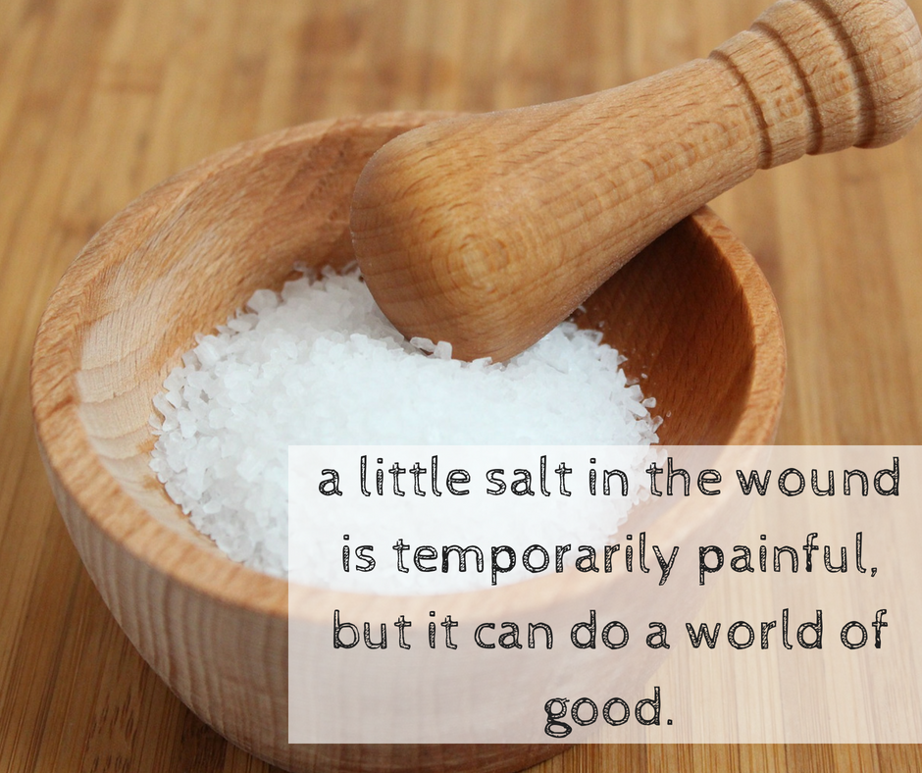
Matt 5:13 – “You are the salt of the earth; but if the salt has become tasteless, how can it be made salty again? It is no longer good for anything, except to be thrown out and trampled under foot by men.”

