Slide 2
CURRICULUM
Apr 6 – Introduction
Apr 13 – Its Nature
Apr 20 – Its Standard of Authority
Apr 27 – False Standards of Authority
May 4 – Applying the Standard (1)
May 11 – Applying the Standard (2)
May 18 – Local Organization
May 25 – Local Organization Apostasy
Jun 1 – Nature of Worship
Jun 8 – Elements of Worship
Jun 15 – Its Work of Edification
Jun 22 – Its Work of Evangelism
Jun 29 – Its Work of Benevolence

Slide 3
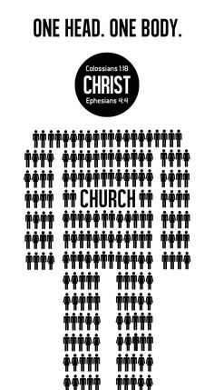
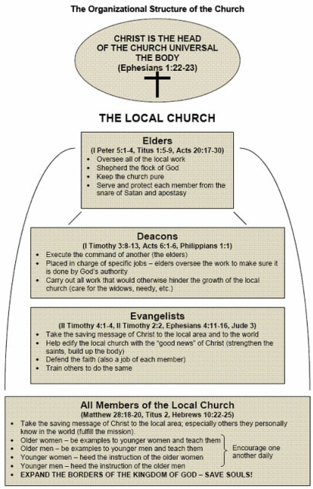
Universal
Local

Slide 4
Local Church Organization
Phil 1:1 – “Paul and Timothy, bond-servants of Christ Jesus, to all the saints in Christ Jesus who are in Philippi, including the overseers and deacons.”
Eph 4:11-12 – “¹¹And he gave some as apostles, and some as prophets, and some as evangelists, and some as pastors and teachers, ¹²for the equipping of the saints for the work of service, to the building up of the body of Christ”

Slide 5
Local Church Organization
Elders
Acts 14:21-23 – “²¹After they had preached the gospel to that city and had made many disciples, they returned to Lystra and to Iconium and to Antioch, ²²strengthening the souls of the disciples, encouraging them to continue in the faith, and saying, ‘Through many tribulations we must enter the kingdom of God.’ ²³When they had appointed elders for them in every church, having prayed with fasting, they commended them to the Lord in whom they had believed.”
Tit 1:5 – “For this reason I left you in Crete, that you would set in order what remains and appoint elders in every city as I directed you”

Slide 6
Local Church Organization
Elders
Elders/Presbyters
Greek “presbuteros”
Older men
Experience
Spiritual Maturity
Bishops/Overseers
Greek “episkopos”
Oversees/watches
Wisdom
Responsibility
Pastors/Shepherds
Greek “poimen”
Shepherd/feed flock
Guide
Care

Slide 8
1 Tim 3:1-7 | Tit 1:5-9
A man (not a woman) | A man (not a woman)
Blameless (w/o reproach) | Blameless (w/o reproach)
Husband of one wife | Husband of one wife
Vigilant (temperate) | Temperate (self-governed)
Sober | Sober
Given to hospitality | Lover of hospitality
Apt to teach | Hold faithful word to teach
Not given to wine | No brawler (not given to wine)
Not a striker | Not a striker
Not greedy of filthy lucre | Not greedy of filthy lucre
Not a brawler | Not a brawler
Rule house well – children in subjection | Have believing children
Of good report, good reputation | Holy, saintly, religious man
Not a novice (not puffed up) | Not self-willed (arrogant, presumptuous)
Not covetous (contentious, quarrelsome) | Not soon angry
Patient (gentle, lenient) | Just (upright, justice to all)
Of good behavior | Lover of good men (of good)
Desire for office | (desire implied from other qualities)

Slide 9
Local Church Organization
Elders
Plurality
Equal Authority
Acts 14:23 – “When they had appointed elders for them in every church, having prayed with fasting, they commended them to the Lord in whom they had believed.”
Acts 20:17 – “From Miletus he sent to Ephesus and called to him the elders of the church.”
Phil 1:1 – “Paul and Timothy, bond-servants of Christ Jesus, to all the saints in Christ Jesus who are in Philippi, including the overseers and deacons.”
Tit 1:5 – “For this reason I left you in Crete, that you would set in order what remains and appoint elders in every city as I directed you”

Slide 10
Local Church Organization
Elders
Plurality
Equal Authority
Local Authority
Local Autonomy
Acts 20:28 – “Be on guard for yourselves and for all the flock, among which the Holy Spirit has made you overseers, to shepherd the church of God which He purchased with His own blood”
1 Pet 5:1-2a – “Therefore, I exhort the elders among you, as your fellow elder and witness of the sufferings of Christ, and a partaker also of the glory that is to be revealed, shepherd the flock of God among you…”

Slide 11
Local Church Organization
Elders
Deacons
Acts 6:1-6 – “¹Now at this time while the disciples were increasing in number, a complaint arose on the part of the Hellenistic Jews against the native Hebrews, because their widows were being overlooked in the daily serving of food. ²So the twelve summoned the congregation of the disciples and said, ‘It is not desirable for us to neglect the word of God in order to serve tables. ³Therefore, brethren, select from among you seven men of good reputation, full of the Spirit and of wisdom, whom we may put in charge of this task. ⁴But we will devote ourselves to prayer and to the ministry of the word.’ ⁵The statement found approval with the whole congregation; and they chose Stephen, a man full of faith and of the Holy Spirit, and Philip, Prochorus, Nicanor, Timon, Parmenas and Nicolas, a proselyte from Antioch. ⁶And these they brought before the apostles; and after praying, they laid their hands on them.”

Slide 12
Local Church Organization
Elders
Deacons
Deacon
Greek “diakonos”
Special servants
In charge of tasks
1 Tim 3:8-13
Men
Dignity
Not double-tongued
Not addicted to much wine
Not fond of sordid gain
Holding to the faith w/a clear conscience
First tested
Beyond reproach
Husband of one wife
Good managers of children/household

Slide 13
Local Church Organization
Elders
Deacons
Saints/Members
Phil 1:1 – “Paul and Timothy, bond-servants of Christ Jesus, to all the saints in Christ Jesus who are in Philippi, including the overseers and deacons”
Eph 4:11 – “And he gave some as apostles, and some as prophets, and some as evangelists, and some as pastors and teachers,”

Slide 14
Local Church Organization
Elders
Deacons
Saints/Members
Evangelists
2 Tim 4:2 – “preach the word; be ready in season and out of season; reprove, rebuke, exhort, with great patience and instruction.”
1 Tim 4:13 – “Until I come, give attention to the public reading of Scripture, to exhortation and teaching.”
1 Tim 1:3 – “As I urged you upon my departure for Macedonia, remain on at Ephesus so that you may instruct certain men not to teach strange doctrines”
2 Tim 2:25a – “with gentleness correcting those who are in opposition”
2 Tim 2:14a – “Remind them of these things…”

Slide 15
Local Church Organization
Elders
Deacons
Saints/Members
Evangelists
1 Tim 4:16 – “In pointing out these things to the brethren, you will be a good servant of Christ Jesus, constantly nourished on the words of the faith and of the sound doctrine which you have been following.”
2 Tim 2:24c – “able to teach”
2 Tim 2:2 – “The things which you have heard from me in the presence of many witnesses, entrust these to faithful men who will be able to teach others also.”
Tit 2:7 – “in all things show yourself to be an example of good deeds, with purity in doctrine, dignified”

Slide 16
Local Church Organization
Elders
Deacons
Saints/Members
Evangelists
Teachers
Heb 5:11-12 – “¹¹Concerning him we have much to say, and it is hard to explain, since you have become dull of hearing. ¹²For though by this time you ought to be teachers, you have need again for someone to teach you the elementary principles of the oracles of God, and you have come to need milk and not solid food.”

Slide 17
CURRICULUM
Apr 6 – Introduction
Apr 13 – Its Nature
Apr 20 – Its Standard of Authority
Apr 27 – False Standards of Authority
May 4 – Applying the Standard (1)
May 11 – Applying the Standard (2)
May 18 – Local Organization
May 25 – Local Organization Apostasy
Jun 1 – Nature of Worship
Jun 8 – Elements of Worship
Jun 15 – Its Work of Edification
Jun 22 – Its Work of Evangelism
Jun 29 – Its Work of Benevolence

