Slide 2
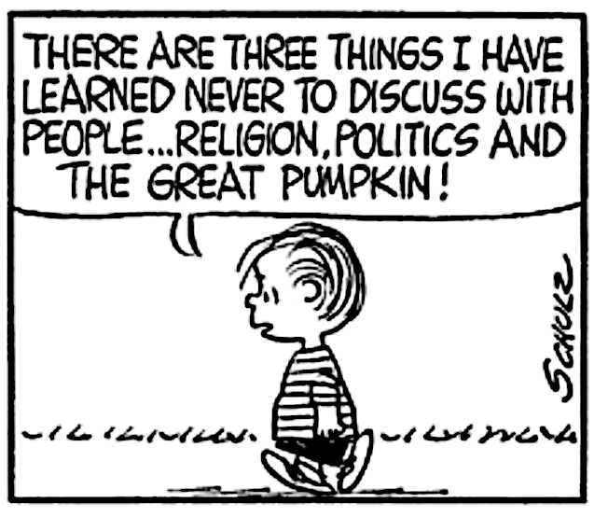

Slide 3
Politics
A Sojourner’s Perspective

Slide 4
Time

Slide 5
See then that you walk circumspectly, not as fools but as wise, redeeming the time, because the days are evil.
Ephesians 5: 15

Slide 6
What is your life? For you are a mist that appears for a little time and then vanishes.
James 4:14

Slide 7
But the day of the Lord will come as a thief in the night, in which the heavens will pass away with a great noise, and the elements will melt with fervent heat; both the earth and the works that are in it will be burned up.
2 Peter 3:10

Slide 8
Time Identity

Slide 9
It is no longer I who live, but Christ lives in me.
Galatians 2:20

Slide 10
You are not your own, for you were bought with a price.
1 Corinthians 6:19–20

Slide 11
…for he has said, “I will never leave you nor forsake you.”
Hebrews 13:5

Slide 12
Peace I leave with you; my peace I give to you.
John 14:27

Slide 13
See what kind of love the Father has given to us, that we should be called children of God;…
1 John 3:1

Slide 14
Time Identity Citizenship

Slide 15
My Kingdom is not of this world…
John 18:36

Slide 16
But our citizenship is in heaven...
Philippians 3:20

Slide 17
do not be anxious about anything, but in everything by prayer and supplication with thanksgiving let your requests be known to God.
Philippians 4:6

Slide 18
Beloved, I urge you as sojourners and exiles to abstain from the passions of the flesh, which wage war against your soul. Keep your conduct among the Gentiles honorable, so that when they speak against you as evildoers, they may see your good deeds and glorify God on the day of visitation.
1 Peter 2:11-12

Slide 19
But seek the welfare of the city where I have sent you into exile, and pray to the Lord on its behalf, for in its welfare you will find your welfare.
Jeremiah 29:7

Slide 20
Time Identity Citizenship Mission

Slide 21
unless you repent you will all likewise perish
Luke 13:1-5

Slide 22
But seek first the kingdom of God, and His righteousness
Matthew 6:33

Slide 23
Let your light so shine before men, that they may see your good works and glorify your Father in heaven.
Matthew 5:16

Slide 24
If it is possible, as much as depends on you, live peaceably with all men.
Romans 12:18

Slide 25
I urge that supplications, prayers, intercessions, and thanksgivings be made for all people, for kings and all who are in high positions, that we may lead a peaceful and quiet life, godly and dignified in every way.
I Timothy 2:1-2

Slide 26
…But we urge you, brethren, that you increase more and more; that you also aspire to lead a quiet life, to mind your own business, and to work with your own hands, as we commanded you.
I Thessalonians 4:10-11

Slide 27
By this all people will know that you are my disciples, if you have love for one another.
John 13:35

Slide 28
Let every person be subject to the governing authorities. For there is no authority except from God, and those that exist have been instituted by God. Therefore whoever resists the authorities resists what God has appointed, and those who resist will incur judgment. For rulers are not a terror to good conduct, but to bad. Would you have no fear of the one who is in authority? Then do what is good, and you will receive his approval, for he is God's servant for your good.
Romans 13:1-4

Slide 29
We must obey God rather than men.
Acts 5:29

Slide 30
