Slide 3
CONFLICTING FORCES
TV/Movies
Comedians
Governing Bodies

Slide 4
ROLE OF MEN
Power

Slide 5
ROLE OF MEN
Power
Protection

Slide 6
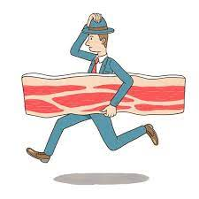
ROLE OF MEN
Power
Protection
Provision

Slide 7
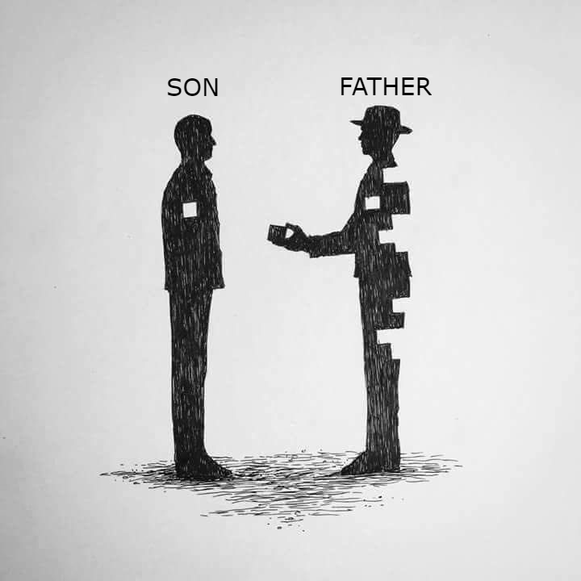
ROLE OF MEN
Gen 2:22 – “The Lord God fashioned into a woman the rib which He had taken from the man, and brought her to the man.”
Gen 2:23 – “The man said, ‘This is now bone of my bones, and flesh of my flesh; she shall be called Woman, because she was taken out of Man.’”
Gen 2:24 – “For this reason a man shall leave his father and his mother, and be joined to his wife; and they shall become one flesh.”

Slide 8
ROLE OF MEN
Gen 3:6 – “When the woman saw that the tree was good for food, and that it was a delight to the eyes, and that the tree was desirable to make one wise, she took from its fruit and ate; and she gave also to her husband with her, and he ate.”
1 Tim 2:14 – “And it was not Adam who was deceived, but the woman being deceived, fell into transgression.”
Gen 3:9 – “Then the Lord God called to the man, and said to him, ‘Where are you?’”
Gen 3:17 – ““Because you have listened to the voice of your wife…””
1 Cor 11:11 – “However, in the Lord, neither is woman independent of man, nor is man independent of woman.”

Slide 9
ROLE OF MEN
Extreme #1: Weak Passivity
2 Sam 13:21 – “Now when King David heard of all these matters, he was very angry.”
2 Sam 14:24 – “However the king said, “Let him turn to his own house, and let him not see my face.” So Absalom turned to his own house and did not see the king’s face.”
2 Sam 15:6b – “However the king said, “Let him turn to his own house, and let him not see my face.” So Absalom turned to his own house and did not see the king’s face.”

Slide 10
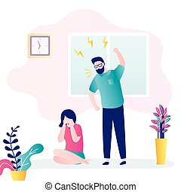
ROLE OF MEN
Extreme #2: Aggression
Gen 4:23-24 – “Lamech said to his wives, ‘Adah and Zillah, listen to my voice, you wives of Lamech, give heed to my speech, for I have killed a man for wounding me; and a boy for striking me; if Cain is avenged sevenfold, then Lamech seventy-sevenfold.’”

Slide 11
ROLE OF WOMEN
Help
Support
Empower

Slide 13
ROLE OF WOMEN
Help
Support
Empower
Restrain
Job 30:13 – “They break up my path, they profit from my destruction; no one restrains them.”
Prov 31:12 – “She does him good and not evil all the days of her life.”

Slide 14
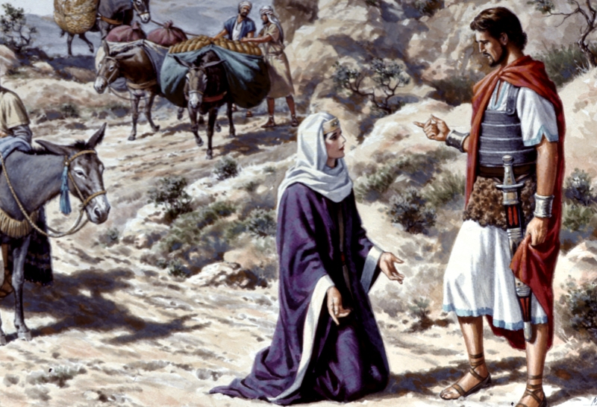
ROLE OF WOMEN
1 Sam 25:23-24 – “When Abigail saw David, she hurried and dismounted from her donkey, and fell on her face before David and bowed herself to the ground. She fell at his feet and said, ‘On me alone, my lord, be the blame. And please let your maidservant speak to you, and listen to the words of your maidservant.”
1 Sam 25:26-28a – “Now therefore, my lord, as the Lord lives, and as your soul lives, since the Lord has restrained you from shedding blood, and from avenging yourself by your own hand, now then let your enemies and those who seek evil against my lord, be as Nabal. Now let this gift which your maidservant has brought to my lord be given to the young men who accompany my lord. Please forgive the transgression of your maidservant”
1 Sam 25:30-31 – “And when the Lord does for my lord according to all the good that He has spoken concerning you, and appoints you ruler over Israel, this will not cause grief or a troubled heart to my lord, both by having shed blood without cause and by my lord having avenged himself. When the Lord deals well with my lord, then remember your maidservant.”

Slide 15
ROLE OF WOMEN
Extreme #1: Taking Over Leadership
1 Cor 14:34-35 – “The women are to keep silent in the churches; for they are not permitted to speak, but are to subject themselves, just as the Law also says. If they desire to learn anything, let them ask their own husbands at home; for it is improper for a woman to speak in church.”
1 Tim 2:11-15 – “A woman must quietly receive instruction with entire submissiveness. But I do not allow a woman to teach or exercise authority over a man, but to remain quiet. For it was Adam who was first created, and then Eve. And it was not Adam who was deceived, but the woman being deceived, fell into transgression. ¹⁵But women will be preserved through the bearing of children if they continue in faith and love and sanctity with self-restraint.”

Slide 16
ROLE OF WOMEN
Extreme #2: Misusing Your Influence
Judg 16:15-17a – “Then she said to him, ‘How can you say, “I love you,” when your heart is not with me? You have deceived me these three times and have not told me where your great strength is.’ It came about when she pressed him daily with her words and urged him, that his soul was annoyed to death. So he told her all that was in his heart…”
Mark 6:21-25 – “A strategic day came when Herod on his birthday gave a banquet for his lords and military commanders and the leading men of Galilee; and when the daughter of Herodias herself came in and danced, she pleased Herod and his dinner guests; and the king said to the girl, ‘Ask me for whatever you want and I will give it to you.’ And he swore to her, ‘Whatever you ask of me, I will give it to you; up to half of my kingdom.’ And she went out and said to her mother, ‘What shall I ask for?’ And she said, ‘The head of John the Baptist.’ Immediately she came in a hurry to the king and asked, saying, ‘I want you to give me at once the head of John the Baptist on a platter.’”
2 Sam 6:20 – “But when David returned to bless his household, Michal the daughter of Saul came out to meet David and said, ‘How the king of Israel distinguished himself today! He uncovered himself today in the eyes of his servants’ maids as one of the foolish ones shamelessly uncovers himself!’”

