Slide 1
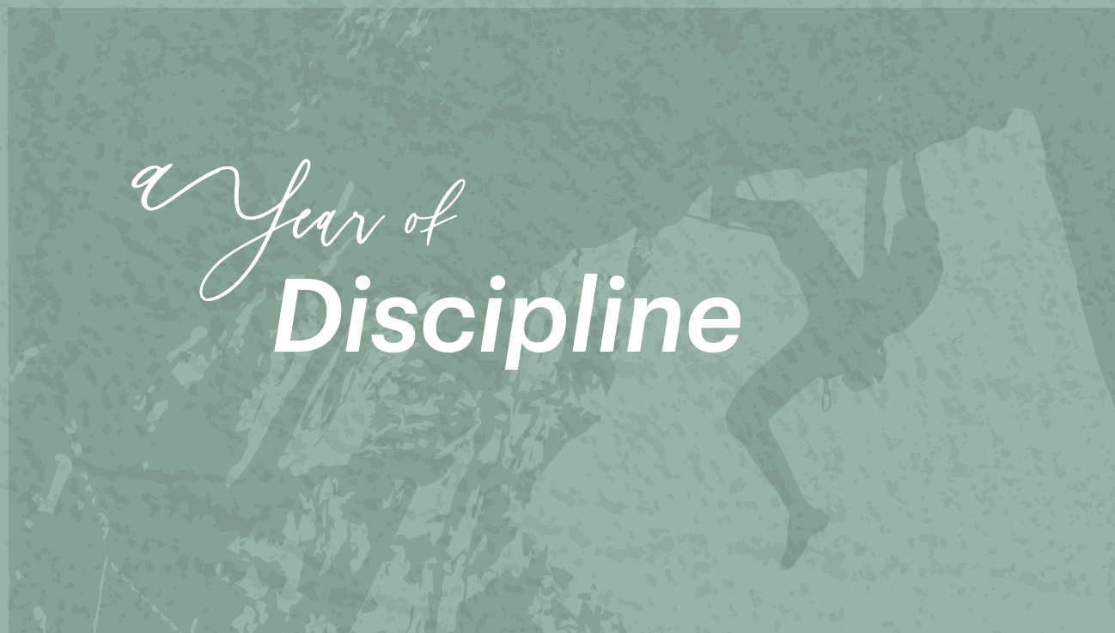

Slide 2
WORSHIP
THE CORPORATE DISCIPLINES

Slide 3
UNITY
And all the people gathered as one person at the public square… Nehemiah 8:1
Then Ezra the priest brought the Law before the assembly of men, women, and all who could listen with understanding… Nehemiah 8:2

Slide 4
UNITY
And he read from it before the public square which was in front of the Water Gate, from early morning until midday, in the presence of men and women, those who could understand; and all the people were attentive to the Book of the Law. Nehemiah 8:3

Slide 5
UNITY
And Ezra opened the book in the sight of all the people, for he was above all the people, and as he opened it all the people stood. Nehemiah 8:5
Then Ezra blessed the Lord, the great God. And all the people answered, “Amen, Amen!” Nehemiah 8:6

Slide 6
EMOTION
And Ezra opened the book in the sight of all the people, for he was above all the people, and as he opened it all the people stood. Nehemiah 8:5
And Ezra blessed the Lord, the great God, and all the people answered, “Amen, Amen,” lifting up their hands. Nehemiah 8:6

Slide 7
EMOTION
And they bowed their heads and worshiped the Lord with their faces to the ground. Nehemiah 8:6
For all the people wept as they heard the words of the Law. Nehemiah 8:9

Slide 8
EMOTION
And all the people went their way to eat and drink and to send portions and to make great rejoicing… Nehemiah 8:12

Slide 9
RESTORATION
And they told Ezra the scribe to bring the Book of the Law of Moses that the Lord had commanded Israel. Nehemiah 8:1
So Ezra the priest brought the Law before the assembly, both men and women and all who could understand what they heard… Nehemiah 8:2

Slide 10
RESTORATION
And the ears of all the people were attentive to the Book of the Law. Nehemiah 8:3
…the Levites, helped the people to understand the Law… Nehemiah 8:7

Slide 11
RESTORATION
They read from the book, from the Law of God, clearly, and they gave the sense, so that the people understood the reading. Nehemiah 8:8

Slide 12
Prepare.
“Remember the Sabbath day, to keep it holy. Six days you shall labor, and do all your work, but the seventh day is a Sabbath to the Lord your God. On it you shall not do any work…” Exodus 20:8-10

Slide 13
Show up.
And let us consider how to stir up one another to love and good works, not neglecting to meet together, as is the habit of some, but encouraging one another, and all the more as you see the Day drawing near. Hebrews 10:24-25

Slide 14
Participate.
And do not get drunk with wine, for that is debauchery, but be filled with the Spirit, addressing one another in psalms and hymns and spiritual songs, singing and making melody to the Lord with your heart… Ephesians 5:18-19

Slide 15
Engage emotionally.
Then Aaron lifted up his hands toward the people and blessed them, and he came down from offering the sin offering and the burnt offering and the peace offerings. And Moses and Aaron went into the tent of meeting, and when they came out they blessed the people, and the glory of the Lord appeared to all the people. And fire came out from before the Lord and consumed the burnt offering and the pieces of fat on the altar, and when all the people saw it, they shouted and fell on their faces. Leviticus 9:22-24

Slide 16
Don’t judge.
Who are you to pass judgment on the servant of another? It is before his own master that he stands or falls. And he will be upheld, for the Lord is able to make him stand. Romans 14:4

Slide 17
Thank God for distractions.
And they were bringing children to him that he might touch them, and the disciples rebuked them. But when Jesus saw it, he was indignant and said to them, “Let the children come to me; do not hinder them, for to such belongs the kingdom of God. Truly, I say to you, whoever does not receive the kingdom of God like a child shall not enter it.” And he took them in his arms and blessed them, laying his hands on them. Mark 10:13-16

Slide 18
Think about God.
“If his offering is a burnt offering from the herd, he shall offer a male without blemish. He shall bring it to the entrance of the tent of meeting, that he may be accepted before the Lord. He shall lay his hand on the head of the burnt offering, and it shall be accepted for him to make atonement for him. Then he shall kill the bull before the Lord…” Leviticus 1:3-5

