Slide 1
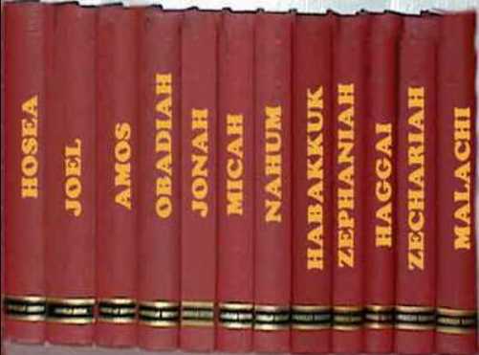
Minor Prophets
Lesson 2 – Overview & Obadiah
Hebrews 1:1-2a, “Long ago, at many times and in many ways, God spoke to our fathers by the prophets, but in these last days He has spoken to us by His Son…”

Slide 2
Types of Prophets \ Teachers
Moses “Lawgiver, friend of God” – his own type
Wise men & women
Priests – teachers of the Law, dutiful servants
Prophets – spokesman for God
Psalmists
False Prophets

Slide 3
How does this apply to me?
Amos 3:7 “For the Lord God does nothing without revealing his secret to his servants the prophets.”
Hosea 4:6 “My people are destroyed for lack of knowledge; because you have rejected knowledge, I reject you from being a priest to me. And since you have forgotten the law of your God, I also will forget your children.”
Hebrews 1:1-2 “Long ago, at many times and in many ways, God spoke to our fathers by the prophets, 2 but in these last days he has spoken to us by his Son, whom he appointed the heir of all things, through whom also he created the world.”
Hebrews 2:1-4 “Therefore we must pay much closer attention to what we have heard, lest we drift away from it. For since the message declared by angels proved to be reliable, and every transgression or disobedience received a just retribution, how shall we escape if we neglect such a great salvation? It was declared at first by the Lord, and it was attested to us by those who heard, while God also bore witness by signs and wonders and various miracles and by gifts of the Holy Spirit distributed according to his will.”

Slide 4
Timeline Surrounding Obadiah
845 B.C.
9th Century – “The Divided Kingdom” - the Assyrian empire rising to the east\north
King Jehoram 852 – 841 BC (Israel) – last King in Ahab’s line (referred to as Joram in Chronicles) – Ahab’s 2nd son to reign
King Jehoram 853 – 841 BC (Judah) – married Athaliah (daughter of Ahab) and worshipped Baal
Son of Jehoshaphat (873 – 848 BC)
I Kings 22:47, death of Jehosphat “There was no King in Edom…”
After 722 BC Assyria takes Israel captive (roughly 75 years after this book is written)

Slide 5
Who is Obadiah?
Name means “Worshiper\Servant of Yahweh”
2 mentions that “might be the prophet” in the OT
I Kings 18:3,7,13 – Ahab’s house, hid 100 prophets
II Chron 17:7,9 – taught the Law in Judah
Potential Contemporary to 3 other Prophets, who?
He is the first prophet to mention:

Slide 6
Brief History of Edom
Birth of Jacob and Esau (Gen 25:23)
Generations of Esau “Edom” (Gen 36:1)
Life of Jacob and Esau
Jacob chosen as the son of promise
Edom refused Israel passage (Num 20)
Israel to treat them as brothers (Deut 23:7)
Subdued by King David (II Sam 8:14)
Edom revolted against Judah (II Kings 8:20)
Joined Assyria in attacking Judah (II Chron 28:17)

Slide 7
The Judgement of Edom
Judgement against Edom for its pride (1-4)
Complete Judgement against Edom (5-9)
Reason for coming judgement (10-14)
Judgement on Edom and ALL Nations (15 – 16)
Israel exalted over Edom (17-20)
Heb 12:18,22-24a – spiritual zion
The Kingdom is the Lord’s (21)

Slide 8
Practical Lessons from Obadiah
A warning not to trust in ourselves or this present world for security.
God is sovereign and has the right to choose
No nation is beyond God’s power to judge
God is jealous for and will protect His children
Zech 2:8b, “he who touches you touches the apple of His eye:”
Do not rejoice over your enemies
Matt 5:44-45b “but I say to you, Love your enemies and pray for those who persecute you, so that you may be sons of your Father who is in heaven…”

Slide 9
Obadiah in the New Testament?
Anyone find anything?

Slide 10
Obadiah in the New Testament?
Romans 9:13,23-26 “As it is written, “Jacob I loved, but Esau I hated….
…in order to make known the riches of his glory for vessels of mercy, which he has prepared beforehand for glory— even us whom he has called, not from the Jews only but also from the Gentiles? As indeed he says in Hosea,
“Those who were not my people I will call ‘my people,’ and her who was not beloved I will call ‘beloved.’” “And in the very place where it was said to them, ‘You are not my people,’ there they will be called sons of the living God.’”
Not Obadiah

Slide 11
Obadiah in the New Testament?
II Peter 3:7-13 “The Lord is not slow to fulfill his promise as some count slowness, but is patient toward you, not wishing that any should perish, but that all should reach repentance. But the day of the Lord will come like a thief, and then the heavens will pass away with a roar, and the heavenly bodies will be burned up and dissolved, and the earth and the works that are done on it will be exposed”
Not Obadiah

