Slide 1
As for Me and My House
Three reasons for faithfulness to the Lord

Slide 2
God has been faithful to us.
Joshua 24:1-13

Slide 3
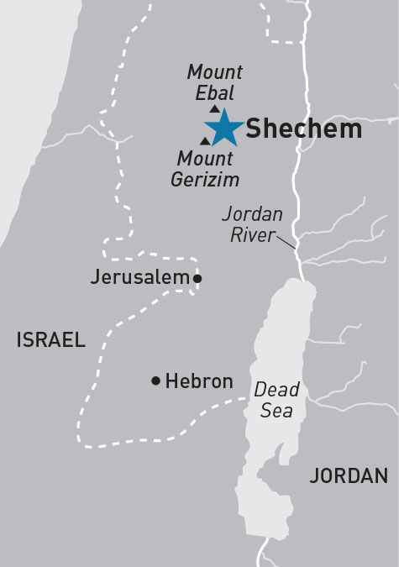
Joshua gathered all the tribes of Israel to Shechem… v. 1
Promises to Abram
Jacob’s return
Idols buried
Blessings & curses

Slide 4
Snapshots of God’s faithfulness
Vs 2-4 – Abraham through Joseph
Vs 5-7 – Moses
Vs 8-10 – Two kings east of Jordan
Vs 11-13 – Inhabitants of the land

Slide 5
God’s faithfulness.
Faithfulness historically.
Faithfulness specifically.

Slide 6
Our confession demands it.
Joshua 24:14-28

Slide 7
“But as for me and my house, we will serve the LORD.” v. 15

Slide 8
A surprising response…
Then the people answered, “Far be it from us that we should forsake the LORD to serve other gods… we also will serve the LORD, for he is our God.” v. 16, 18
But Joshua said to the people, “You are not able to serve the LORD…” v. 19

Slide 9
Give up your idols!
Abram passed through the land to the place at Shechem… So he built there an altar to the LORD, who had appeared to him. Genesis 12:6, 7
So Jacob said to his household and to all who were with him, “Put away the foreign gods that are among you… Then let us arise and go up to Bethel, so that I may make there an altar to the God who answers me in the day of my distress…” Genesis 35:2, 3

Slide 10
Others are counting on us.
Joshua 24:29-33

Slide 11
After these things Joshua the son of Nun, the servant of the LORD, died, being 110 years old. v. 29

Slide 12
Israel served the LORD all the days of Joshua, and all the days of the elders who outlived Joshua…
Joshua 24:31

Slide 13
There arose another generation after them who did not know the LORD or the work that he had done for Israel. Judges 2:10

Slide 14
Homework
Choose this day whom you will serve…

Slide 15
