Slide 1
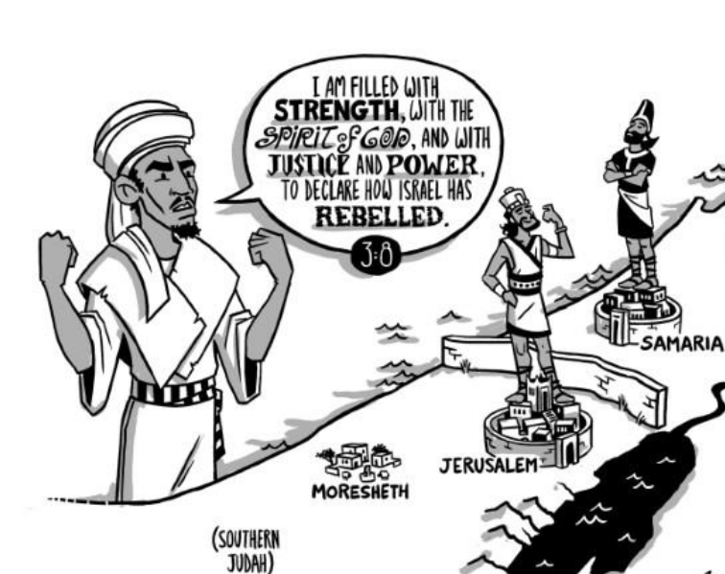
Study of MiCAH of MoreSHETH
Minor Prophets of the Old Testament

Slide 2
INTRODUCTION
The eighth century (800-700 B.C.) was filled with prophetic activity...
Starting with Jonah, who prophesied to the city of Nineveh (ca. 790 B.C.)
Continuing with prophets sent primarily to the northern kingdom of Israel
1) Amos (755 B.C.) 2) Hosea (750-725 B.C.)
The southern kingdom of Judah was also the recipient of God’s prophets
1) Isaiah (740-700 B.C.) 2) Micah (735-700 B.C.)
Supporting Scriptures for Jacob’s & Judah’s transgressions
(Micah; 2 Kings 15:17- 20:21; 2 Chronicles 26-30, Jeremiah 26:17-19)
Jeremiah supports Micah’s calling
Jeremiah 26:18 “Micah of Moresheth prophesied in the days of Hezekiah king of Judah, and said to all the people of Judah: ‘Thus says the Lord of hosts,
“ ‘Zion shall be plowed as a field;
Jerusalem shall become a heap of ruins,
and the mountain of the house a wooded height.’ (Micah 3:12)
Notes:
Historical Background Of Micah-- Micah’s ministry spanned the rule of three kings of Judah (1:1) Jotham, Ahaz, & Hezekiah. Compare with the historical background of Isaiah and his prophecies. He began prophesying before the destruction of Samaria in 722 BC (1:5-7; 6:9-16) and continued into the reign of Hezekiah (3:12; cf. Jeremiah 26:17-19). The HOLY SPIRIT confirms Micah’s calling. (Micah 3:8)

Slide 3
INTRODUCTION (CONTINUED)
MICAH - THE MAN...
1. His name means “Who is like Jehovah?” very similar to the name Michael - cf. Mic 7:18
2. His home was Moresheth-Gath - Mic 1:1,14
a. In the lowlands of Judah, near Philistia
b. About 20-25 miles southwest of Jerusalem
3. Nothing is known of his occupation prior to becoming God’s prophet
4. Characterization
a. “He was the prophet of the poor and downtrodden.” (Homer Hailey)
b. “He had Amos’ passion for justice and Hosea’s heart for love.” (J. M .P. Smith)
c. Comparing Micah to his contemporary Isaiah (as suggested by Hailey)
1) Micah was a man of the fields, Isaiah was of the city
2) Micah took little interest in politics, giving himself to the concern over spiritual and moral problems; Isaiah was in close contact with world affairs, the associate of kings and princes
3) Both Micah and Isaiah...
a) Saw God as the infinite Ruler of nations and men
b) Recognized the absolute holiness and majesty of God
c) Stressed that violating principles of God’s divine sovereignty and holiness would bring judgment and doom
Notes:
Unlike Isaiah who was a city prophet, Micah was a prophet of the country. He was a prophet to the common people. He championed the cause of the poor and cried out against social and moral injustices. Their actual messages are so similar though, that Micah has been called “Isaiah in shorthand.” Micah was the last of the cluster of writing prophets sent to announce the doom of Israel, and of Judah if she didn’t repent. Amos and Hosea were prophets of Israel sent directly with a message to Israel. Isaiah and Micah were prophets of Judah who announced the imminent destruction of Israel and the threat coming from the ungodliness that had spread to Judah (1:3-9). Micah denounced the same things in Judah that Amos and Hosea had condemned in Israel. The wealthy were corrupt and robbed the poor (2:1-2,8-9; 6:11). Religious leaders were corrupt (2:11; 3:6,11). Rulers and judges were corrupt (3:1-3,9; 7:3). The people were idolatrous (6:16).

Slide 4
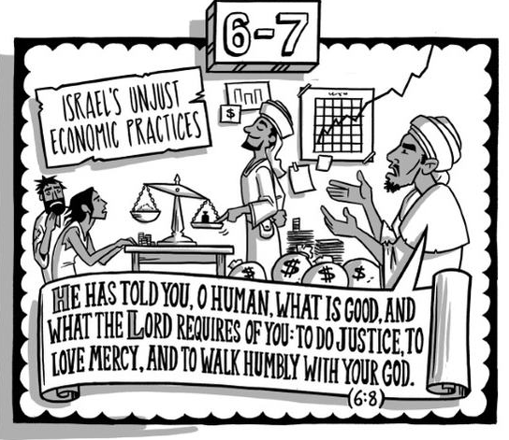
“He has shown you, O man, what is good; and what does the Lord require of you but to do justly, to love mercy, and to walk humbly with your God?” (Micah 6:8) NKJV. The two prevailing themes of Micah can ARE balanced on this verse- JUDGMENT AND RESTORATION
If I were to summarize Micah in a verse if would be….
Notes:
How to “do justly”?
Following God’s commands, statutes, and precepts with all your heart, soul, and might.- Deuteronomy 6:5
What’s loving mercy? Leviticus 19:18
What does walking humbly look like?
Read Psalm 119: 97-104 (Mem)
Any comments?

Slide 5
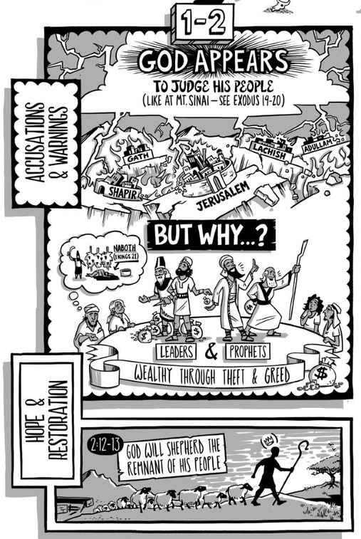
Chapters 1
JUDGMENT PRONOUNCED ON ISRAEL AND JUDAH...
Micah’s message is for both Samaria (Israel) and Jerusalem (Judah) - Mic 1:1
2. The Lord announces His coming judgment - Mic 1:2-5
3. The destruction of Samaria (representing the northern kingdom of Israel) - Mic 1:6
4. Micah’s mourning - Mic 1:8-16
a. For the judgment has reached even Judah and Jerusalem
b. His lament involves making a play on words involving the names of cities, for example...
1) “Tell it not in Gath” (Gath mean wine press) (Rev 14:19)
2) “Weep not at all in Beth Aphrah, Roll yourself in the dust” (Beth Aphrah means “house of dust”)
3) “Pass by in naked shame, you inhabitant of Shaphir” (Shaphir means “fair, beautiful, pleasant”)
4) “The inhabitant of Zaanan does not go out” (Zaanan sounds like “come out”)
5) “Beth Ezel mourns; its place to stand is taken away from you” (Beth-Ezel can be paraphrased as “house near the Going away stone”) (1 Samuel 20:19;41)
c. As revealed in verse 16, their judgment will involve captivity
Micah’s Warning!!
Notes:
Gath could refer to the people crying out once judgment occurs not realizing the judgment is upon them.
Shaphir speaks to how they are carried out. They were lofty and covered in jewels but not naked.
1 Samuel 20 is the passage about Johnathan warning David to flee because King Saul seeks his life.
Verse 19-Ezel

Slide 6
Chapter 2
B. REASONS FOR THE INEVITABLE JUDGMENT...
The arrogance and violence of the nobles - Mic 2:1-5
a. For coveting fields and taking them by violence
b. So it will happen to them
2. For rejecting true prophets, and accepting false ones - Mic 2:6-11
a. They tell the prophets of God not to speak of God’s words
b. They abuse the people of God
c. Destruction is coming, because they are defiled and accept false prophets
C. RESTORATION PROMISED...
It will involve God assembling a remnant - Mic 2:12
2. God will lead them like a flock of sheep, with a king at their head - Mic 2:12-13
Micah’s Warning!!
Notes:
1. Later, Micah will tell us more about the ultimate fulfillment of that restoration, and from where that “king” shall arise who shall lead God’s flock! - cf. Mic 5:2-5 2. But for now we have seen that Micah certainly follows the pattern of God’s prophets at that time... a. Proclaiming the coming judgment, which would involve captivity b. Providing the basis for such judgment, describing the nature of their sins and departure from God c. Promising that God would one day restore the good fortunes of Israel, but requiring repentance and involving a “remnant” 3. How sad that Israel and Judah did not heed the words of such men like Micah, Amos, Hosea, and Isaiah... a. But are we heeding God’s spokesmen for today? b. Such as His apostles Peter and Paul, and of course, His Son Jesus Christ? We would do well to remember the preaching of Micah as we read in the New Testament... “For this reason, we must pay much closer attention to what we have heard, lest we drift away from it. For if the word spoken through angels proved unalterable, and every transgression and disobedience received a just recompense, how shall we escape if we neglect so great a salvation? After it was at the first spoken through the Lord, it was confirmed to us by those who heard, God also bearing witness with them, both by signs and wonders and by various miracles and by gifts of the Holy Spirit according to His own will.” (He 2:1-4) Israel as a nation failed to heed the message sent to them; are we heeding the message for us today?

Slide 7
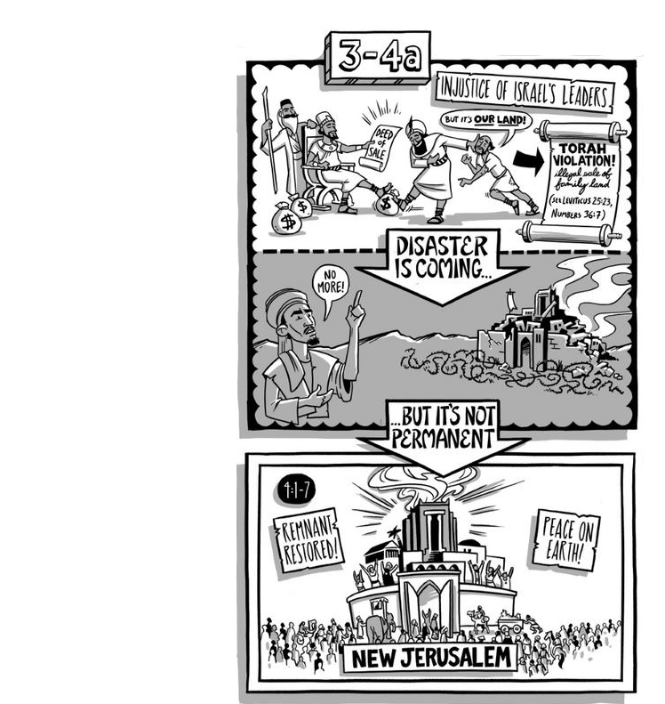
Chapter 3
INDICTMENT OF ISRAEL’S CIVIL LEADERS...
The outrageous conduct of the rulers - Mic 3:1-3
a. They hate good and love evil
b. They consume the people (i.e., oppress them)
2. The judgment to come upon them - Mic 3:4
a. They will cry to the Lord, but He will not hear them
b. He will hide His face from them
B. INDICTMENT OF ISRAEL’S RELIGIOUS LEADERS...
The judgment to come upon the false prophets - Mic 3:5-7
a. Because they lead God’s people astray
b. They shall have no vision, they shall be made ashamed
2. Micah’s own ministry, in contrast to that of the false prophets - Mic 3:8
a. He is full of the power of the Spirit, and of justice and might
b. He declares the transgression and sin of Israel
C. INDICTMENT OF ISRAEL’S LEADERS RENEWED...
Addressing once again the rulers of Israel, their sins are categorized - Mic 3:9-11
a. They abhor justice and pervert equity (fairness)
b. They build up Jerusalem with bloodshed and iniquity
c. Whether judges, priests, or prophets, they do it only for the money, belying their claim to trust in the Lord
2. The judgment to come upon Israel because of them - Mic 3:12
Zion shall be plowed like a field
b. Jerusalem shall become heaps of ruins
Notes:
[This prophecy of Micah was fulfilled when Babylon destroyed Jerusalem in 586 B. C. (cf. 2 Chr 36:17-21). But his message is not finished; as ominous as it was in proclaiming the coming judgment, he now continues with a glimpse into the future...]

Slide 8
Chapter 4
THE GLORY TO COME IN “THE LATTER DAYS”...
What will happen “in the latter days”
The “mountain of the Lord’s house” will be established, and many people will want to go it - Mic 4:1-2
They will want to learn of God’s ways, and the word of the Lord will go forth from Jerusalem - Mic 4:2
The Lord will judge the nations, and there will be peace - Mic 4:3
Everyone will be content, walking in the name of the Lord forever - Mic 4:4-5 -- Isaiah had a similar prophecy - Isa 2:1-4 2.
What is the fulfillment of this prophecy?
I am inclined to believe there are past, present, and future elements
It began in Jerusalem with the preaching of the gospel on Pentecost
For Peter identifies the events of that day as beginning the fulfillment of what would occur in the “last days” - cf. Joel 2:28-32; Ac 2:16-17
For Jesus said the gospel would go forth from Jerusalem as prophesied - Lk 24:46-47; cf. Mic 4:2; Isa 2:3
It continues as people respond to the gospel that originated from Jerusalem
Such people “have come to Mount Zion” - He 12:22-24; cf. Mic 4:2
They learn the ways of the Lord - Ep 4:20-24; cf. Mic 4:2
The “judging among many people” may be both present and future
The book of Revelation reveals the Lord as judging both in the present and in
the future - cf. Re 1:5; 2:26-27; 17:14; 20:11-15
Peter viewed some of Isaiah’s prophecies yet to be fulfilled - 2 Pe 3:13; cf. Isa 65:17-19; 66:22
Therefore Mic 4:3-5 may find some of its fulfillment in the eternal destiny of the redeemed, as part of the “New Jerusalem” of the “new heaven and new earth” described in Re 21-22

Slide 9
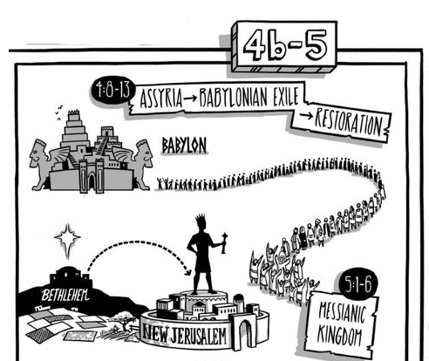
Chapter 4
As Micah continues, he describes what will occur “in that day” - Mic 4:6-8
The Lord will assemble a remnant of those whom He afflicted - cf. Ro 11:5
He will reign over them forever - cf. Lk 1:30-33 -- I understand that the fulfillment of this prophecy began with the first coming of Christ, and that the church is a spiritual kingdom in which the “former dominion” of Israel has been restored and given to Jesus who reigns from heaven - cf. Mt 28:18; Ac 1:6-8; 2:30-36; Re 1:5; 2:26-27; 3:21
B. THE DISTRESS AND CAPTIVITY BEFORE RESTORATION...
The “Now” of Mic 4:9 suggests that Micah has returned from his glimpse of the future hope to what will occur in the immediate present
Their judgment will involve distress like a woman in labor, as they will be delivered to Babylon, from which they will also be redeemed - Mic 4:9-10
3. Even “now”, many nations (e.g., Assyria) have come up against them - Mic 4:11-5:1
Who seek to defile Zion, whom God will use to break them into many pieces
b. Yet the daughter of Zion (Israel) shall be humbled also - cf. Mic 5:1

Slide 10
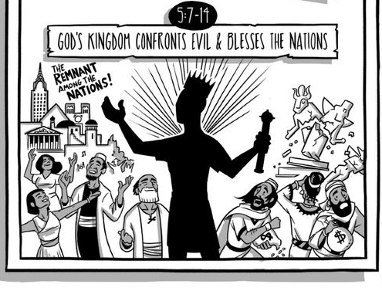
Chapter 5
C. THE COMING MESSIAH...
Here we find the prophecy of the Messiah’s birthplace - Mic 5:2; cf. Mt 2:1-6
The Messiah would be born in Bethlehem Ephrathah
He would become the ruler of Israel - cf. Isa 9:6-7; Lk 1:30-33
His “goings forth have been from old, from everlasting” - cf. Jn 1:1-3
2. The Messiah will lead His people in peace - Mic 5:3-5a
a. Though first they must be given up for a short time (Babylonian captivity)
b. Then a remnant shall return, whom the Ruler shall feed in the strength of the Lord
D. FURTHER JUDGMENT ON ISRAEL AND HER ENEMIES...
Some take this section to be Messianic
I tend to take it as pertaining to Micah’s day and those that followed shortly after...
The Assyrian threat would prove to be no real threat (for Judah) - Mic 5:5b-6; cf. Isa 36-37
When the remnant is dispersed (as a result of the Babylonian captivity), they shall be a lion among flocks of sheep - Mic 5:7-9 (e.g., Daniel, Esther?)
God would cut off her false strengths (such as horses and chariots, cf. Isa 31:1) and her idolatry - Mic 5:10-15
Notes:
. With the recurrent theme in his messages (“Present Judgment, Future Blessings”), Micah’s purpose appears to be twofold... Mark A. Copeland Studies In The Minor Prophets 50 a. To warn the people, that they may repent as necessary b. To encourage the people, that their hope for the future might help them to endure the hard times to come 2. A similar twofold message is found in the New Testament as well... a. Warnings to persevere, lest we fall away - e.g., He 4:1,11 b. Promises to encourage us for whatever lies ahead - e.g., 2 Pe 3:13-14 3. Today, we have an advantage over the Israelites of Micah’s day... a. We have already seen much of his prophecy fulfilled with the first coming of the Messiah b. As Peter wrote, “we also have the prophetic word made surer” - 2 Pe 1:19 c. Made surer by virtue of its fulfillment, it can serve to comfort us and strengthen our hope regarding any future promise of God - cf. Ro 15:4 -- If God kept His promise concerning the first coming of His Messiah, we can have confidence He will keep His promise concerning His return! Perhaps that is why Peter went on to say concerning “the prophetic word” (e.g., The Minor Prophets)... “which you do well to heed as a light that shines in a dark place, until the day dawns and the morning star rises in your hearts” (2 Pe 1:19) By careful study and consideration of the prophets, both in the Old Testament and New Testament, our hope for the future is strengthened!

Slide 11
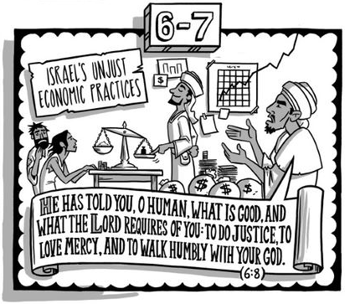
Chapter 6
GOD’S COMPLAINT...
The people called to present their case against God, as He has a complaint against them - Mic 6:1-2
How has the Lord wearied them? Testify against Him! - Mic 6:3
Did He not redeem them from Egyptian bondage with the aid of His servants Moses, Aaron, and Miriam? - Mic 6:4
Remember how He even had Balaam counter the counsel of Balak - Mic 6:5
B. WHAT THE LORD REQUIRED OF THEM...
What must they offer for their sins? - Mic 6:6-7
What God wanted was for them to do justly, love mercy, and walk humbly before Him - Mic 6:8
C. THE PUNISHMENT FOR ISRAEL’S INJUSTICE...
Justified, for they were full of dishonesty and violence - Mic 6:9-12
Judgment is coming in the form of desolation, for they hold on to the idolatry of Omri and works of Ahab - Mic 6:13-16
Notes:
[Once again, for the third time, Micah has foretold of the judgment to come. As before, he does not close without offering a hope for blessings in the future...]

Slide 12
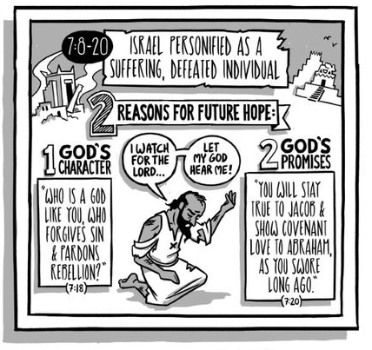
Chapter 7
PERHAPS SPEAKING FOR THE FAITHFUL REMNANT, MICAH LAMENTS...
His sorrow because the faithful man had perished - Mic 7:1-4
Things are so bad, only the Lord can be trusted - Mic 7:5-7
B. A CONFESSION OF SIN, WITH COMFORT IN WHAT THE LORD WILL BRING...
His enemy is not to rejoice over him - Mic 7:8-10a
For though he may fall, he will arise; the Lord will be a light to him
He is willing to bear the indignation of the Lord, for he has sinned; he knows also that the Lord will eventually plead his case and execute justice for him
He takes comfort in the future restoration of Zion - Mic 7:10b-13
a. Though first to be trampled down like mire in the streets
b. When restored, all will come to her (a messianic reference akin to Mic 4:1-2?)
c. But first there will be desolation (cf. the destruction of the city by Babylon)
C. A CLOSING PRAYER, WITH PRAISE TO GOD...
A prayer for God’s protection, to shepherd them as in days gone by - Mic 7:14
God answer: “I will show them marvelous things” - Mic 7:15
Micah’s song of praise - Mic 7:16-20
a. The nations shall be made afraid when they see what the Lord has done
Who is a God like Jehovah?
Who pardons iniquity?
Who passes over the transgressions of the remnant of His heritage?
Who does not retain anger forever, for He delights in mercy?
Who will again have compassion, subdue their sins, and cast their sins away?
Who will give truth and mercy to Jacob and Abraham (i.e., their descendants) as He has sworn from days of old (cf. Gen 12:2-3)?
Notes:
CONCLUSION 1. Thus Micah ends his book like he ended each of his three messages: offering hope concerning the future for the people of Israel 2. In our previous lesson we noted how these promises concerning a glorious future to a great extent were fulfilled “in the latter days”, beginning with the coming of our Lord a. Certainly their restoration and rebuilding of temple following Babylonian captivity were a partial Mark A. Copeland Studies In The Minor Prophets 53 fulfillment b. But even that was just a glimpse of what Jesus Christ would offer in His spiritual kingdom, which we now enjoy by being in Him 3. From Micah, we can learn a lot about... a. The nature of God - cf. Mic 7:18-20 b. How God would have us live - cf. Mic 6:6-8 4. We also can have our faith strengthened by observing those prophecies which have been fulfilled... a. Such as the birthplace of the Messiah - Mic 5:2 b. Such as the establishment of the Lord’s house - Mic 4:1-2 So while Micah may have been sent first to the nation of Israel, let’s not forget what Peter said concerning the Old Testament prophets... “To them it was revealed that, not to themselves, but to us they were ministering the things which now have been reported to you through those who have preached the gospel to you by the Holy Spirit sent from heaven; things which angels desire to look into.” (1 Pe 1:12) Yes, when the prophets like Micah foretold of the “the glories that would follow” (cf. 1 Pe 1:11), they were serving us who would be later be in the kingdom of God. Do we appreciate how blessed we are? If so, then let’s also do what God requires of us, as expressed in Micah’s own words: “...to do justly, to love mercy, and to walk humbly with your God” (Mic 6:8)

Slide 13
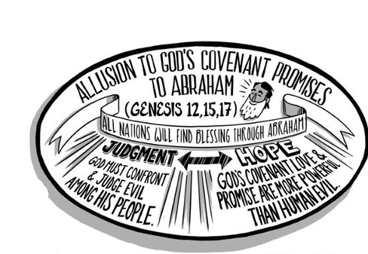
SUMMARY
So, while Micah may have been sent first to the nation of Israel, let’s not forget what Peter said concerning the Old Testament prophets...
“To them it was revealed that, not to themselves, but to us they were ministering the things which now have been reported to you through those who have preached the gospel to you by the Holy Spirit sent from heaven; things which angels desire to look into.” (1 Pe 1:12)
Yes, when the prophets like Micah foretold of the “the glories that would follow” (cf. 1 Pe 1:11), they were serving us who would be later be in the kingdom of God. Do we appreciate how blessed we are?
If so, then let’s also do what God requires of us, as expressed in Micah’s own words: “...to do justly, to love mercy, and to walk humbly with your God” (Mic 6:8)

Slide 14
