Slide 2
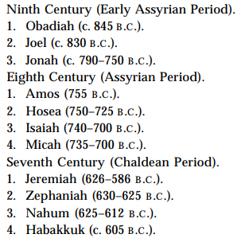
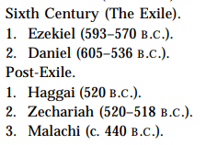
Minor Prophets Timeline

Slide 3
Amos General Info
Amos means “burden-bearer”
755 BC suggested date. He prophesied during the reign of Uzziah in Judah and Jereboam II of Israel
From Tekoa, south of Jerusalem
Shepherd & gatherer of sycamore fruit
Amos calls down sinners within and without God’s nation, focusing on justice instead of sympathy

Slide 4
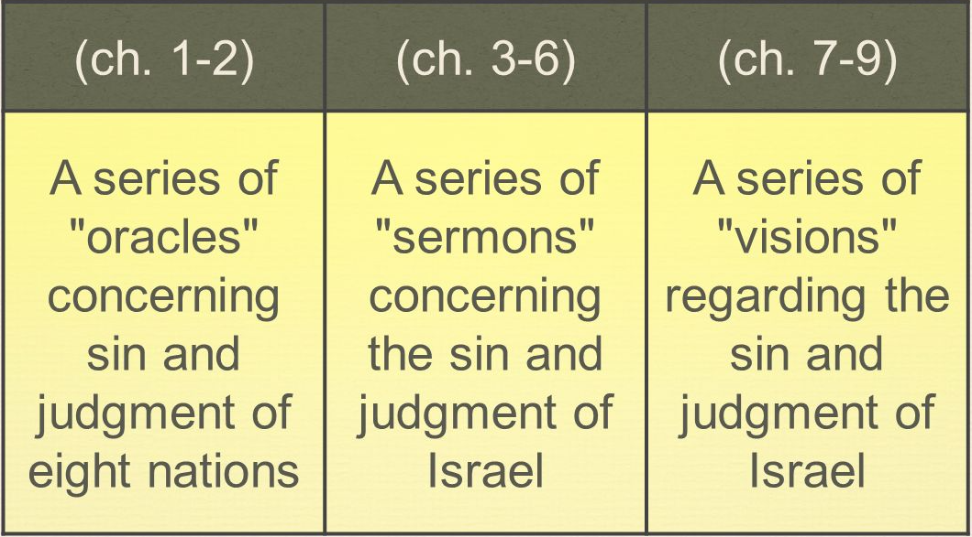
3 Major Sections to Amos

Slide 5
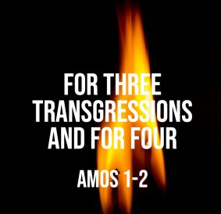
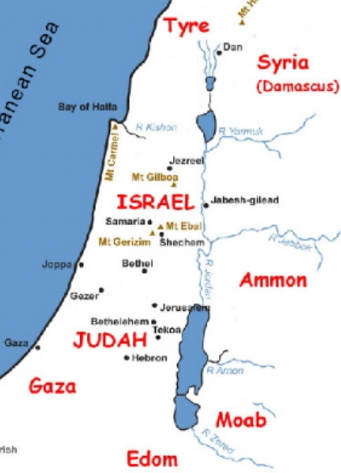
Oracles to the 8 Nations Amos Chapters 1-2

Slide 6
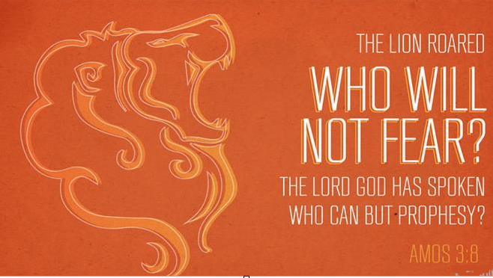
Sermons Judging Israel (Chapters 3-6)

Slide 7
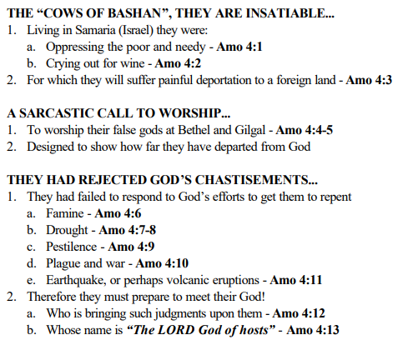

Slide 8
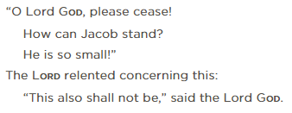
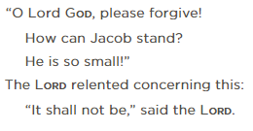
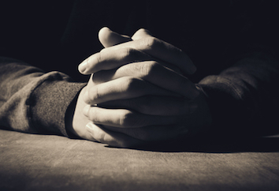
Prayers of Amos (7:2,5)
After the first two visions, Amos prays:
In the middle of this prophetic book of judgement we see compassion from Amos, and we see an example of God answering the prayer of a righteous servant.

Slide 9
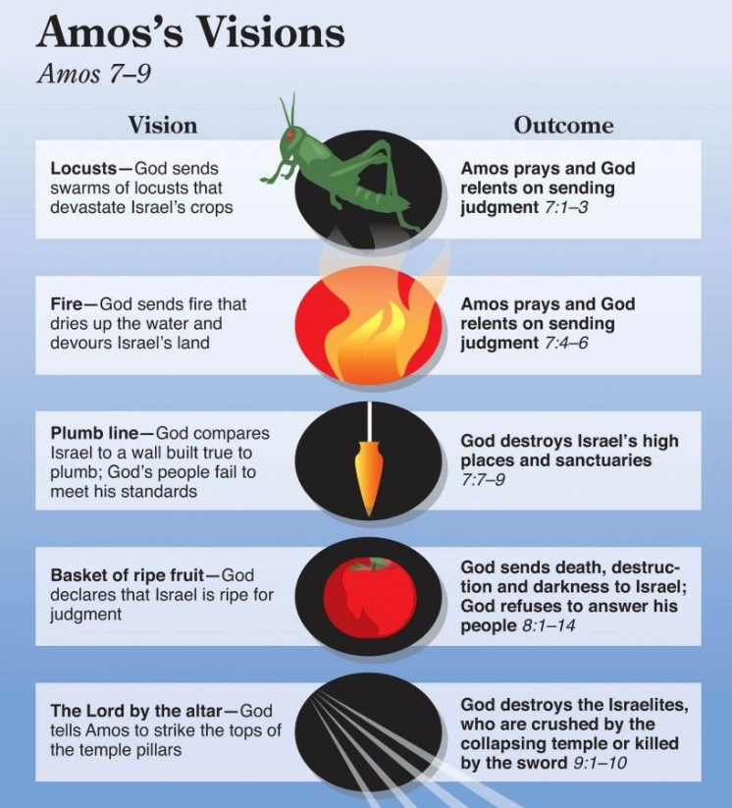

Slide 10
A brighter future (9:11-15)
Beautiful passage of restoration and hope
While judgement and destruction is coming a remnant will remain
“all the nations”
Quoted in Acts 15:15-17
Used as proof text of God’s plan to save gentiles

