Slide 2
Timeline of Hosea
Kings of Judah before the fall is Israel
Kings of Israel up to Captivity

Slide 3
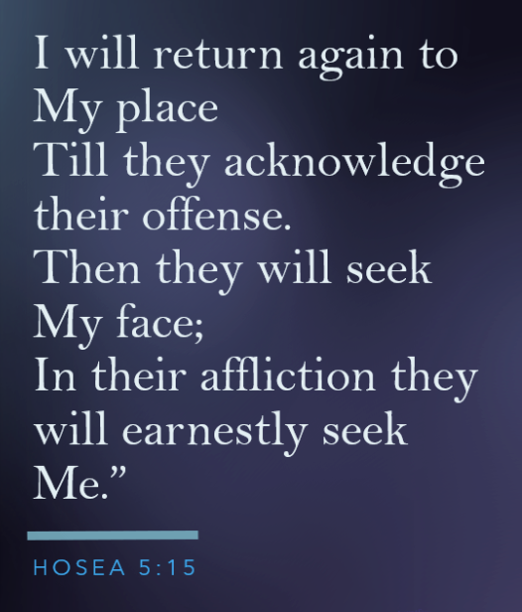
The Lord’s Indictment of Israel

Slide 5
God’s redeeming Love (11-14)
History Lesson Given & Future Revealed
God brought Israel from Egypt
They worshipped Baals
God nurtured Israel
They didn’t realize it
God will send them to Assyria
God will return them home

Slide 6
What lasting things should we understand?
“Now these things became our examples, to the intent that we should not lust
after evil things as they also lusted.”
(1 Cor 10:6)

