Slide 1
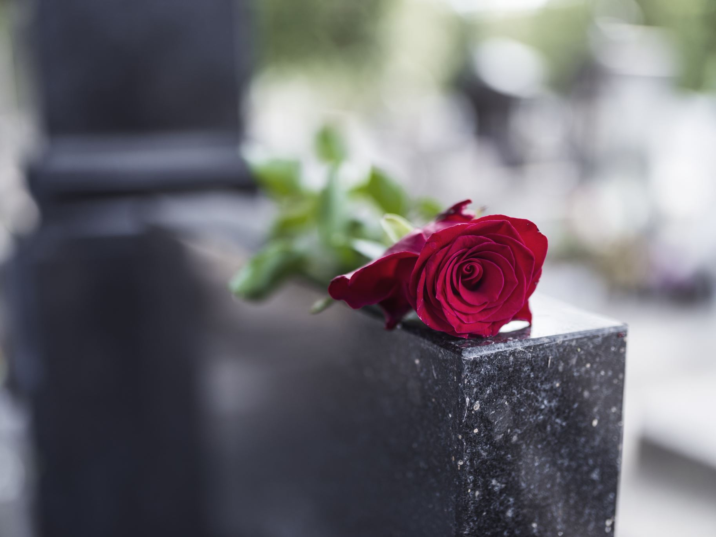
Near the Cross
What Four Disciples Found at the Cross

Slide 2
Mary Magdalene
Redemption

Slide 3
Mary’s deliverance
Mary, called Magdalene, from whom seven demons had gone out… Luke 8:2

Slide 4
Possession | Influence
Mouth Matt 9:32 | Mouth James 3:14-16
Eyes Matt 12:22 | Eyes 2 Cor 4:4
Mind Mark 5:15 | Mind 2 Cor 11:3
Body Mark 9:18, 20, 22 | Body Rom 7:14-20

Slide 5
Our deliverance
“‘to open their eyes, so that they may turn from darkness to light and from the power of Satan to God, that they may receive forgiveness of sins and a place among those who are sanctified by faith in me.’” Acts 26:18

Slide 6
Salome
Rebuke

Slide 7
Salome’s shame
And he said to her, “What do you want?” She said to him, “Say that these two sons of mine are to sit, one at your right hand and one at your left, in your kingdom.” Matthew 20:21

Slide 8
Our shame
All we like sheep have gone astray; we have turned—every one—to his own way; and the LORD has laid on him the iniquity of us all. Isaiah 53:6
For we ourselves were once foolish, disobedient, led astray, slaves to various passions and pleasures, passing our days in malice and envy, hated by others and hating one another. Titus 3:3

Slide 9
Our shame
…in which you once walked, following the course of this world, following the prince of the power of the air, the spirit that is now at work in the sons of disobedience… Ephesians 2:2

Slide 10
Jesus’ mother
Reward

Slide 11
Mary’s reward
When Jesus saw his mother and the disciple whom he loved standing nearby, he said to his mother,
“Woman, behold, your son!” John 19:26

Slide 12
Our reward
But rejoice insofar as you share Christ's sufferings, that you may also rejoice and be glad when his glory is revealed. 1 Peter 4:13
“Blessed are you when others revile you and persecute you and utter all kinds of evil against you falsely on my account. Rejoice and be glad, for your reward is great in heaven, for so they persecuted the prophets who were before you.” Matthew 5:11-12

Slide 13
Our reward
The Spirit himself bears witness with our spirit that we are children of God, and if children, then heirs—heirs of God and fellow heirs with Christ, provided we suffer with him in order that we may also be glorified with him. Romans 8:16-17
Then Jesus told his disciples, “If anyone would come after me, let him deny himself and take up his cross and follow me. For whoever would save his life[a] will lose it, but whoever loses his life for my sake will find it. Matthew 16:24-25

Slide 14
John
Responsibility

Slide 15
John’s shame
And Jesus said to him, “Truly, I tell you, this very night, before the rooster crows twice, you will deny me three times.” ³¹ But he said emphatically, “If I must die with you, I will not deny you.” And they all said the same.

Slide 16
John received all four blessings!
If we confess our sins, he is faithful and just to forgive us our sins and to cleanse us from all unrighteousness. 1 John 1:9
And now, little children, abide in him, so that when he appears we may have confidence and not shrink from him in shame at his coming. 1 John 2:28

Slide 17
John received all four blessings!
“This is my commandment, that you love one another as I have loved you. Greater love has no one than this, that someone lay down his life for his friends.” John 15:12-13
By this we know love, that he laid down his life for us, and we ought to lay down our lives for the brothers. 1 John 3:16

