Slide 1
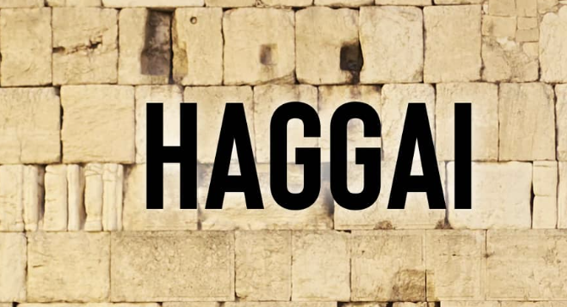

Slide 2
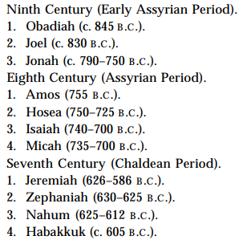
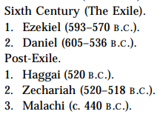
Minor Prophets Timeline

Slide 3
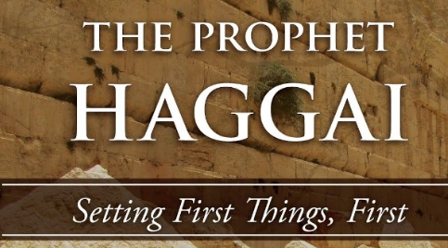
4 Proclamations of Haggai
Rebuilding the temple is long overdue (1:1)
A Word of Support (2:1)
A Word of Explanation (2:10)
A Word of Promise (2:20)

Slide 5
Zechariah’s Call & First 4 Visions
Zechariah's call to Repentance (Zech 1:1-6)
First 4 Visions
The Rider & the Horses (Zech 1:7-17)
The 4 Horns & the 4 Craftsman (Zech 1:18-21)
Man with the Measuring Line (Zech 2)
Joshua, the High Priest (Zech 3)

