Slide 2
Approaching
The Throne
Of Grace

Slide 3
Hurdles To The Throne of Grace
Guilt
Sorrow
Regret
Disappointment
Fear
Punishing Self
Letting Go
Matt 26:33-34,74-75; 27:3-6; 2 Cor 2:6-8; 7:8-10

Slide 4
How Not To Deal With It
Victimhood
Minimization
Generalization
Suppression
Justification
1 Cor 15:57; Rom 3:23

Slide 5
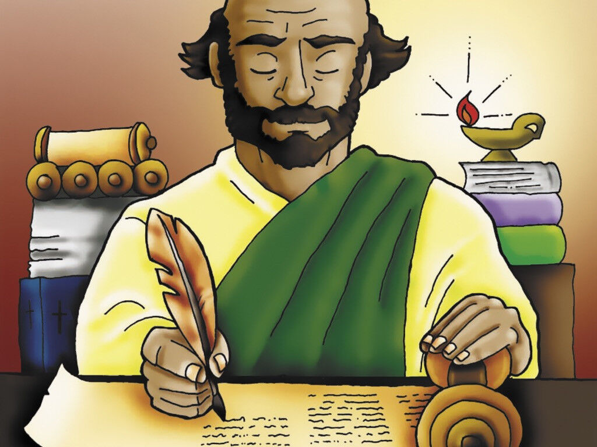
How Did Paul Deal With It?
1 Cor 15:9-10 – “For I am the least of the apostles, and not fit to be called an apostle, because I persecuted the church of God. But by the grace of God I am what I am, and His grace toward me did not prove vain; but I labored even more than all of them, yet not I, but the grace of God with me.”

Slide 6
Things To Accept
I am deeply flawed
Grace is for sinners
I am useful to God
Others need our grace
Deut 3:23-26; Psa 31:9-10; 32:3-5; John 1:17; 1 Tim 1:12-15; 1 John 1:8-9; Luke 22:31-32; Matt 6:14-15; Rom 5:20

