Slide 2
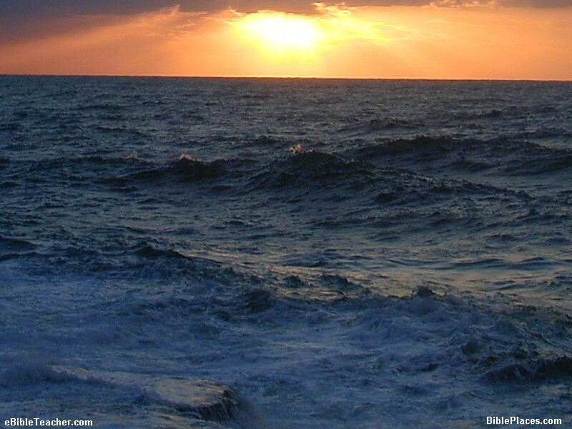
GENESIS
In the Beginning

Slide 3
Exodus 24:4
⁴ And Moses wrote all the words of the Lord. And he rose early in the morning, and built an altar at the foot of the mountain, and twelve pillars according to the twelve tribes of Israel.
John 1:45
⁴⁵ Philip found Nathanael and said to him, “We have found Him of whom Moses in the law, and also the prophets, wrote—Jesus of Nazareth, the son of Joseph.”

Slide 4
PENTATEUCH
Genesis
Exodus
Leviticus
Numbers
Deuteronomy

Slide 5
Major Divisions (Bob Waldron)
Creation - Chapters 1-5
Flood - Chapters 6-10
Scattering of the People - Chapter 11
Patriarchs - Chapters 12-50

Slide 6
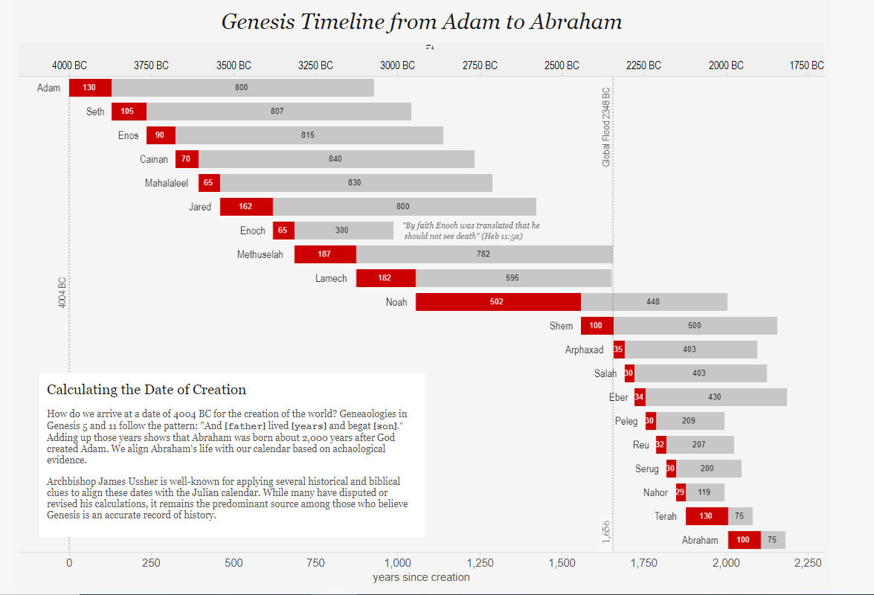

Slide 8
WHY DO WE STUDY THE OLD TESTAMENT – GENESIS IN PARTICULAR?
From Bob Waldren’s Workbook Series – “IN THE BEGINNING” page 11
But how can I understand the law of Christ? How can I understand the blessing of forgiveness? How can I understand the language of redemption? It is the Old Testament that tells how sin entered the world in the first place.

Slide 9
WHY DO WE STUDY THE OLD TESTAMENT – GENESIS IN PARTICULAR?
From Bob Waldren’s Workbook Series – “IN THE BEGINNING” page 11
It teaches the concept of a sacrifice being offered whereby another can be saved. It shows how God makes promises of blessings for those who serve Him and promises of punishment for those who disobey Him – then it shows how God keeps every one of his promises.

Slide 10
WHY DO WE STUDY THE OLD TESTAMENT – GENESIS IN PARTICULAR?
From Bob Waldren’s Workbook Series – “IN THE BEGINNING” page 11
The Old Testament shows God to be a God of justice and righteousness, but also to be a God of love and mercy. How can I fully understand the nature of God without the history of how He has treated mankind?

Slide 11
Genesis 3:15
¹⁵ And I will put enmity Between you and the woman, And between your seed and her Seed; He shall bruise your head, And you shall bruise His heel.”
Genesis 26:4
⁴ And I will make your descendants multiply as the stars of heaven; I will give to your descendants all these lands; and in your seed all the nations of the earth shall be blessed;

