Slide 2
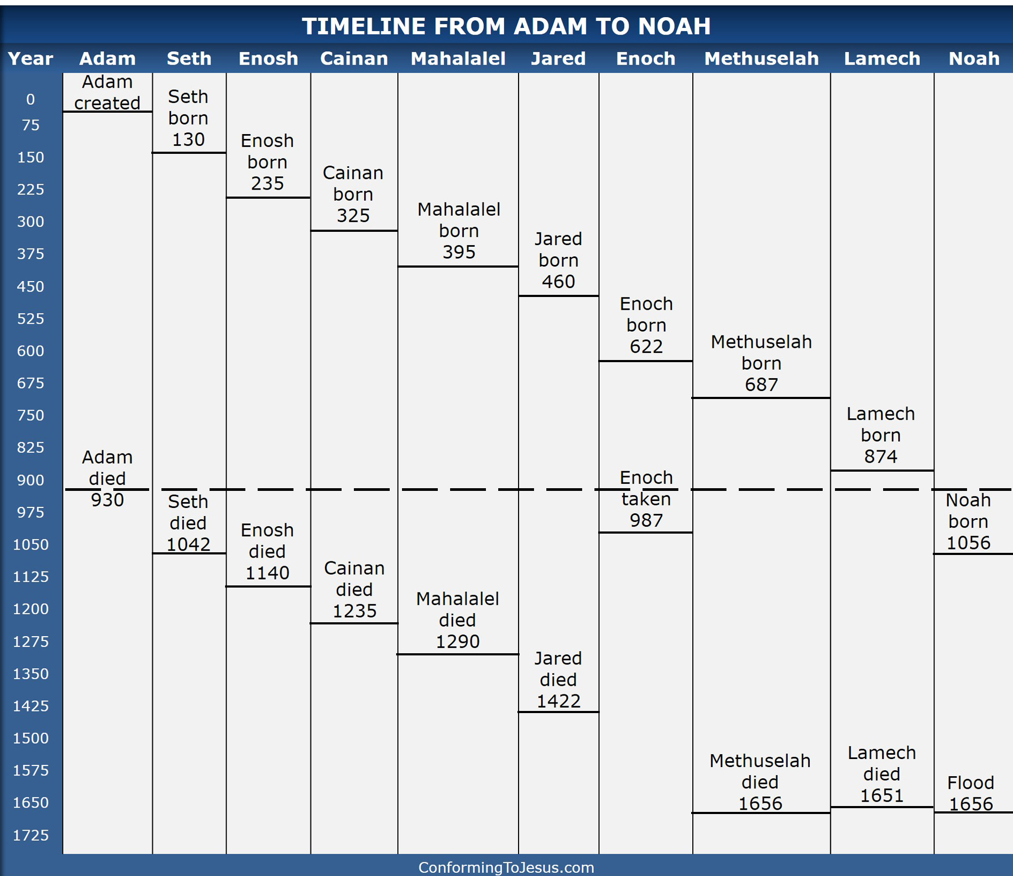

Slide 3
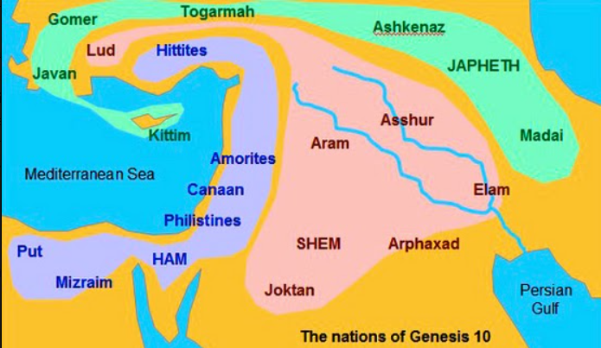

Slide 4
Hebrews 11:7
⁷ By faith Noah, being divinely warned of things not yet seen, moved with godly fear, prepared an ark for the saving of his household, by which he condemned the world and became heir of the righteousness which is according to faith.

Slide 5
Matthew 24:38-39
³⁸ For as in the days before the flood, they were eating and drinking, marrying and giving in marriage, until the day that Noah entered the ark, ³⁹ and did not know until the flood came and took them all away, so also will the coming of the Son of Man be.
Luke 17:26-27
26 And as it was in the days of Noah, so it will be also in the days of the Son of Man: 27 They ate, they drank, they married wives, they were given in marriage, until the day that Noah entered the ark, and the flood came and destroyed them all.

