Slide 1
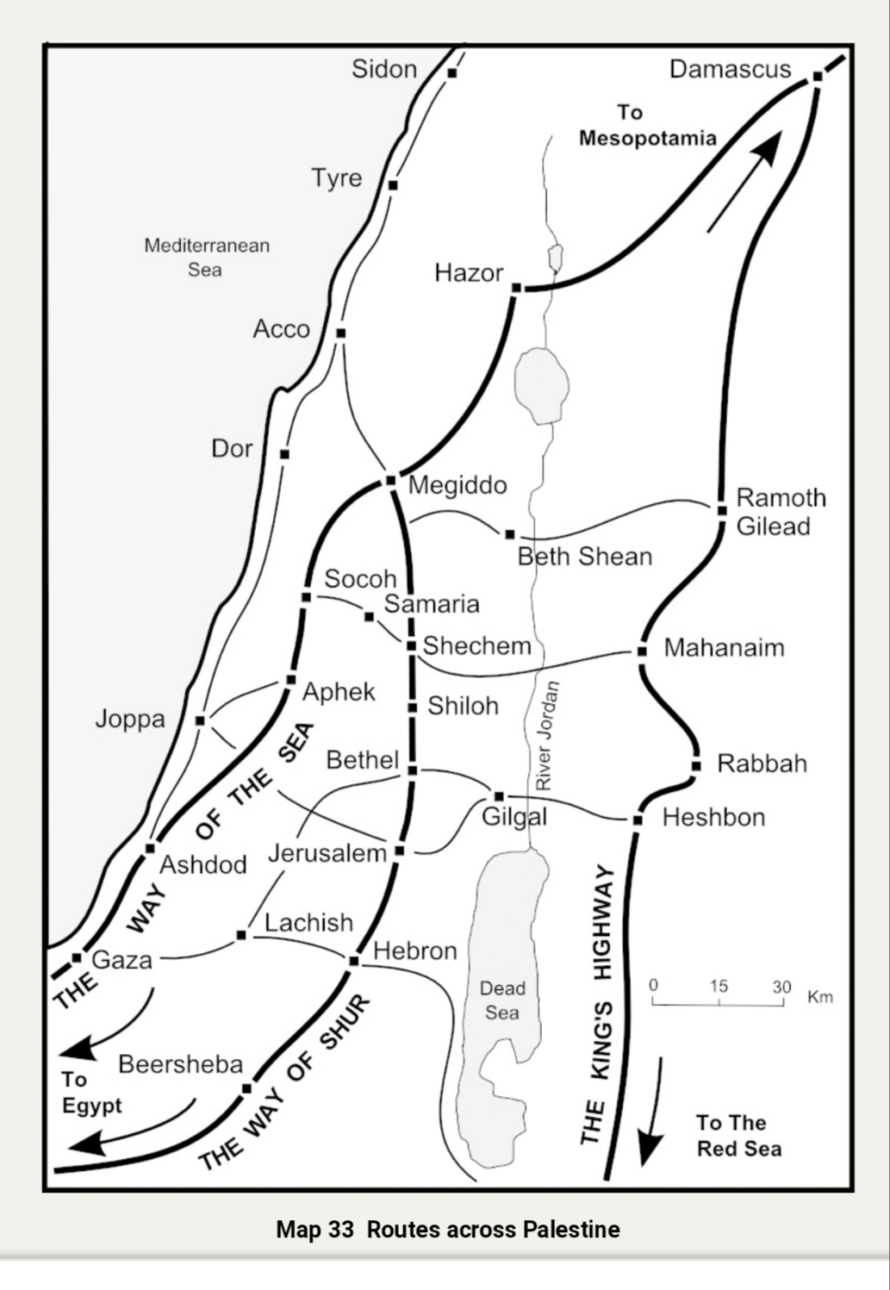
Abram Genesis 12-15

Slide 2
Abram Genesis 12-15
Promises 12:1-3, 7
* Great Nation 13:15
I will bless you 13:2 15:1
I will make thy name Great
9 other OT Books, 27 Nt mentions extensively Romans, Gal & Hebrews
I will bless them that bless and curse them that curse
* In thee shall all families of earth blessed
Gal 3:8-14 Acts 3:23 Jn 8:56
* Land Promise v.7 15:18 (boundries) Gen 47:30 Lev. 18:24f
Heb. 11:13 Gen 23:5-7

Slide 3
Abraham Genesis 16-18
Chapt 17
99 years old Sarai 90
* Change names
“Exalted father” - “father of nations”
“princess” - “noble woman” v 16 & 19
* Circumcision token (sign) of covenant v 11
“everlasting” v. 13 v 8 Gal 5
Col 2:10-11
* Covenant “I will be a (your) God to you …and your seed” v 7 Lev. 25:38

Slide 4
Abraham Genesis 16-20
Chapter 17 The Covenant
Covenant “I will be God unto thee and to thy seed…” v 7-8
Ex 29:45 (ASV) "And I will sanctify the tent of meeting, and the altar: Aaron also and his sons will I sanctify, to minister to me in the priest's office. (45) And I will dwell among the children of Israel, and will be their God."
Lev 26:11-12 (ASV) " And I will set my tabernacle among you: and my soul shall not abhor you. (12) And I will walk among you, and will be your God, and ye shall be my people.“ Joel 2:27 “midst”

Slide 5
Abraham Genesis 16-20
Ezek 37:24-27 ASV "And my servant David shall be king over them; and they all shall have one shepherd: they shall also walk in mine ordinances, and observe my statutes, and do them… David my servant shall be their prince for ever. (26) Moreover I will make a covenant of peace with them; it shall be an everlasting covenant with them; and I will place them, and multiply them, and will set my sanctuary in the midst of them for evermore. (27) My tabernacle also shall be with them; and I will be their God, and they shall be my people."

Slide 6
Abraham Genesis 16-20
Jer 31:31-34 (ASV) "Behold, the days come, saith Jehovah, that I will make a new covenant with the house of Israel, and with the house of Judah: (32) not according to the covenant that I made with their fathers in the day that I took them by the hand to bring them out of the land of Egypt; which my covenant they brake, although I was a husband unto them, saith Jehovah. (33) But this is the covenant that I will make with the house of Israel after those days, saith Jehovah: I will put my law in their inward parts, and in their heart will I write it; and I will be their God, and they shall be my people. (34) And they shall teach no more every man his neighbor, and every man his brother, saying, Know Jehovah; for they shall all know me, from the least of them unto the greatest of them, saith Jehovah: for I will forgive their iniquity, and their sin will I remember no more."

Slide 7
Abraham Genesis 16-20
2Cor 6:17-18 (ASV) " Wherefore Come ye out from among them, and be ye separate, saith the Lord, And touch no unclean thing; And I will receive you, (18) And will be to you a Father, And ye shall be to me sons and daughters, saith the Lord Almighty.“
Rev 21:2-3 (ASV) "And I saw the holy city, new Jerusalem, coming down out of heaven from God, made ready as a bride adorned for her husband. (3) And I heard a great voice out of the throne saying, Behold, the tabernacle of God is with men, and he shall dwell with them, and they shall be his peoples, and God himself shall be with them, [and be] their God:"

Slide 8
Abraham Genesis 16-20
“He shall dwell with them and they shall be His people and He shall be their God”
Garden Israel Church Heaven

Slide 9
Abraham Genesis 16-18
Chapt. 18
3 men foretell Sarah’s motherhood
Sodom’s doom, Abraham’s bargaining8

Slide 10
Abram Genesis 17-20
chapt. 18
Kings of Plains
Bera “son of evil” Sodom “Scorched”
Birsha “with iniquity” Gomorrah “Heap”
Shinab “changed Father” Admah “red earth”
Shemeber “lofty flight” Zeboim “gazelles”
- Bela/ Zoar Bela “destruction”
Zoar “insignificant”

Slide 11
Genesis 16-20
Deut 29:23 ASV] " the whole land thereof is brimstone, and salt, a burning, it is not sown, nor beareth, nor any grass groweth therein, like the overthrow of Sodom and Gomorrah, Admah and Zeboiim, which Jehovah overthrew in his anger, and in his wrath:“

Slide 12
Genesis 16-20
Lessons from Sodom &Gomorrah
* Referenced no less than 17 times in OT prophets
* Referenced at least 9 times in NT

Slide 13
Abraham Genesis 16-20
Jude 1:7 (ASV) " Even as Sodom and Gomorrah, and the cities about them, having in like manner with these given themselves over to fornication and gone after strange flesh, are set forth as an example, suffering the punishment of eternal fire.“
2Pe 2:5-6, 9 (ASV) “and spared not the ancient world, but preserved Noah with seven others, a preacher of righteousness, when he brought a flood upon the world of the ungodly; (6) and turning the cities of Sodom and Gomorrah into ashes condemned them with an overthrow, having made them an example unto those that should live ungodly; ... (9) the Lord knoweth how to deliver the godly out of temptation, and to keep the unrighteous under punishment unto the day of judgment;"

Slide 14
Genesis 16-20

Slide 15
Genesis 16-20

Slide 16
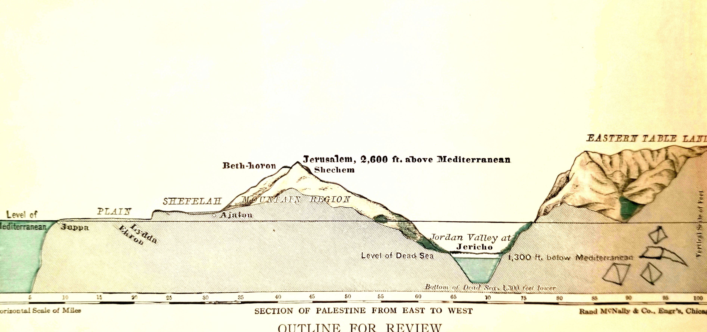

Slide 17
Genesis 16-20

