Slide 1
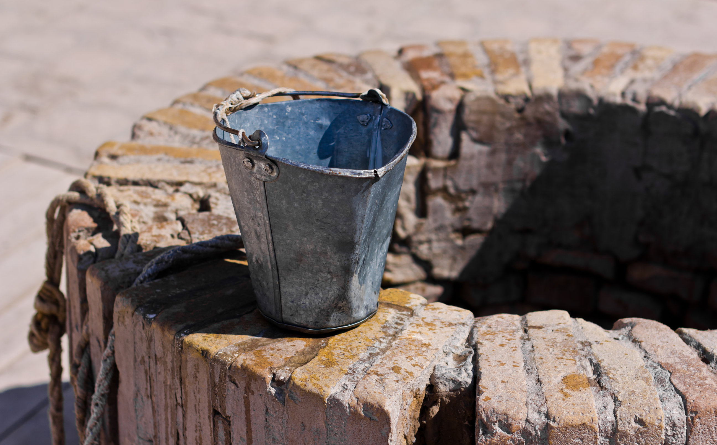
Lessons From The Well
Spirit & Truth

Slide 3
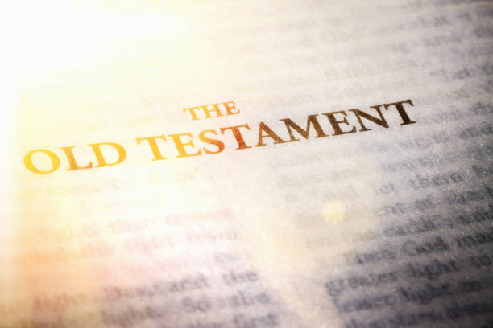
The Heart
Isa 29:13a – “Then the Lord said, ‘Because this people draw near with their words and honor Me with their lip service, but they remove their hearts far from Me…”
Ezek 31:33 – “They come to you as people come, and sit before you as My people and hear your words, but they do not do them, for they do the lustful desires expressed by their mouth, and their heart goes after their gain.”

Slide 4
God’s Word
Gen 4:4-5a – “⁴Abel, on his part also brought of the firstlings of his flock and of their fat portions. And the Lord had regard for Abel and for his offering; ⁵but for Cain and for his offering He had no regard…”
Lev 10:1-2 – “¹Now Nadab and Abihu, the sons of Aaron, took their respective firepans, and after putting fire in them, placed incense on it and offered strange fire before the Lord, which He had not commanded them. ²And fire came out from the presence of the Lord and consumed them, and they died before the Lord.”

Slide 5
Spirit & Truth
Heb 9:9-10 – “…a symbol for the present time. Accordingly both gifts and sacrifices are offered which cannot make the worshiper perfect in conscience, since they relate only to food and drink and various washings, regulations for the body imposed until a time of reformation.”

Slide 6
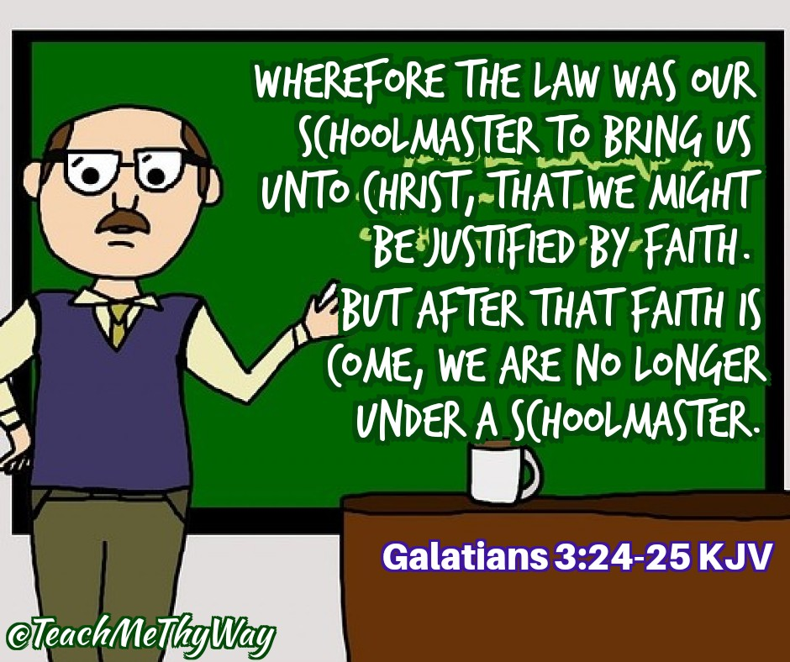
Spirit & Truth
Heb 9:9-10 – “…a symbol for the present time. Accordingly both gifts and sacrifices are offered which cannot make the worshiper perfect in conscience, since they relate only to food and drink and various washings, regulations for the body imposed until a time of reformation.”

Slide 7
Spirit & Truth
Heb 9:9-10 – “…a symbol for the present time. Accordingly both gifts and sacrifices are offered which cannot make the worshiper perfect in conscience, since they relate only to food and drink and various washings, regulations for the body imposed until a time of reformation.”

Slide 9
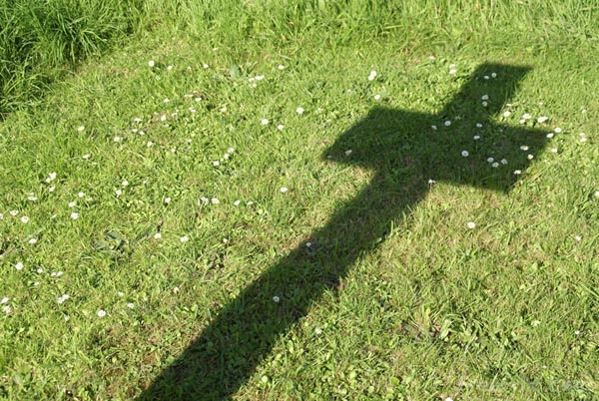
Jerusalem
Heb 12:22 – “But you have come to Mount Zion and to the city of the living God, the heavenly Jerusalem…”
Passover
1 Cor 5:7 – “Clean out the old leaven so that you may be a new lump, just as you are in fact unleavened. For Christ our Passover also has been sacrificed.”
High Priest
Heb 9:11 – “…Christ appeared as a high priest of the good things to come…”
Heb 4:15 – “For we do not have a high priest who cannot sympathize with our weaknesses, but One who has been tempted in all things as we are, yet without sin.”

Slide 10
Priestly Garments
Ex 28:40 – “For Aaron’s sons you shall make tunics; you shall also make sashes for them, and you shall make caps for them, for glory and for beauty.”
1 Pet 2:5a – “you also, as living stones, are being built up as a spiritual house for a holy priesthood…”
1 Pet 2:9a – “But you are a chosen race, a royal priesthood…”
Gal 3:26-27 – “²⁶For you are all sons of God through faith in Christ Jesus. ²⁷For all of you who were baptized into Christ have clothed yourselves with Christ.”
Animal Sacrifices
Heb 9:12 – “[Jesus entered the more perfect tabernacle] not through the blood of goats and calves, but through His own blood, He entered the holy place once for all, having obtained eternal redemption.”
John 1:29b – “… Behold, the Lamb of God who takes away the sin of the world!”

Slide 11
Musical Instruments
Eph 5:19 – “speaking to one another in psalms and hymns and spiritual songs, singing and making melody with your heart to the Lord”
Circumcision
Col 2:11-13 – “and in Him you were also circumcised with a circumcision made without hands, in the removal of the body of the flesh by the circumcision of Christ; having been buried with Him in baptism, in which you were also raised up with Him through faith in the working of God, who raised Him from the dead. When you were dead in your transgressions and the uncircumcision of your flesh, He made you alive together with Him, having forgiven us all our transgressions”

Slide 13
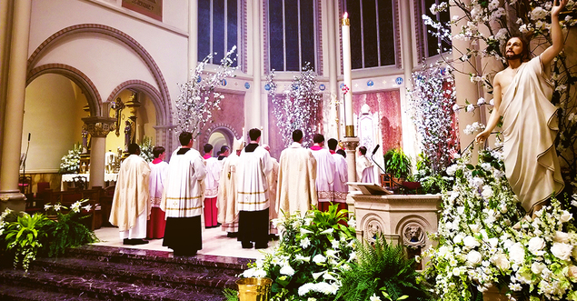

Slide 15
