Slide 1
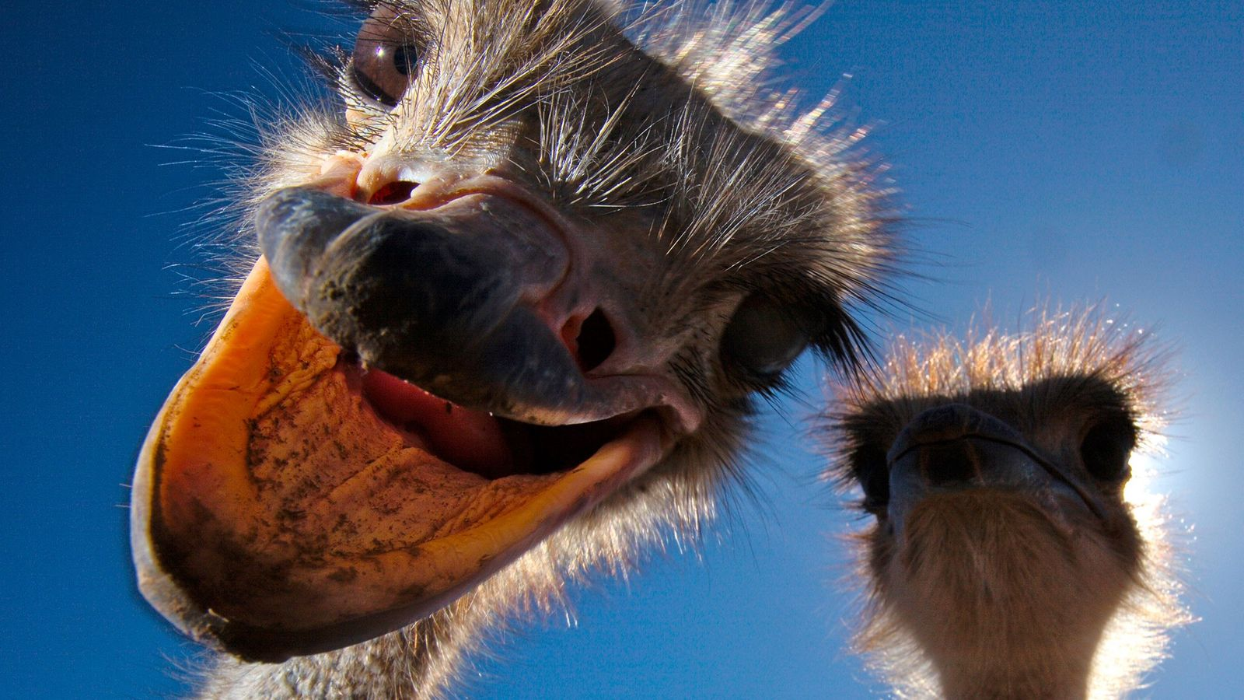

Slide 3
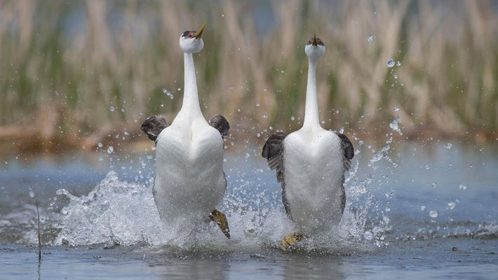

Slide 4
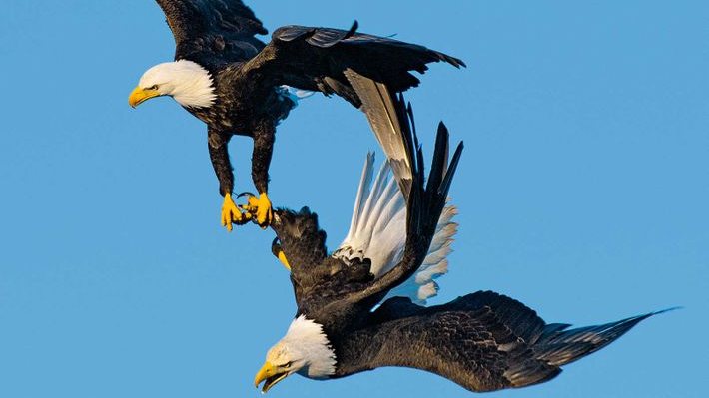

Slide 6
As Is Proper Among Saints
Three Questions to Avoid Sexual Sin

Slide 7
Question #1: Is it loving?
Therefore be imitators of God, as beloved children. And walk in love, as Christ loved us and gave himself up for us, a fragrant offering and sacrifice to God. (vs 1-2)
But sexual immorality and all impurity or covetousness must not even be named among you, as is proper among saints. (vs 3)
Let there be no filthiness nor foolish talk nor crude joking, which are out of place, but instead let there be thanksgiving. (vs 4)

Slide 8
Question #2: Does it reflect Christ before the world?
Therefore do not become partners with them; for at one time you were darkness, but now you are light in the Lord. Walk as children of light… (vs 7-8)
(for the fruit of light is found in all that is good and right and true)… (vs 9)
…and try to discern what is pleasing to the Lord. (vs 10)

Slide 9
Question #2: Does it reflect Christ before the world?
Take no part in the unfruitful works of darkness, but instead expose them. Ephesians 5:11
For it is shameful even to speak of the things that they do in secret. Ephesians 5:12
But when anything is exposed by the light, it becomes visible, for anything that becomes visible is light. Ephesians 5:13-14

Slide 10
Question #3: Is it wise?
Look carefully then how you walk, not as unwise but as wise… Ephesians 5:15
Therefore do not be foolish, but understand what the will of the Lord is. Ephesians 5:17
And do not get drunk with wine, for that is debauchery, but be filled with the Spirit… Ephesians 5:18

Slide 11
Question #3: Is it wise?
…addressing one another in psalms and hymns and spiritual songs, singing and making melody to the Lord with your heart, giving thanks always and for everything to God the Father in the name of our Lord Jesus Christ, submitting to one another out of reverence for Christ. Ephesians 5:19-21

