Slide 2
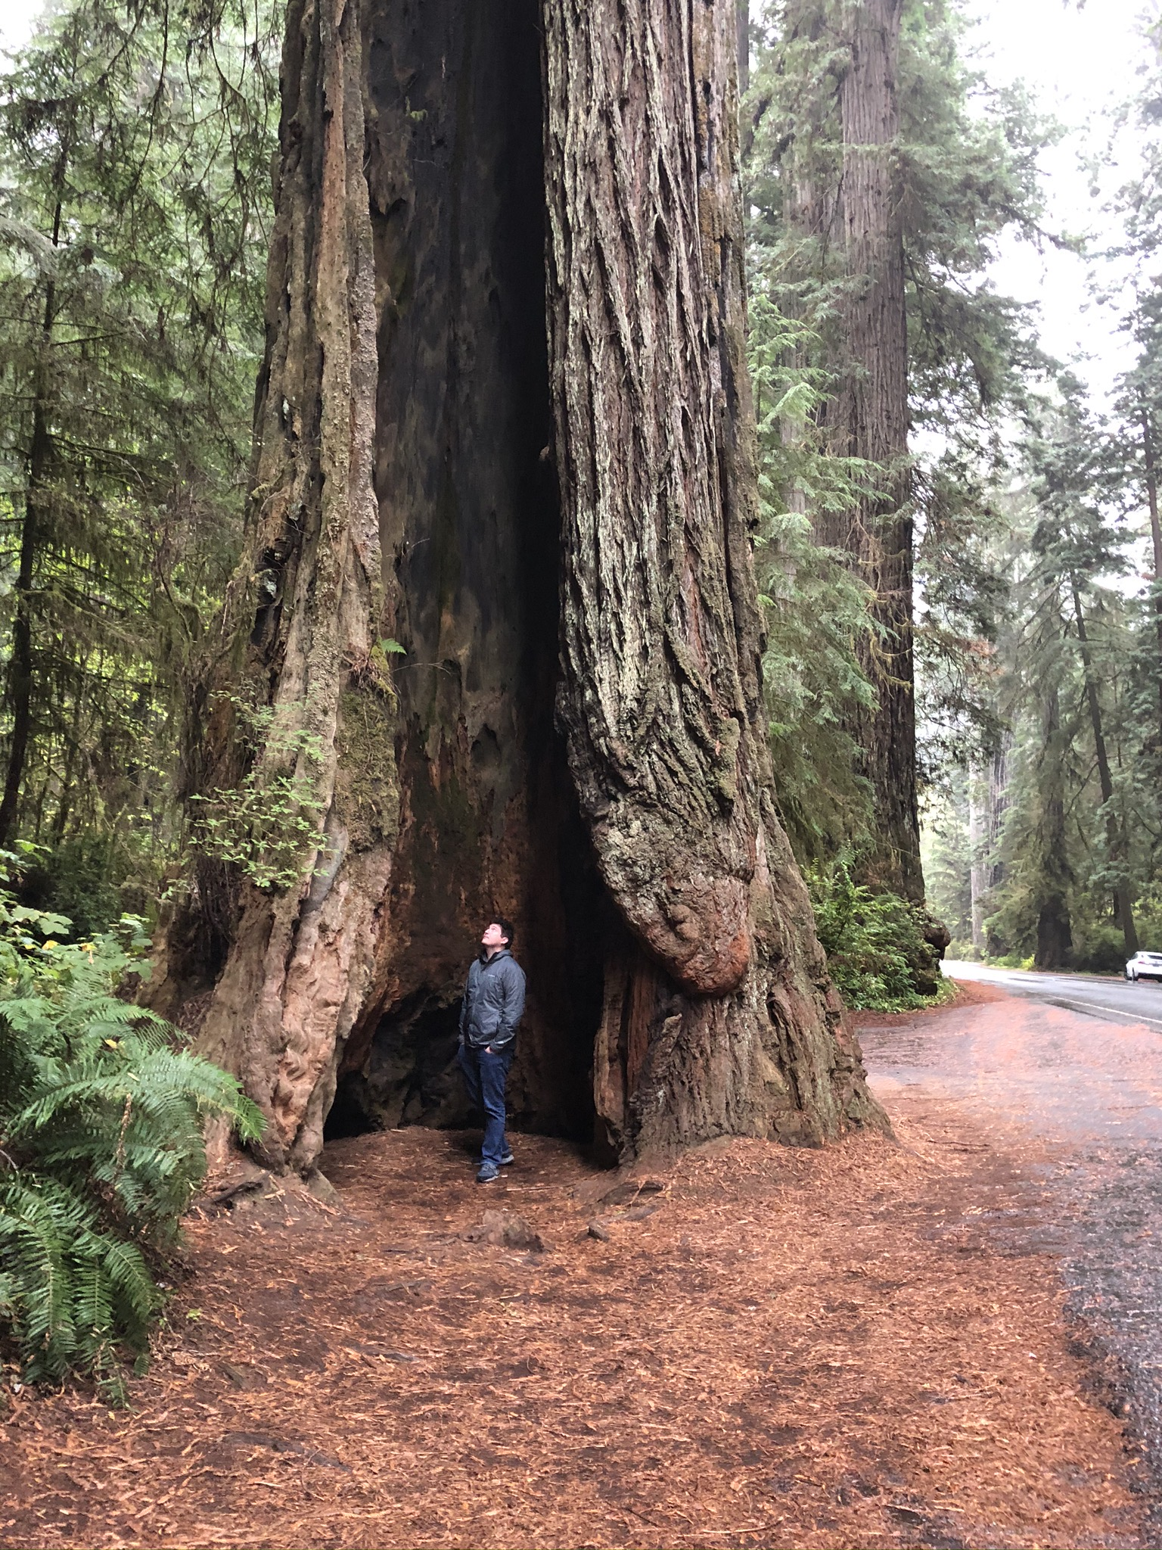
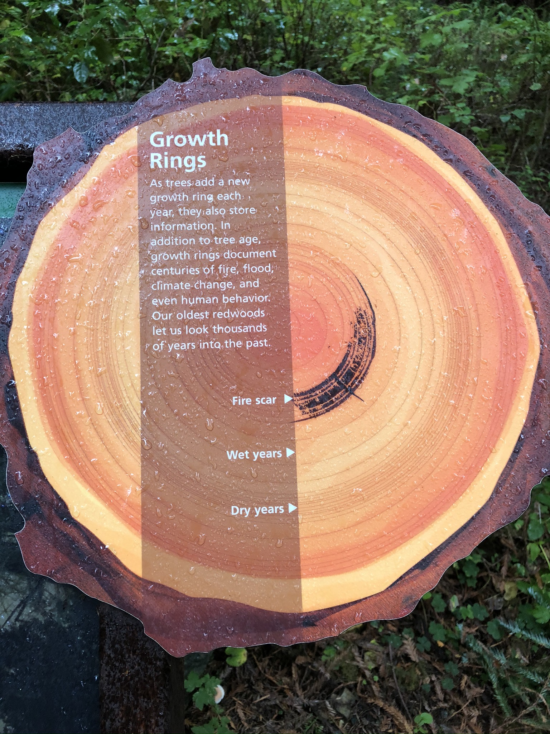

Slide 3
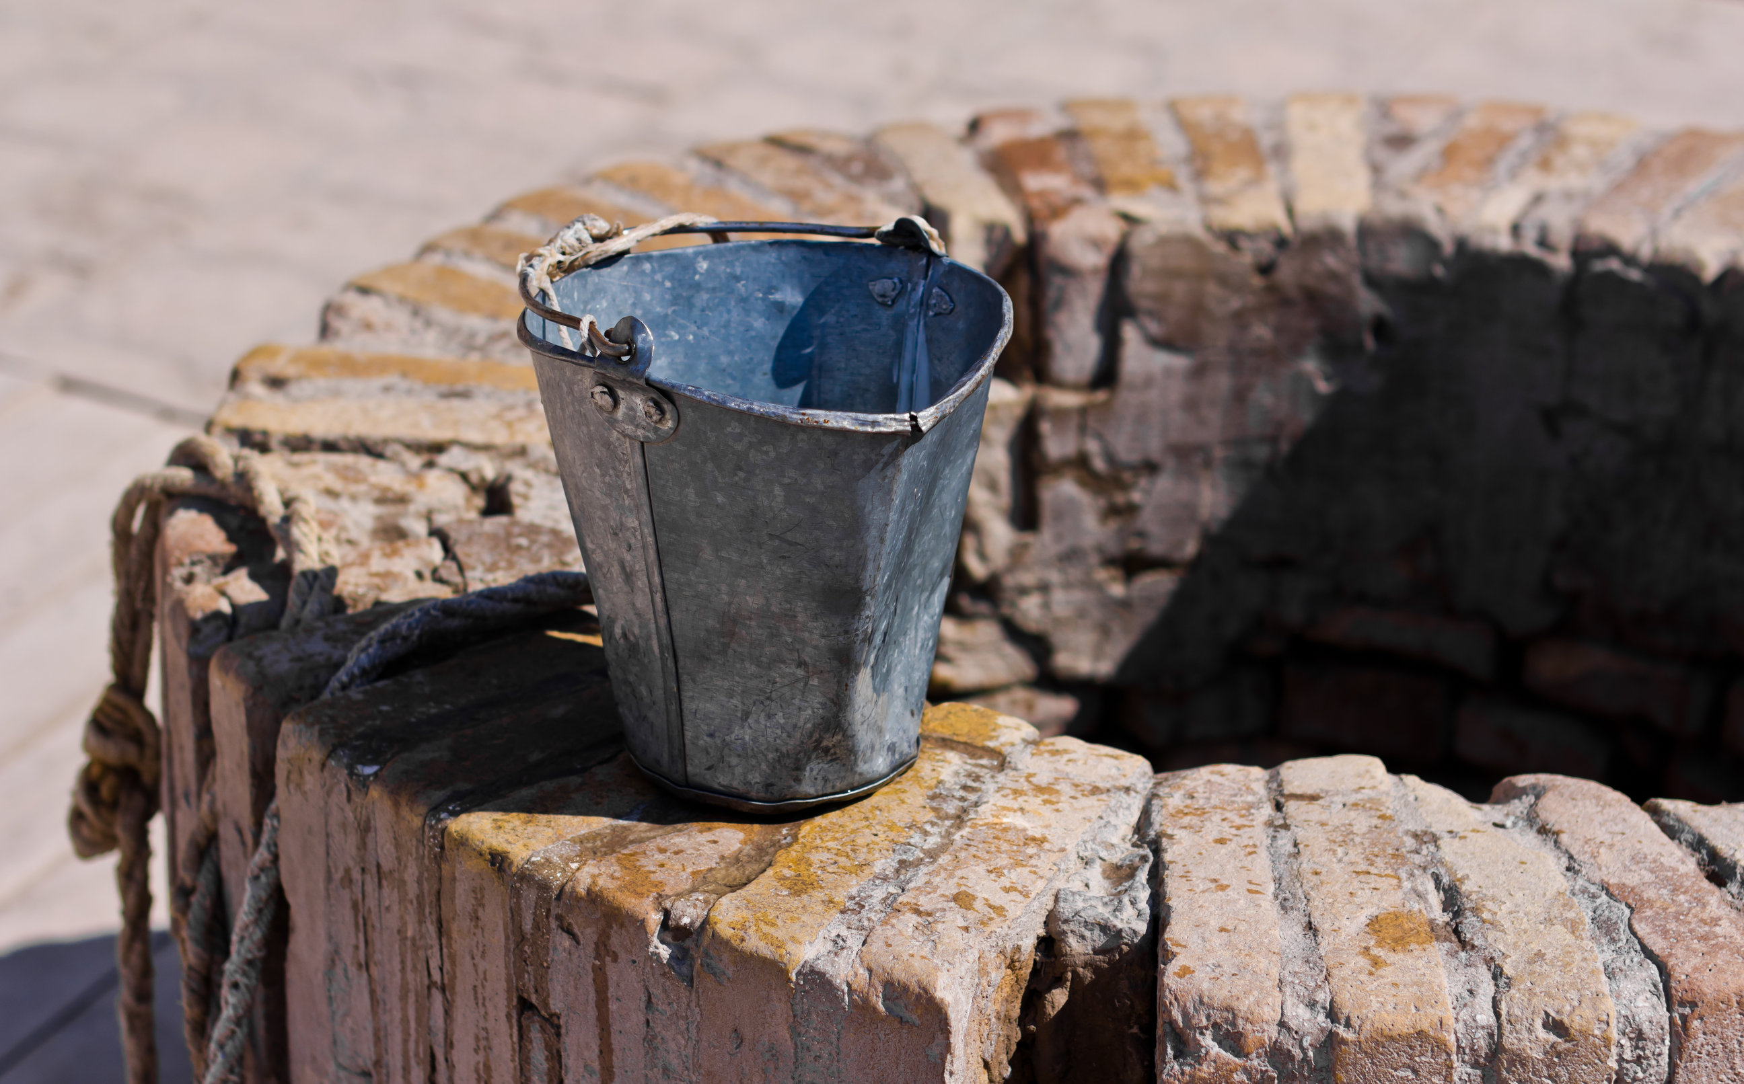
Lessons From The Well
Going Against The Grain

Slide 4
Jesus Went Against The Grain Of…
Of Deity
Psa 139:7-10; Isa 40:28-29a; Psa 50:12; Phil 2:5-7
Of Society
John 4:9,27
Of The Religious
John 4:18,25-26; Mark 2:16; Isa 42:2

Slide 5
Jesus Went Against The Grain Of…
Of Deity
Psa 139:7-10; Isa 40:28-29a; Psa 50:12; Phil 2:5-7
Of Society
John 4:9,27
Of The Religious
John 4:18,25-26; Mark 2:16; Isa 42:2

Slide 6
Jesus Went Against The Grain Of…
Of Deity
Psa 139:7-10; Isa 40:28-29a; Psa 50:12; Phil 2:5-7
Of Society
John 4:9,27
Of The Religious
John 4:18,25-26; Mark 2:16; Isa 42:2

Slide 7
How Do We Do It?
Sacrifice
Rom 12:1-2; 2 Sam 24:24; 1 Pet 1:7
Not A People-Pleaser
John 4:10; Acts 17:5-6; Luke 6:26; Prov 22:1
Different Is Attractive
1 Tim 2:10; Prov 15:2a

Slide 8
How Do We Do It?
Sacrifice
Rom 12:1-2; 2 Sam 24:24; 1 Pet 1:7
Not A People-Pleaser
John 4:10; Acts 17:5-6; Luke 6:26; Prov 22:1
Different Is Attractive
1 Tim 2:10; Prov 15:2a

Slide 9
How Do We Do It?
Sacrifice
Rom 12:1-2; 2 Sam 24:24; 1 Pet 1:7
Not A People-Pleaser
John 4:10; Acts 17:5-6; Luke 6:26; Prov 22:1
Different Is Attractive
1 Tim 2:10; Prov 15:2a

