Slide 1
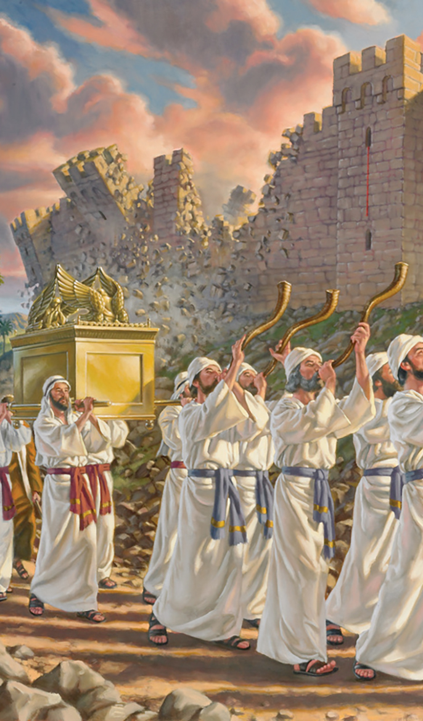
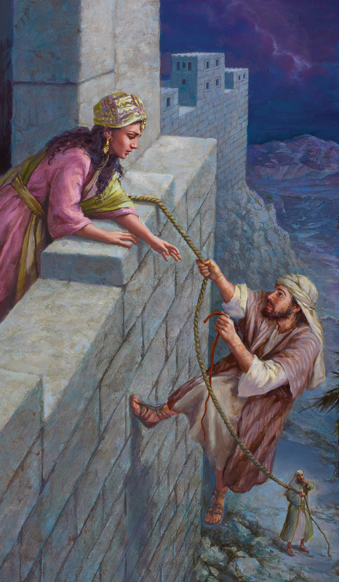
verse
29
verse
30
verse
31
Hebrews 11

Slide 2
The Faith of Hebrews 11…
v. 1 – is “the substance (or reality) of things hoped for, the evidence of things not seen (or the unseen)”
v. 2 – by it “the elders obtained a good testimony”
v. 6 – without it, it is impossible to please God
In order to come to God, one must:
Believe that God exists
Believe that God is a rewarder of those who seek him

Slide 3
Because of Faith, the elders of Hebrews 11…
Responded in 4 Ways:
Believed strongly in God’s promises not yet realized
And moved with godly fear to do unusual things (extraordinary)
And obeyed God rather than men
And maintained a relationship with God in the face of suffering and persecution

Slide 4
3 of the 4 Ways the Elders Responded B/c of their Faith: | Elder | What? | Verse(s)
1. Believed strongly in God’s promises not yet realized | Enoch | Prophesied | Hebrews 11:5-6; Jude 14-15
2. And moved with godly fear to do unusual things | Abraham | Sojourned, Offered Isaac | Hebrews 11:8-12, 17-19
(extraordinary things) | Sarah | Judged Him faithful | Hebrews 11:11-12
 | Isaac | Blessed Jacob & Esau | Hebrews 11:20
 | Jacob | Blessed sons of Joseph | Hebrews 11:21
 | Joseph | Mention departure of Egypt | Hebrews 11:22
 | Abel | Better Sacrifice | Hebrews 11:4
 | Noah | Ark | Hebrews 11:7
 | Sarah | Received strength | Hebrews 11:11-12
3. And obeyed God rather than men | Moses’s parents | Saved Moses | Hebrews 11:23
 | Moses | Refused Egypt | Hebrews 11:24-28

Slide 5
Because of the Faith, the elders of Hebrews 11…
Responded in 4 Ways:
Believed strongly in God’s promises not yet realized
And moved with godly fear to do unusual things (extraordinary)
And obeyed God rather than men
And maintained a relationship with God in the face of suffering and persecution
Why?
v. 10 “waited for the city which has foundations, whose builder and maker is God”
v. 13 “seen them [promises] afar off were
assured of them
embraced them
and confessed that they were strangers and pilgrims on the earth.”
v. 14 “they desire a better, that is, a heavenly country.”
What then?
v. 14 “God is not ashamed to be called their God, for He has prepared a city for them.”

Slide 6
verse
29
Hebrews 11:29 “By faith they passed through the Red Sea as by dry land, whereas the Egyptians, attempting to do so, were drowned.”
Exodus 14
v. 3 “the wilderness has shut them in.”
v. 13 “Do not fear! Stand by and see the salvation of the LORD which He will accomplish for you today;…”
v. 14 “The LORD will fight for you while you keep silent.”
v. 31 “When Israel saw the great power which the LORD had used against the Egyptians, the people feared the LORD, and they believed in the LORD and in His servant Moses.”

Slide 7
3 of the 4 Ways the Elders Responded B/c of their Faith: | Elder | What? | Verse(s)
1. Believed strongly in God’s promises not yet realized | Enoch | Prophesied | Hebrews 11:5-6; Jude 14-15
2. And moved with godly fear to do unusual things | Abraham | Sojourned, Offered Isaac | Hebrews 11:8-12, 17-19
(extraordinary things) | Sarah | Judged Him faithful | Hebrews 11:11-12
 | Isaac | Blessed Jacob & Esau | Hebrews 11:20
 | Jacob | Blessed sons of Joseph | Hebrews 11:21
 | Joseph | Mention departure of Egypt | Hebrews 11:22
 | Abel | Better Sacrifice | Hebrews 11:4
 | Noah | Ark | Hebrews 11:7
 | Sarah | Received strength | Hebrews 11:11-12
 | Israelites | Passed through the Red Sea | Hebrews 11:29
3. And obeyed God rather than men | Moses’s parents | Saved Moses | Hebrews 11:23
 | Moses | Refused Egypt | Hebrews 11:24-28

Slide 8
verse
29
When has the wilderness shut me in?
Overcome with sin
Hurt by death
Challenged by life
Faith says… God delivers!!!
Psalm 118:5-6 - "Out of my distress I called on the Lord; the Lord answered me and set me free. The Lord is on my side; I will not fear. What can man do to me?“
Galatians 5:1 – “For freedom Christ has set us free; stand firm therefore, and do not submit again to a yoke of slavery.“
Colossians 1:13-14 – "He has delivered us from the domain of darkness and transferred us to the kingdom of his beloved Son."

Slide 9
verse
30
Hebrews 11:30 “By faith the walls of Jericho fell down after they were encircled for seven days.”
Joshua 6
v. 2 “See! I have given Jericho into your hand, its king, and the mighty men of valor.”
All you have to do is…
v. 3 “March around the city, all you men of war; you shall go all around the city once. This you shall do six days.”
v. 4 “And seven priests shall bear seven trumpets of rams’ horns before the ark. But the seventh day you shall march around the city seven times,…”

Slide 10
3 of the 4 Ways the Elders Responded B/c of their Faith: | Elder | What? | Verse(s)
1. Believed strongly in God’s promises not yet realized | Enoch | Prophesied | Hebrews 11:5-6; Jude 14-15
2. And moved with godly fear to do unusual things | Abraham | Sojourned, Offered Isaac | Hebrews 11:8-12, 17-19
(extraordinary things) | Sarah | Judged Him faithful | Hebrews 11:11-12
 | Isaac | Blessed Jacob & Esau | Hebrews 11:20
 | Jacob | Blessed sons of Joseph | Hebrews 11:21
 | Joseph | Mention departure of Egypt | Hebrews 11:22
 | Abel | Better Sacrifice | Hebrews 11:4
 | Noah | Ark | Hebrews 11:7
 | Sarah | Received strength | Hebrews 11:11-12
 | Israelites | Passed through the Red Sea | Hebrews 11:29
 | Israelites | Encircled Jericho 13x’s | Hebrews 11:30
3. And obeyed God rather than men | Moses’s parents | Saved Moses | Hebrews 11:23
 | Moses | Refused Egypt | Hebrews 11:24-28

Slide 11
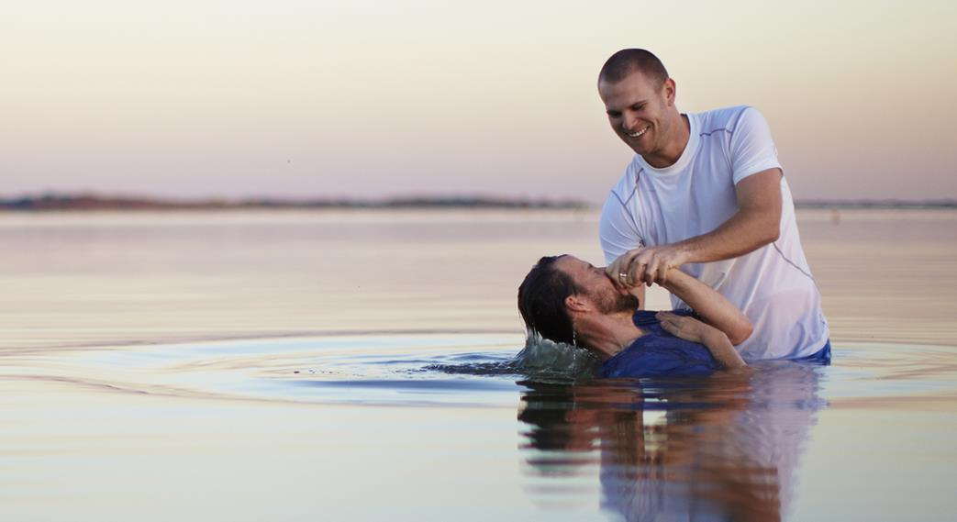
Am I willing to do extraordinary things
to attain the victories God has already won?
To be baptized? – Romans 6:4
To give up lusts of life? – 1 Peter 4:2-4
To love my enemies & pray for them? – Matt. 5:44
To deny self / take up cross? – Matt. 16:24
To forgive those who have wronged me? – Matt. 6:14-15
What other things do Christians do that the world thinks it is strange?
Faith does… the extraordinary!

Slide 12
Hebrews 11:31 “By faith the harlot Rahab did not perish with those who did not believe, when she had received the spies in peace.”
Exodus 15:15 “…All the inhabitants of Canaan will melt away”
Joshua 5:1 “…all the kings of Canaanites… that their heart melted; and there was no spirit in them…”
Joshua 2:9 ”I know that the LORD has given you the land, that the terror of you has fallen on us, and that all inhabitants of the land are fainthearted because of you.”
Joshua 2:10-11 ”our hearts melted”
Because of her faith, Rahab chose to obey God rather than man, her king, and “received the spies in peace.”
Acts 5:29, James 2:25
verse
31

Slide 13
3 of the 4 Ways the Elders Responded B/c of their Faith: | Elder | What? | Verse(s)
1. Believed strongly in God’s promises not yet realized | Enoch | Prophesied | Hebrews 11:5-6; Jude 14-15
2. And moved with godly fear to do unusual things | Abraham | Sojourned, Offered Isaac | Hebrews 11:8-12, 17-19
(extraordinary things) | Sarah | Judged Him faithful | Hebrews 11:11-12
 | Isaac | Blessed Jacob & Esau | Hebrews 11:20
 | Jacob | Blessed sons of Joseph | Hebrews 11:21
 | Joseph | Mention departure of Egypt | Hebrews 11:22
 | Abel | Better Sacrifice | Hebrews 11:4
 | Noah | Ark | Hebrews 11:7
 | Sarah | Received strength | Hebrews 11:11-12
 | Israelites | Passed through the Red Sea | Hebrews 11:29
 | Israelites | Encircled Jericho 13x’s | Hebrews 11:30
3. And obeyed God rather than men | Moses’s parents | Saved Moses | Hebrews 11:23
 | Moses | Refused Egypt | Hebrews 11:24-28
 | Rahab | Received the spies | Hebrews 11:31

Slide 14
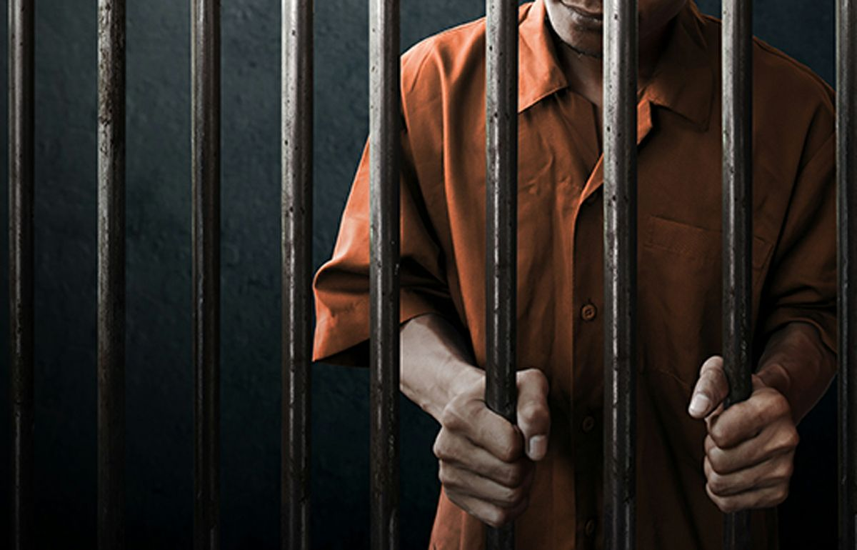
When my heart melts with fear, will my faith perform
illegal actions to be right with God?
Because of her faith, she chose to obey God rather than man, her king, and “received the spies in peace.”
Acts 5:29, James 2:25

