Slide 2
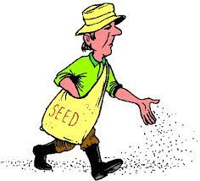
Phil 1:1 – “Paul and Timothy, bond-servants of Christ Jesus, to all the saints in Christ Jesus who are in Philippi, including the overseers and deacons”
“diakonos”
“doulos”

Slide 3
Acts 6:1-5 – “Now at this time while the disciples were increasing in number, a complaint arose on the part of the Hellenistic Jews against the native Hebrews, because their widows were being overlooked in the daily serving of food. So the twelve summoned the congregation of the disciples and said, ‘It is not desirable for us to neglect the word of God in order to serve tables. Therefore, brethren, select from among you seven men of good reputation, full of the Spirit and of wisdom, whom we may put in charge of this task. But we will devote ourselves to prayer and to the ministry of the word.’ The statement found approval with the whole congregation; and they chose Stephen, a man full of faith and of the Holy Spirit, and Philip, Prochorus, Nicanor, Timon, Parmenas and Nicolas, a proselyte from Antioch.”
DEACONS: specially qualified servants put in charge of tasks of the local church

Slide 4
Men of Dignity
ESV: “dignified”
NKJV: “reverent”
KJV: “grave”
NIV: “worthy of respect”
1 Tim 3:8 (NASB)
“Deacons likewise must be men of dignity, not double-tongued, or addicted to much wine or fond of sordid gain”
Not Those Who…
are flighty
are frivolous
see the role as unspiritual
But Those Who…
properly discern serious things
take their role seriously
respected by the church

Slide 5
Not Double-Tongued
ESV: “not double-tongued”
NKJV: “not double-tongued”
KJV: “not double-tongued”
NIV: “sincere”
1 Tim 3:8 (NASB)
“Deacons likewise must be men of dignity, not double-tongued, or addicted to much wine or fond of sordid gain”
Not Those Who…
say one thing and do another
can’t be counted on
are duplicitous
But Those Who…
are honest
are forthright
are consistent

Slide 6
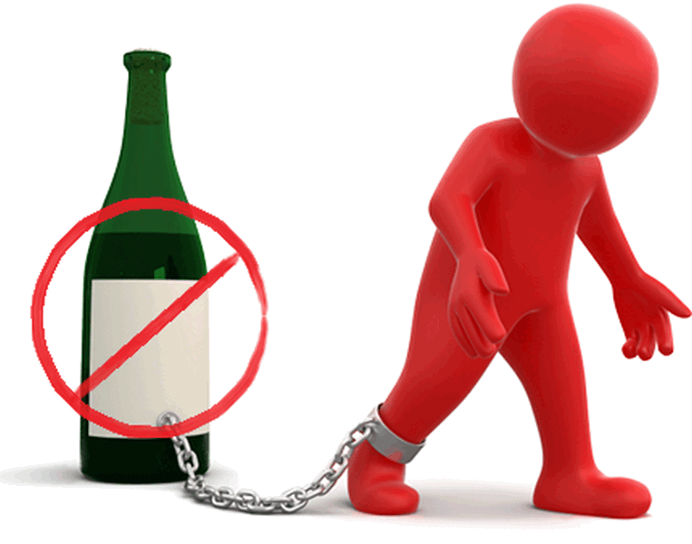
Not Addicted To Much Wine
ESV: “not addicted to much wine”
NKJV: “not given to much wine”
KJV: “not given to much wine”
NIV: “not indulging in much wine”
1 Tim 3:8 (NASB)
“Deacons likewise must be men of dignity, not double-tongued, or addicted to much wine or fond of sordid gain”
Not Those Who…
whose judgment is affected
depends on depressants
make provisions for the flesh
But Those Who…
are sober-minded
are alert and attentive
use sound judgment

Slide 7
Not Fond of Sordid Gain
ESV: “not greedy for dishonest gain”
NKJV: “not greedy for money”
KJV: “not greedy of filthy lucre”
NIV: “not pursuing dishonest gain”
1 Tim 3:8 (NASB)
“Deacons likewise must be men of dignity, not double-tongued, or addicted to much wine or fond of sordid gain”
Not Those Who…
are materialistic
are greedy
distracted w/secular gain
But Those Who…
upright in his dealings
heart is inclined toward service
strive for honest labor

Slide 8
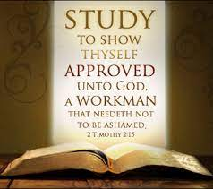
Holding To The Mystery of the Faith…
ESV: “…with a clear conscience”
NKJV: “…with a pure conscience”
KJV: “...in a pure conscience”
NIV: “they must keep hold of the deep truths of the faith with a clear conscience”
1 Tim 3:9 (NASB)
“but holding to the mystery of the faith with a clear conscience.”
Not Those Who…
don’t know the bible
don’t follow the bible
aren’t spiritually consistent
But Those Who…
study God’s word
understand God’s word
apply God’s word consistently

Slide 9
First Be Tested…
ESV: “let them also be tested first…”
NKJV: “let these also first be tested…”
KJV: “let these also first be proved…”
NIV: “they must first be tested…”
1 Tim 3:10 (NASB)
“These men must also first be tested; then let them serve as deacons if they are beyond reproach.”
Not Those Who…
procrastinate regarding tasks
are unproven/unqualified
are irreputable in service
But Those Who…
are go-getters
have proven trustworthiness
have proven experience

Slide 10
Women/Wives
ESV: “Their wives likewise must be…”
NKJV: “Likewise, their wives must be…”
KJV: “Even so must their wives be…”
NIV: “In the same way, the women…”
1 Tim 3:11 (NASB)
“Women must likewise be dignified, not malicious gossips, but temperate, faithful in all things”
But Those Who Are…
dignified
not malicious gossips
temperate
faithful in all things

Slide 11
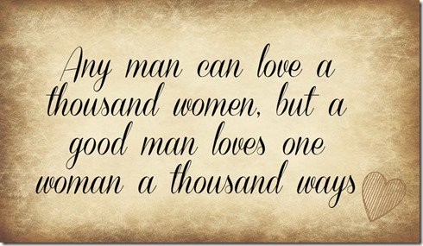
Husbands of Only One Wife
ESV: “…the husband of one wife…”
NKJV: “…the husbands of one wife…”
KJV: “…the husbands of one wife…”
NIV: “…faithful to his wife…”
1 Tim 3:12 (NASB)
“Deacons must be husbands of only one wife, and good managers of their children and their own households”

Slide 12
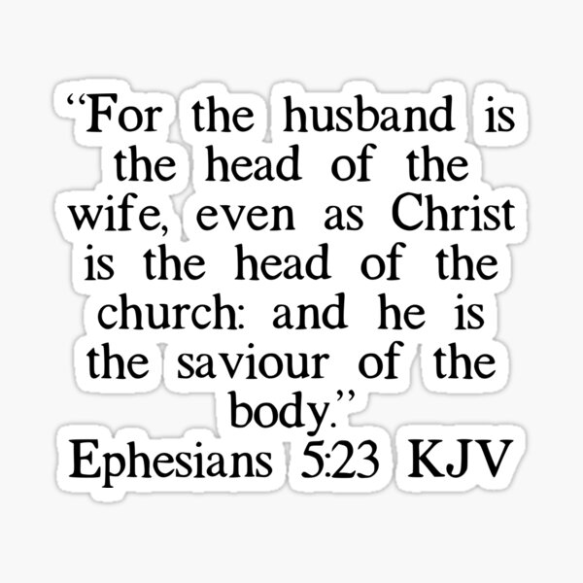
Good Managers of Children/Household
ESV: “husband of one wife, managing their children and their own households well”
NKJV: “husbands of one wife, ruling their children and their own houses well”
KJV: “husbands of one wife, ruling their children and their own houses well”
NIV: “faithful to his wife and must manage his children and his household well”
1 Tim 3:12 (NASB)
“Deacons must be husbands of only one wife, and good managers of their children and their own households”
Not Those Who…
simply have kids
are led by their wives
are led/manipulated by kids
But Those Who…
actually manage/lead their family
has a firm grip on his family
demonstrates an exemplary home

Slide 14
