Slide 1
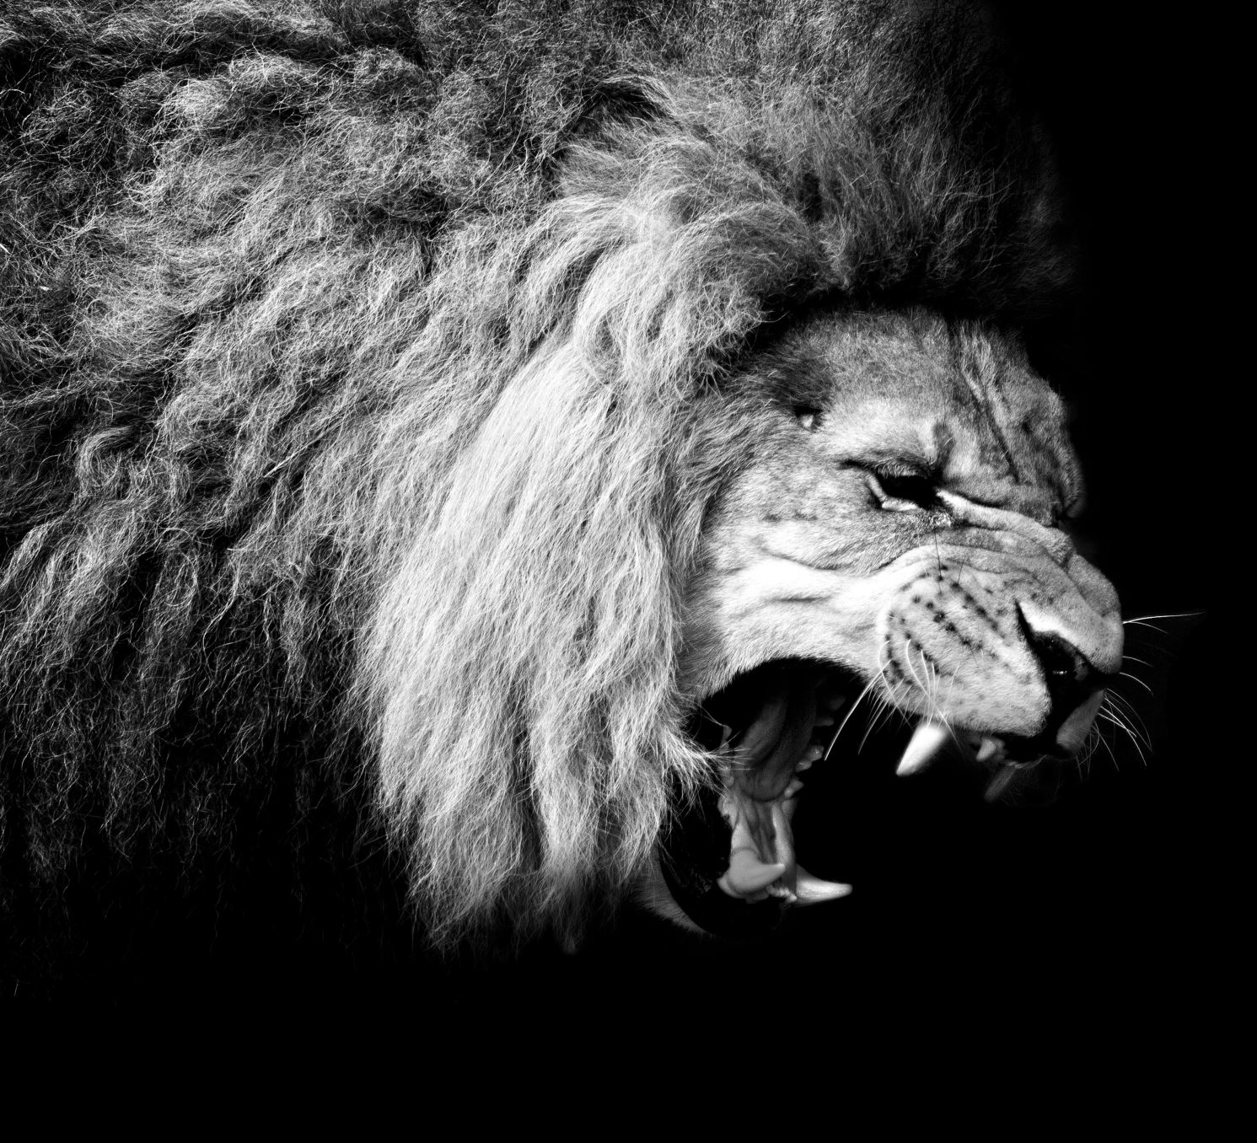
The Kings of Judah

Slide 2
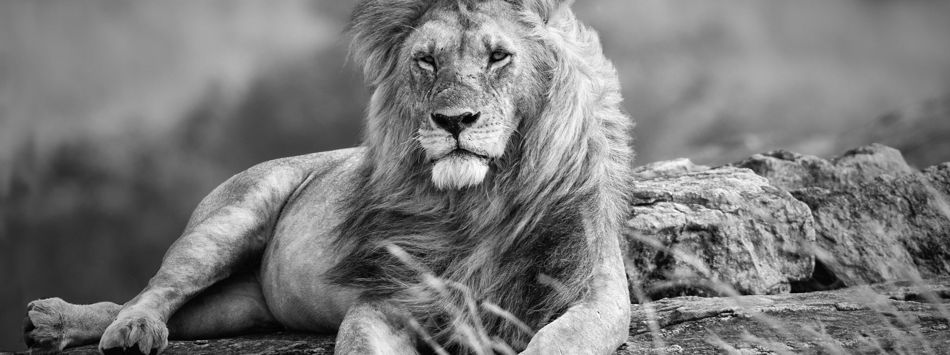
Manasseh
THE PRODIGAL OF THE OLD TESTAMENT

Slide 3
Complete rebellion
And he did what was evil in the sight of the LORD, according to the abominations of the nations whom the LORD drove out before the people of Israel. 33:2
For he rebuilt the high places that his father Hezekiah had broken down, and he erected altars to the Baals, and made Asheroth, and worshiped the host of heaven and served them. 33:3

Slide 4
Complete rebellion
And he built altars in the house of the LORD, of which the LORD had said, “In Jerusalem shall my name be forever.” 33:4
And he built altars for all the host of heaven in the two courts of the house of the LORD. 33:5

Slide 5
Complete rebellion
And he burned his sons as an offering in the Valley of the Son of Hinnom, and used fortune-telling and omens and sorcery, and dealt with mediums and with necromancers. He did much evil in the sight of the LORD, provoking him to anger. 33:6

Slide 6
Complete rebellion
And the carved image of the idol that he had made he set in the house of God, of which God said to David and to Solomon his son, “In this house, and in Jerusalem, which I have chosen out of all the tribes of Israel, I will put my name forever…” 33:7

Slide 7
Complete rebellion
Manasseh led Judah and the inhabitants of Jerusalem astray, to do more evil than the nations whom the LORD destroyed before the people of Israel. 33:9

Slide 8
Two expressions of grace
The LORD spoke to Manasseh and to his people, but they paid no attention. 33:10
Therefore the LORD brought upon them the commanders of the army of the king of Assyria, who captured Manasseh with hooks and bound him with chains of bronze and brought him to Babylon. 33:11

Slide 9
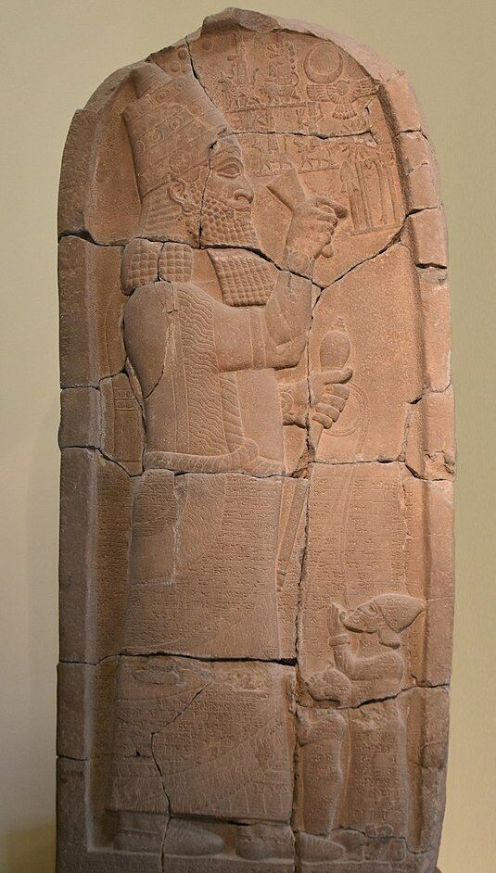

Slide 10
Repentance, prayer, & humility
And when he was in distress, he entreated the favor of the LORD his God and humbled himself greatly before the God of his fathers. 33:12

Slide 11
More grace
He prayed to him, and God was moved by his entreaty and heard his plea and brought him again to Jerusalem into his kingdom. Then Manasseh knew that the LORD was God. 33:13

Slide 12
restoration
And he took away the foreign gods and the idol from the house of the LORD, and all the altars that he had built on the mountain of the house of the LORD and in Jerusalem, and he threw them outside of the city. 33:15
He also restored the altar of the LORD and offered on it sacrifices of peace offerings and of thanksgiving, and he commanded Judah to serve the LORD, the God of Israel. 33:16

Slide 13
If my people who are called by my name…
Humble themselves.
Pray.
Seek my face.
Turn.

