Slide 2
Good Works
CLASS 1 – INTRODUCTION AND OVERVIEW

Slide 3
?
Have you ever studied how much the bible speaks to Good Works?

Slide 4
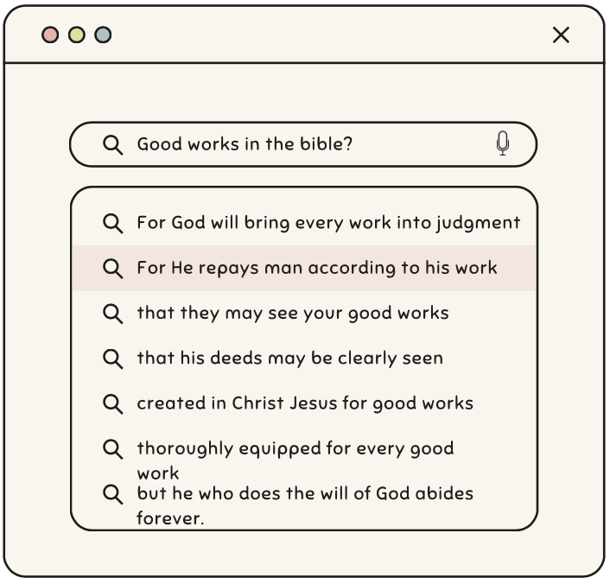

Slide 5
For we are his workmanship, created in Christ Jesus for good works, which God prepared beforehand, that we should walk in them.
And I am sure of this, that he who began a good work in you will bring it to completion at the day of Jesus Christ.
And let us consider how to stir up one another to love and good works
In the same way, let your light shine before others, so that they may see your good works and give glory to your Father who is in heaven.
So then, as we have opportunity, let us do good to everyone, and especially to those who are of the household of faith.
who gave himself for us to redeem us from all lawlessness and to purify for himself a people for his own possession who are zealous for good works.
Now there was in Joppa a disciple named Tabitha, which, translated, means Dorcas. She was full of good works and acts of charity.
Remind them to be submissive to rulers and authorities, to be obedient, to be ready for every good work
so as to walk in a manner worthy of the Lord, fully pleasing to him: bearing fruit in every good work and increasing in the knowledge of God
comfort your hearts and establish them in every good work and word.
And God is able to make all grace abound to you, so that having all sufficiency in all things at all times, you may abound in every good work.
and having a reputation for good works: if she has brought up children, has shown hospitality, has washed the feet of the saints, has cared for the afflicted, and has devoted herself to every good work.
They are to do good, to be rich in good works, to be generous and ready to share
Therefore, if anyone cleanses himself from what is dishonorable, he will be a vessel for honorable use, set apart as holy, useful to the master of the house, ready for every good work.
Jesus answered them, “I have shown you many good works from the Father; for which of them are you going to stone me?”
And let our people learn to devote themselves to good works, so as to help cases of urgent need, and not be unfruitful.
So also good works are conspicuous, and even those that are not cannot remain hidden.
They profess to know God, but they deny him by their works. They are detestable, disobedient, unfit for any good work.
The saying is trustworthy, and I want you to insist on these things, so that those who have believed in God may be careful to devote themselves to good works. These things are excellent and profitable for people.
Keep your conduct among the Gentiles honorable, so that when they speak against you as evildoers, they may see your good deeds and glorify God on the day of visitation.
that the man of God may be complete, equipped for every good work.
Show yourself in all respects to be a model of good works, and in your teaching show integrity, dignity
but with what is proper for women who profess godliness—with good works.

Slide 6
For we are his workmanship, created in Christ Jesus for good works, which God prepared beforehand, that we should walk in them.
And I am sure of this, that he who began a good work in you will bring it to completion at the day of Jesus Christ.
And let us consider how to stir up one another to love and good works
In the same way, let your light shine before others, so that they may see your good works and give glory to your Father who is in heaven.
So then, as we have opportunity, let us do good to everyone, and especially to those who are of the household of faith.
who gave himself for us to redeem us from all lawlessness and to purify for himself a people for his own possession who are zealous for good works.
Now there was in Joppa a disciple named Tabitha, which, translated, means Dorcas. She was full of good works and acts of charity.
Remind them to be submissive to rulers and authorities, to be obedient, to be ready for every good work
so as to walk in a manner worthy of the Lord, fully pleasing to him: bearing fruit in every good work and increasing in the knowledge of God
comfort your hearts and establish them in every good work and word.
And God is able to make all grace abound to you, so that having all sufficiency in all things at all times, you may abound in every good work.
and having a reputation for good works: if she has brought up children, has shown hospitality, has washed the feet of the saints, has cared for the afflicted, and has devoted herself to every good work.
They are to do good, to be rich in good works, to be generous and ready to share
Therefore, if anyone cleanses himself from what is dishonorable, he will be a vessel for honorable use, set apart as holy, useful to the master of the house, ready for every good work.
Jesus answered them, “I have shown you many good works from the Father; for which of them are you going to stone me?”
And let our people learn to devote themselves to good works, so as to help cases of urgent need, and not be unfruitful.
So also good works are conspicuous, and even those that are not cannot remain hidden.
They profess to know God, but they deny him by their works. They are detestable, disobedient, unfit for any good work.
The saying is trustworthy, and I want you to insist on these things, so that those who have believed in God may be careful to devote themselves to good works. These things are excellent and profitable for people.
Keep your conduct among the Gentiles honorable, so that when they speak against you as evildoers, they may see your good deeds and glorify God on the day of visitation.
that the man of God may be complete, equipped for every good work.
Show yourself in all respects to be a model of good works, and in your teaching show integrity, dignity
but with what is proper for women who profess godliness—with good works.

Slide 7
For we are his workmanship, created in Christ Jesus for good works, which God prepared beforehand, that we should walk in them.
And I am sure of this, that he who began a good work in you will bring it to completion at the day of Jesus Christ.
And let us consider how to stir up one another to love and good works
In the same way, let your light shine before others, so that they may see your good works and give glory to your Father who is in heaven.
So then, as we have opportunity, let us do good to everyone, and especially to those who are of the household of faith.
who gave himself for us to redeem us from all lawlessness and to purify for himself a people for his own possession who are zealous for good works.
Now there was in Joppa a disciple named Tabitha, which, translated, means Dorcas. She was full of good works and acts of charity.
Remind them to be submissive to rulers and authorities, to be obedient, to be ready for every good work
so as to walk in a manner worthy of the Lord, fully pleasing to him: bearing fruit in every good work and increasing in the knowledge of God
comfort your hearts and establish them in every good work and word.
And God is able to make all grace abound to you, so that having all sufficiency in all things at all times, you may abound in every good work.
and having a reputation for good works: if she has brought up children, has shown hospitality, has washed the feet of the saints, has cared for the afflicted, and has devoted herself to every good work.
They are to do good, to be rich in good works, to be generous and ready to share
Therefore, if anyone cleanses himself from what is dishonorable, he will be a vessel for honorable use, set apart as holy, useful to the master of the house, ready for every good work.
Jesus answered them, “I have shown you many good works from the Father; for which of them are you going to stone me?”
And let our people learn to devote themselves to good works, so as to help cases of urgent need, and not be unfruitful.
So also good works are conspicuous, and even those that are not cannot remain hidden.
They profess to know God, but they deny him by their works. They are detestable, disobedient, unfit for any good work.
The saying is trustworthy, and I want you to insist on these things, so that those who have believed in God may be careful to devote themselves to good works. These things are excellent and profitable for people.
Keep your conduct among the Gentiles honorable, so that when they speak against you as evildoers, they may see your good deeds and glorify God on the day of visitation.
that the man of God may be complete, equipped for every good work.
Show yourself in all respects to be a model of good works, and in your teaching show integrity, dignity
but with what is proper for women who profess godliness—with good works.

Slide 8
Remind them to be submissive to rulers and authorities, to be obedient, to be ready for every good work
So then, as we have opportunity, let us do good to everyone, and especially to those who are of the household of faith.

Slide 9
Remind them to be submissive to rulers and authorities, to be obedient, to be ready for every good work
So then, as we have opportunity, let us do good to everyone, and especially to those who are of the household of faith.

Slide 10
Major Principles:
Good works are to glorify God, not ourselves
Good works should be a labor of love
We should know that our labor is not in vain
God won’t forget our good works
Good works will influence others
We are to be the light of the world

Slide 13
Judgment Scene (Matt 25:35-36)
I was hungry and you gave me food,
I was thirsty and you gave me drink,
I was a stranger and you welcomed me,
I was naked and you clothed me,
I was sick and you visited me,
I was in prison and you came to me.’

Slide 14
For we are his workmanship, created in Christ Jesus for good works, which God prepared beforehand, that we should walk in them.
Ephesians 2:10

Slide 15
Why Good Works?
Created for this (Eph 2:10)
It’s our identity (Titus 2:11-14)
To glorify God (Matt 5:16, I Peter 2:11-12)
It’s a responsibility (Proverbs 3:27)

Slide 16
Okay, what’s a Good Work?
Not defined by man
Not defined by society
Not defined by the government (tax-deductible)
2 Tim 3:16-17 tells us that scripture defines every good work

Slide 17
16 All Scripture is breathed out by God and profitable for teaching, for reproof, for correction, and for training in righteousness, 17 that the man of God may be complete, equipped for every good work.
2 Timothy 3:16-17

Slide 18
Not to be seen of men
In Matthew 6, Jesus identifies the wrong motivation
Giving to be praised 2-4
Praying to be heard 5-8
Fasting to be seen 16-18
Jesus encouraged the actions:
“…when you give to the poor”
“…when you pray”
“…when you fast”
Jesus didn’t criticize the action, but rather gives modifications:
Don’t let your left hand know what your right hand is doing
Pray privately in your room
Anoint your hair and wash your face

Slide 19
11 For the grace of God has appeared, bringing salvation for all people, 12 training us to renounce ungodliness and worldly passions, and to live self-controlled, upright, and godly lives in the present age, 13 waiting for our blessed hope, the appearing of the glory of our great God and Savior Jesus Christ, 14 who gave himself for us to redeem us from all lawlessness and to purify for himself a people for his own possession who are zealous for good works.
Titus 2:11-14

Slide 22
We intend to use an in-class, anonymous survey tool you can access from your phone. These surveys will help us measure progress, give feedback to the teachers, and possibly inspire others to action.
Good
Works

Slide 23
Survey Results

Slide 24
Please fill in the survey
ⓘ Start presenting to display the poll results on this slide.

Slide 25
In this class, we intend to ask open-ended and sometimes challenging questions to foster discussion. This is not a lectureship.

Slide 26
There is an expectation of mutual accountability between all of us – in order to “stir one another up to love and good works.”

Slide 27
Class Schedule
May 7th - Introduction and overview
May 14th - Emulating Jesus
May 21st - Redeeming the time
May 28th - Money Matters
June 4th - Remembering the Poor
June 11th - Finding your Groove
June 18th - It’s the little things…
June 25th - (Not) To Be Seen of Men
July 2nd - Raising Awareness
July 9th - And how does that make you feel?
July 16th - Blessed are the Peace Makers
July 23rd - Stirring the Pot
July 30th - For better or worse
August 6th - Do as I do
August 13th - The Battle: Good vs. Evil
August 20th - No Class – Fall Meeting
August 27th - Wrap Up, Survey Data Review, Conclusions

