Slide 1
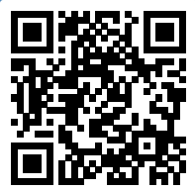
Please take a moment to complete this week’s survey.
For we are his workmanship, created in Christ Jesus for good works, which God prepared beforehand, that we should walk in them.
Ephesians 2:10

Slide 2
Money Matters

Slide 3
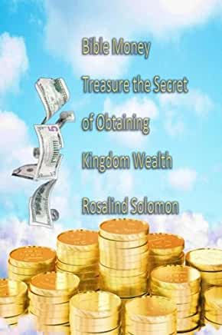
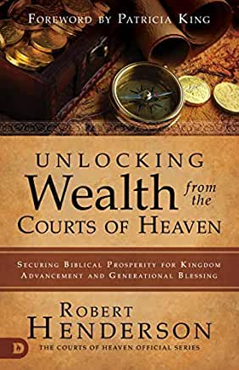
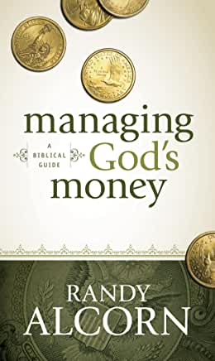
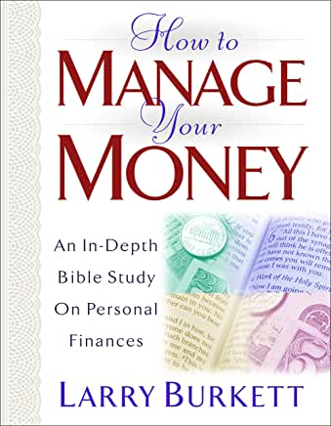
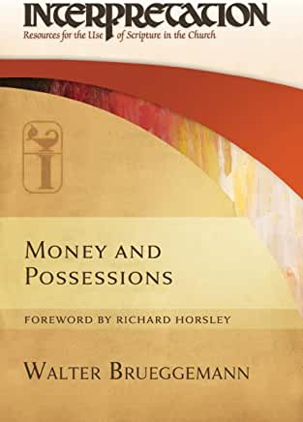
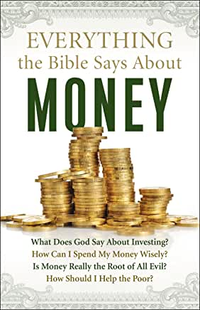
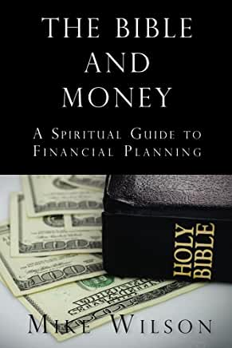
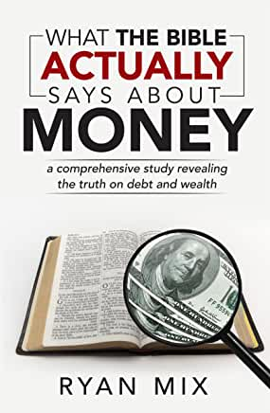
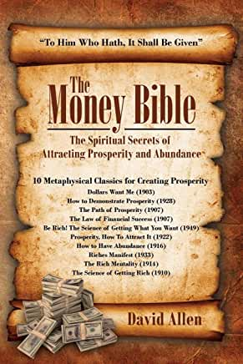
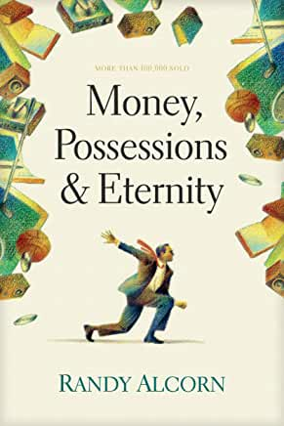
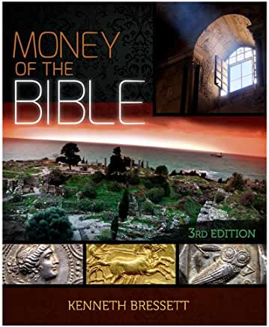
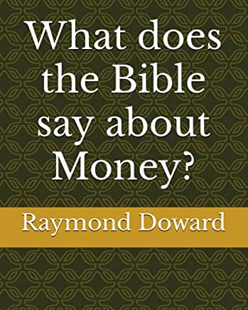
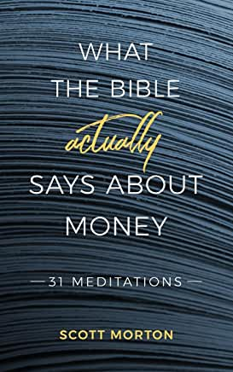
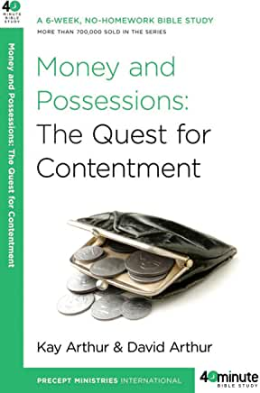
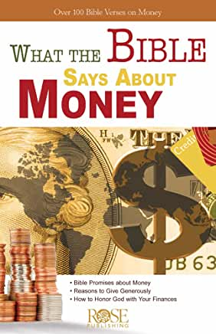

Slide 4
17 And as he was setting out on his journey, a man ran up and knelt before him and asked him, “Good Teacher, what must I do to inherit eternal life?” 18 And Jesus said to him, “Why do you call me good? No one is good except God alone. 19 You know the commandments: ‘Do not murder, Do not commit adultery, Do not steal, Do not bear false witness, Do not defraud, Honor your father and mother.’”
Mark 10:17-22

Slide 5
20 And he said to him, “Teacher, all these I have kept from my youth.” 21 And Jesus, looking at him, loved him, and said to him, “You lack one thing: go, sell all that you have and give to the poor, and you will have treasure in heaven; and come, follow me.” 22 Disheartened by the saying, he went away sorrowful, for he had great possessions.
Mark 10:17-22

Slide 6
21 And Jesus, looking at him, loved him, and said to him, “You lack one thing: go, sell all that you have and give to the poor, and you will have treasure in heaven; and come, follow me.”
What would it have meant for him to sell all and give it to the poor?
Mark 10:17-22

Slide 7
Could you sell all you have
and give it to the poor?

Slide 8
29And everyone who has left houses or brothers or sisters or father or mother or children or lands, for my name’s sake, will receive a hundredfold and will inherit eternal life.
How will someone receive a hundredfold if they forsake all to follow Jesus?
Mark 10:29

Slide 9
1 We want you to know, brothers, about the grace of God that has been given among the churches of Macedonia, 2 for in a severe test of affliction, their abundance of joy and their extreme poverty have overflowed in a wealth of generosity on their part. 3 For they gave according to their means, as I can testify, and beyond their means, of their own accord, 4 begging us earnestly for the favor of taking part in the relief of the saints—
for in a severe test of affliction
their abundance of joy
their extreme poverty
a wealth of generosity
2 Corinthians 8:1-4

Slide 10
for in a severe test of affliction
their abundance of joy
their extreme poverty
a wealth of generosity
2 Corinthians 8:1-4

Slide 11
for in a severe test of affliction
their abundance of joy
their extreme poverty
a wealth of generosity
2 Corinthians 8:1-4

Slide 12
affliction (joy + poverty) = generosity
Biblical Algebra?

Slide 13
How were the Macedonians able to have a
“wealth of generosity”
while being in extreme poverty?

Slide 14
The average American is more wealthy that 99 % of the entire rest of the world

Slide 15
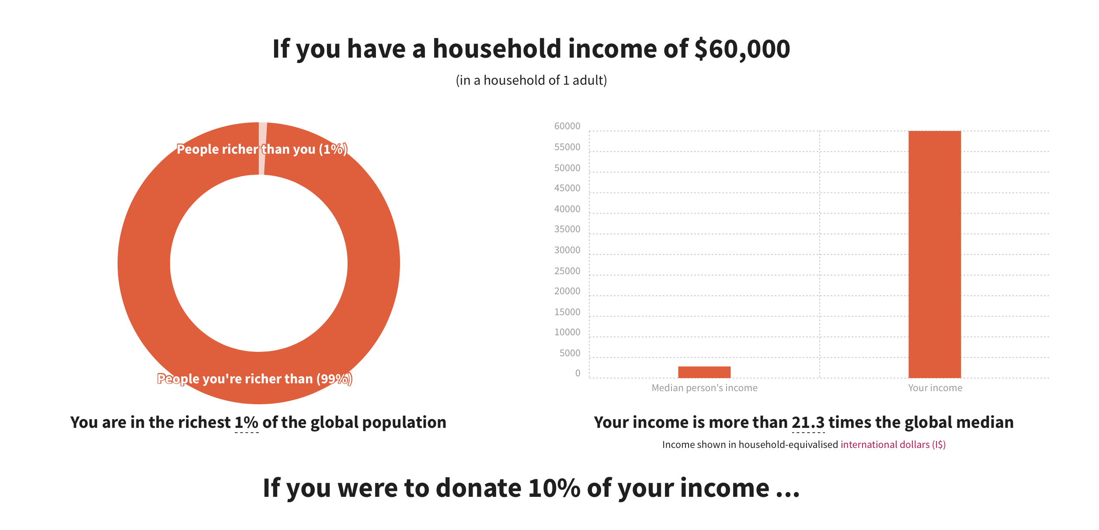
givingwhatwecan.org

Slide 16
Please take a moment to complete this special in-class survey.

Slide 17
17 Command those who are rich in this present world not to be arrogant nor to put their hope in wealth, which is so uncertain, but to put their hope in God, who richly provides us with everything for our enjoyment. 18 Command them to do good, to be rich in good deeds, and to be generous and willing to share.
1 Timothy 6:17-18

Slide 18
17 Command those who are rich in this present world not to be arrogant nor to put their hope in wealth, which is so uncertain, but to put their hope in God, who richly provides us with everything for our enjoyment.
What actions can wealthy people take to demonstrate humility?
1 Timothy 6:17-18

Slide 19
17 Command those who are rich in this present world not to be arrogant nor to put their hope in wealth, which is so uncertain, but to put their hope in God, who richly provides us with everything for our enjoyment.
What does it mean for wealthy people to put their hope in God?
1 Timothy 6:17-18

Slide 20
17 Command those who are rich in this present world not to be arrogant nor to put their hope in wealth, which is so uncertain, but to put their hope in God, who richly provides us with everything for our enjoyment.
What would prevent us from enjoying the wealth God has blessed us with?
1 Timothy 6:17-18

Slide 21
18 Command them to do good, to be rich in good deeds, and to be generous and willing to share.
Is this command related to our enjoyment mentioned in the previous verse?
1 Timothy 6:17-18

Slide 22
Are we as New Testament Christians commanded to give a tenth of our earnings?

Slide 23
2 A man was there by the name of Zacchaeus; he was a chief tax collector and was wealthy.
8 But Zacchaeus stood up and said to the Lord, “Look, Lord! Here and now I give half of my possessions to the poor, and if I have cheated anybody out of anything, I will pay back four times the amount.”
Luke 19:2,8

Slide 24
1 And He looked up and saw the rich putting their gifts into the treasury, 2 and He saw also a certain poor widow putting in two mites. 3 So He said, “Truly I say to you that this poor widow has put in more than all; 4 for all these out of their abundance have put in offerings for God, but she out of her poverty put in all the livelihood that she had.”
Luke 21:1-4

Slide 25
So what are the percentages used in these two biblical examples?
50%
100%
So, is 10% looking pretty good right now?

Slide 26
On the first day of every week, each of you is to put something aside and store it up, as he may prosper, so that there will be no collecting when I come.
Should our giving be proportional (percentage) to our earnings?
1 Corinthians 16:2

Slide 27
6 The point is this: whoever sows sparingly will also reap sparingly, and whoever sows bountifully will also reap bountifully. 7 Each one must give as he has decided in his heart, not reluctantly or under compulsion, for God loves a cheerful giver. 8 And God is able to make all grace abound to you, so that having all sufficiency in all things at all times, you may abound in every good work.
2 Corinthians 9:6-8

Slide 28
6 The point is this: whoever sows sparingly will also reap sparingly, and whoever sows bountifully will also reap bountifully.
What is the difference between sowing sparingly and bountifully?
2 Corinthians 9:6-8

Slide 29
7 Each one must give as he has decided in his heart, not reluctantly or under compulsion, for God loves a cheerful giver.
What are the requirements of the giver in this verse?
2 Corinthians 9:6-8

Slide 30
8 And God is able to make all grace abound to you, so that having all sufficiency in all things at all times, you may abound in every good work.
What is God’s blessing to the cheerful giver?
What is God’s promise to the cheerful giver?
What is God’s expectation of the cheerful giver?
2 Corinthians 9:6-8

Slide 31
You will be enriched in every way to be generous in every way, which through us will produce thanksgiving to God.
How are givers enriched? To what purpose?
What will be the result?
2 Corinthians 9:11

Slide 32
This Week’s Challenge No. 1
Give the amount you said in the survey you could live without
Let’s see the impact on next week’s contribution

Slide 33
This Week’s Challenge No. 2
Do good
Be rich in good deeds
Be generous
Be willing to share.

Slide 34
Class 4
ⓘ Start presenting to display the poll results on this slide.

Slide 35
Survey results chart

