Slide 2
Nicodemus
Samaritan Woman
Man
Jew
Named
Night
Ruler
Righteous
Respected
Stuck
Frustrated
Fades out
Shot down
Unbeliever
Skeptical
Woman
Samaritan
Unnamed
Day
Nobody
Immoral
Despised
Recovers
Engaged
Progresses
Entrusted
Believer
Evangelist

Slide 3
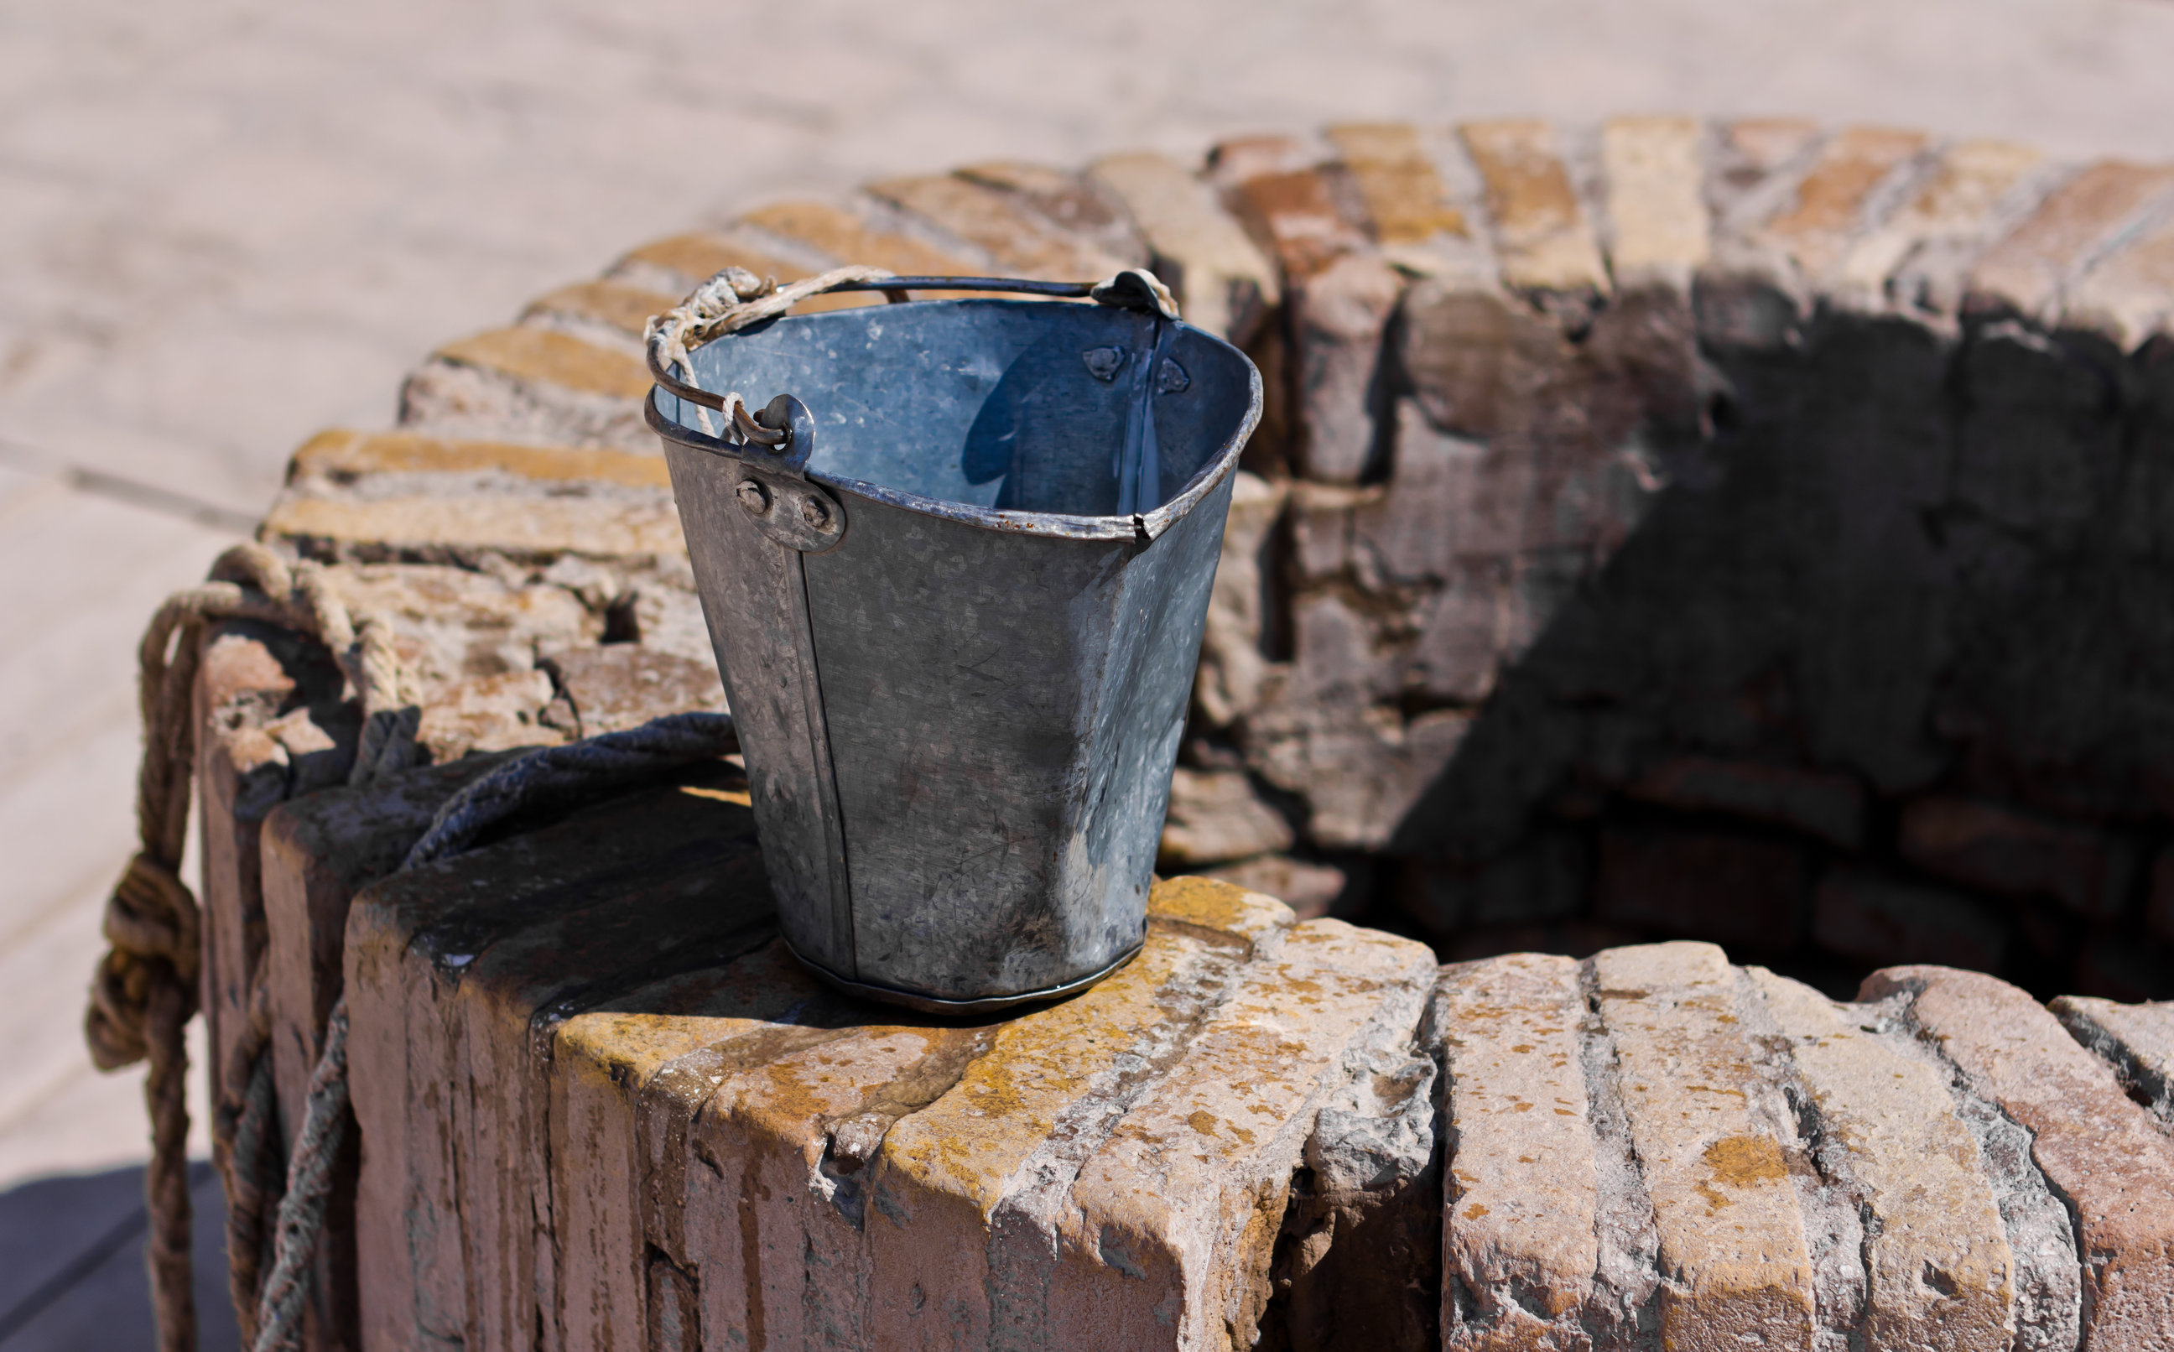
Lessons From The Well
Living Water

Slide 4
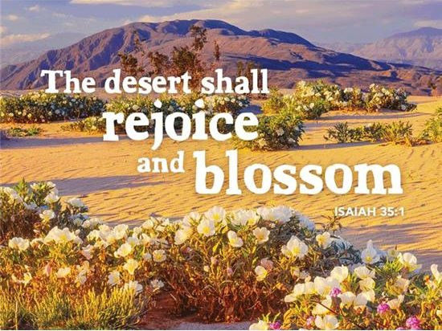

Slide 6
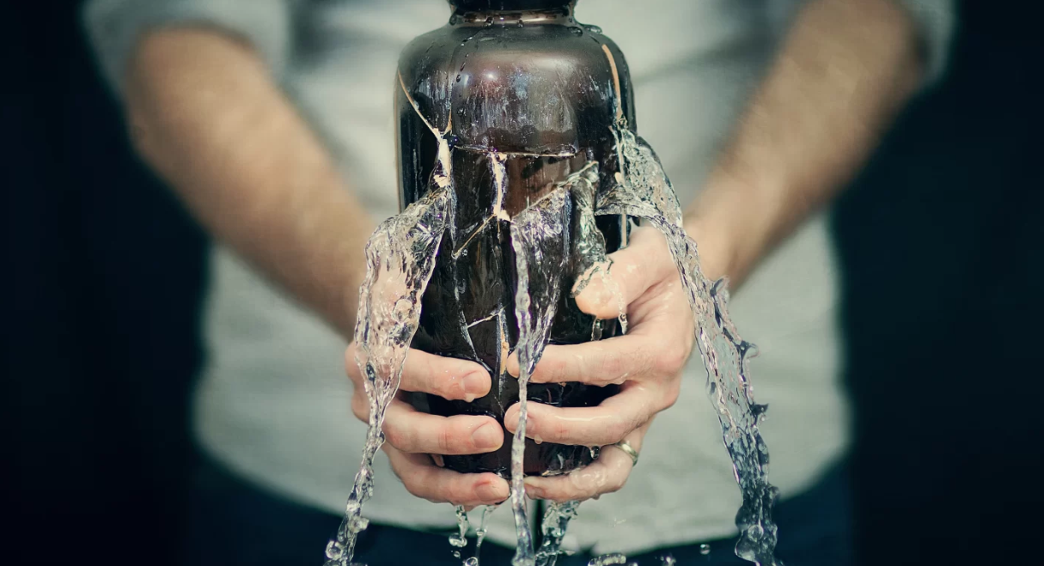
Water That Can’t Satisfy
John 4:15-18 – “The woman said to Him, ‘Sir, give me this water, so I will not be thirsty nor come all the way here to draw.’ He said to her, ‘Go, call your husband and come here.’ The woman answered and said, ‘I have no husband.’ Jesus said to her, ‘You have correctly said, “I have no husband”; for you have had five husbands, and the one whom you now have is not your husband; this you have said truly.’”
Jer 2:13 – “For My people have committed two evils: they have forsaken Me, the fountain of living waters, to hew for themselves cisterns, broken cisterns that can hold no water.”

Slide 7
Water That Can Satisfy
John 4:10 – “Jesus answered and said to her, ‘If you knew the gift of God, and who it is who says to you, “Give Me a drink,” you would have asked Him, and He would have given you living water.’”
Isa 49:10 – “They will not hunger or thirst, nor will the scorching heat or sun strike them down; for He who has compassion on them will lead them and will guide them to springs of water.”

Slide 8
Water That Is In Us
Isa 44:3 – “For I will pour out water on the thirsty land and streams on the dry ground; I will pour out My Spirit on your offspring and My blessing on your descendants”
Isa 32:15-17 – “Until the Spirit is poured out upon us from on high, and the wilderness becomes a fertile field, and the fertile field is considered as a forest. Then justice will dwell in the wilderness and righteousness will abide in the fertile field. And the work of righteousness will be peace, and the service of righteousness, quietness and confidence forever.”
John 7:37-39 – “Now on the last day, the great day of the feast, Jesus stood and cried out, saying, ‘If anyone is thirsty, let him come to Me and drink. He who believes in Me, as the Scripture said, ‘From his innermost being will flow rivers of living water.’ But this He spoke of the Spirit, whom those who believed in Him were to receive; for the Spirit was not yet given, because Jesus was not yet glorified.”
John 6:63 – “It is the Spirit who gives life; the flesh profits nothing; the words that I have spoken to you are spirit and are life.”

Slide 9
Water That Is In Us
Jer 31:33 – “‘But this is the covenant which I will make with the house of Israel after those days,’ declares the Lord, ‘I will put My law within them and on their heart I will write it; and I will be their God, and they shall be My people.’”
Matt 5:6 – “Blessed are those who hunger and thirst for righteousness, for they shall be satisfied.”

Slide 10
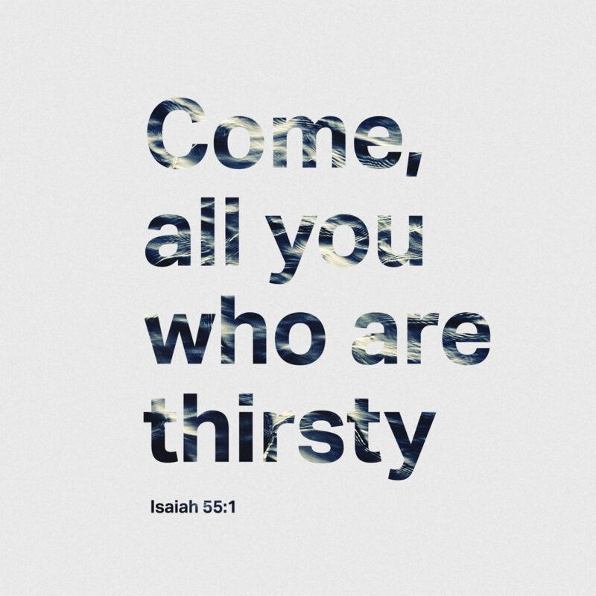
Water Springing Up To Eternal Life
1 John 2:17 – “The world is passing away, and also its lusts; but the one who does the will of God lives forever.”
2 Cor 4:18 – “while we look not at the things which are seen, but at the things which are not seen; for the things which are seen are temporal, but the things which are not seen are eternal.”
Rom 12:2 – “And do not be conformed to this world, but be transformed by the renewing of your mind, so that you may prove what the will of God is, that which is good and acceptable and perfect.”

Slide 11
