Slide 2
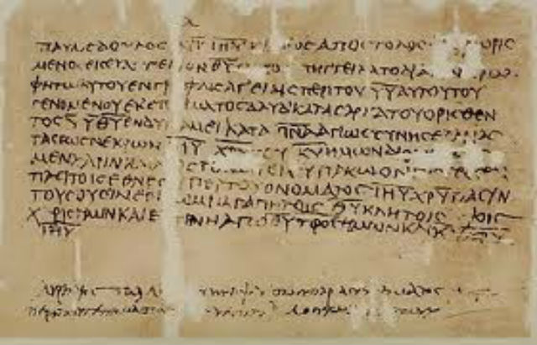
Letter To Diognetus
“…what the soul is in the body, Christians are in the world. The soul is dispersed through all the members of the body, and Christians are scattered through all the cities of the world. The soul dwells in the body, yet is not of the body; and Christians dwell in the world, yet are not of the world.”

Slide 4
Social drinking | Clubbing | Rioting
Gossip | Filthy Language | Self-righteousness
Violence | Pornography | Drugs
“Cancel culture” | Envy/Jealousy | Modern Dancing
Power | Quarrels | Spiritual Apathy
Gambling | Materialism | Criticism
Love of money | Fornication | Immodest apparel
Pride | Glory-seeking | Scoffing

Slide 5
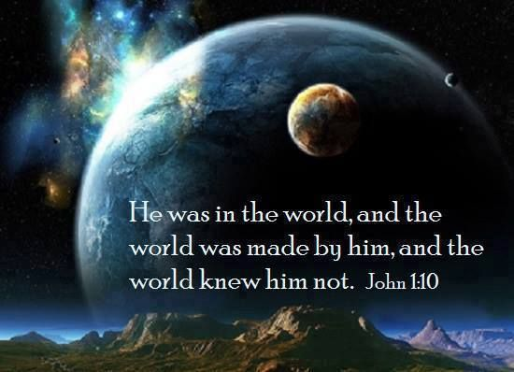

Slide 6
Worldliness
What Is It?
Fleshly, pervasive influence – 1 John 2:15-16
Masterminded by Satan – Gen 3:1-6; 1 John 5:19
Manipulation/exploitation – 2 Cor 4:3-4; Rev 12:9

Slide 7
Worldliness
Features
Elementary – Gal 4:3; Col 2:8,20
Left behind – Eph 2:1-3; Col 1:13; 2 Pet 1:4
Suppression – John 17:25; Rom 1:18-21; Eccl 3:11
Backwards – Isa 5:20a; Gen 2:16 vs. 3:1
Intimidating – 1 Pet 2:11; 4:4
Evangelistic – 2 Tim 4:10a

Slide 9
Worldliness
Features
Elementary – Gal 4:3; Col 2:8,20
Left behind – Eph 2:1-3; Col 1:13; 2 Pet 1:4
Suppression – John 17:25; Rom 1:18-21; Eccl 3:11
Backwards – Isa 5:20a; Gen 2:16 vs. 3:1
Intimidating – 1 Pet 2:11; 4:4
Evangelistic – 2 Tim 4:10a
Hostile – John 15:19; Gal 6:14

Slide 10
Gen 3:15 – “I will put enmity between you and the woman, and between your seed and her seed; He shall bruise you on the head, and you shall bruise him on the heel.”

Slide 11
Worldliness
How To Deal With The World
Embrace Jesus – Isa 53:10; Matt 12:50; John 15:18
Overcome it – Rom 12:2a; Jas 1:27; Tit 2:11-12
Pursue our purpose: holiness – 1 Pet 1:14
Point the world to Jesus – 1 Pet 2:9-11

Slide 12
Worldliness
What Happens If We Don’t
Christians will fall away – 2 Pet 2:20
Evangelism will fail – Rom 12:2b
A leavening affect – 1 Cor 5:6-8
We’ll lose the Lord – Jas 4:4; Rev 2:5b

