Slide 2
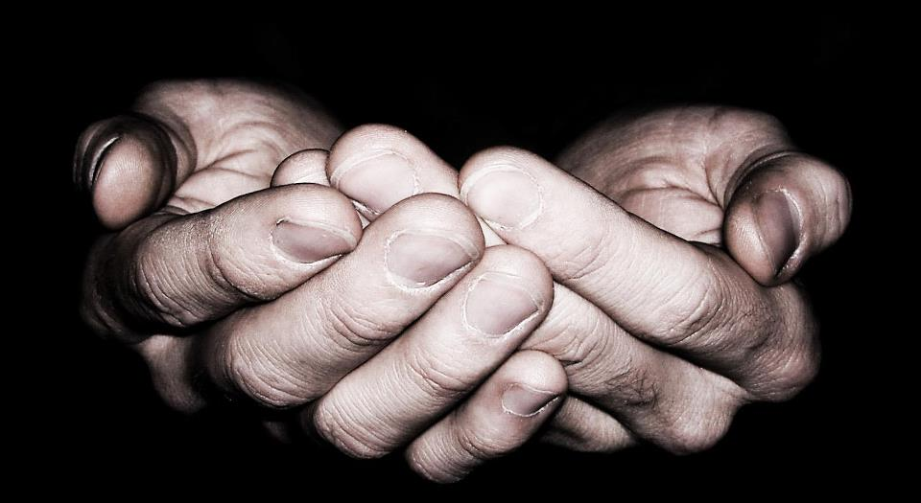
Falling Into The Hands Of God

Slide 3
Matt 17:22 – “And while they were gathering together in Galilee, Jesus said to them, ‘The Son of Man is going to be delivered into the hands of men’”
Luke 22:21 – “The hand of the one betraying me is with mine on the table.”
Matt 26:50 – “Then they came and laid hands on Jesus and seized Him.”
John 18:22 – “When He had said this, one of the officers standing nearby struck Jesus…”
Matt 26:67 – “Then they spat in His face and beat Him with their fists; and others slapped Him
John 19:3 – “and they began to come up to Him and say, ‘Hail, King of the Jews!’ and to give Him slaps in the face.”
Luke 22:63 – “They were mocking Him and beating Him saying, ‘Who is the one who hit you?’”
Matt 27:24 – “When Pilate saw that he was accomplishing nothing, but rather that a riot was starting, he took water and washed his hands in front of the crowd, saying, ‘I am innocent of this Man’s blood…”
Acts 2:23 – “This Man, delivered over by the predetermined plan and foreknowledge of God, you nailed to a cross by the hands of godless men and put Him to death.”

Slide 5
Falling Into The Hands Of God
Doesn’t eliminate suffering
Isa 50:6; Rom 8:18,28
Supplies our deepest needs
Luke 5:12-13

