Slide 2
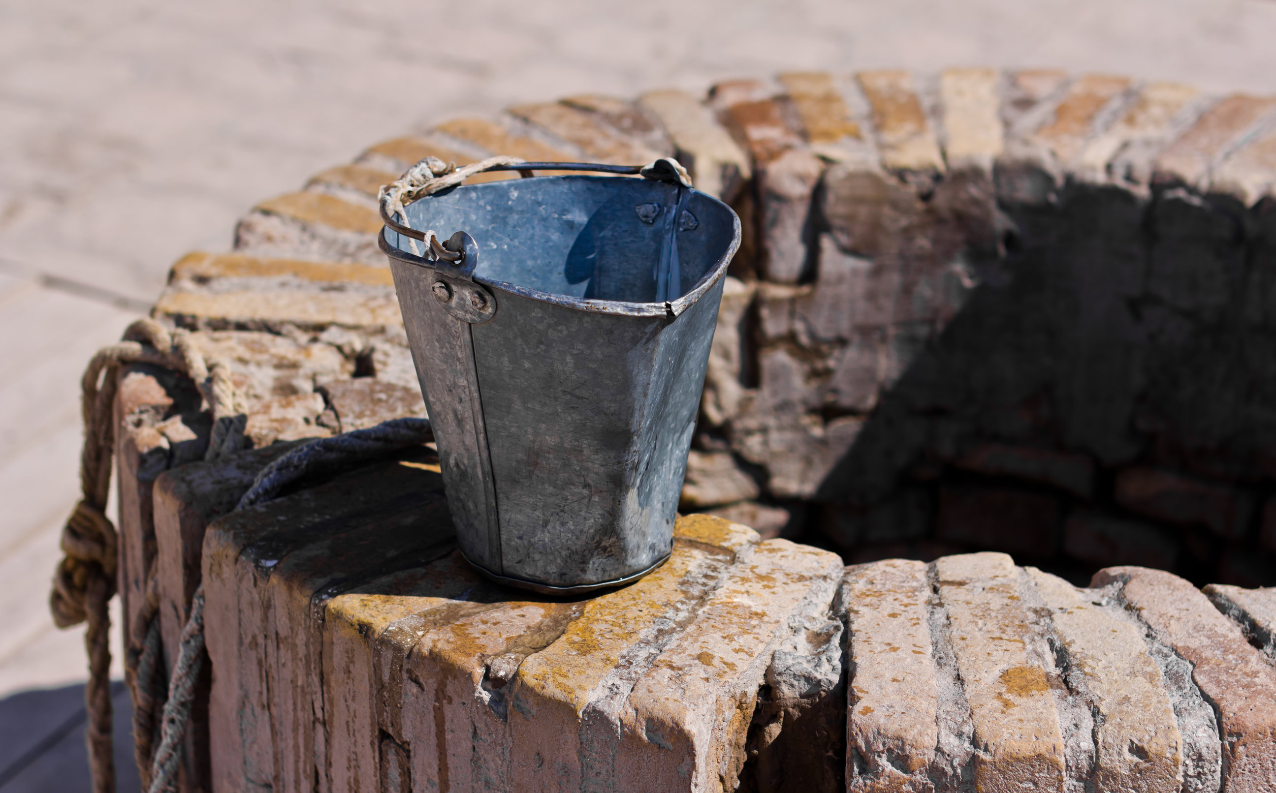
Lessons From The Well
Food To Do God’s Will

Slide 3
Hurdles To Overcome
Compartmentalizing
Luke 8:9;11:1; Matt 26:40-41; Rom 7:22-23
Distractions Of The Flesh
John 4:8; Jon 4:5-11
Waning Excitement
Eph 2:5; Rev 2:2-5

Slide 4
Jesus’ Food
Doing God’s Will
John 4:34a; 1 Pet 2:2; Heb 5:13-14; Jas 1:22-25
Accomplishing God’s Work
John 4:34b; 6:38; 13:13-15; 17:4; Eph 2:10

