Slide 2
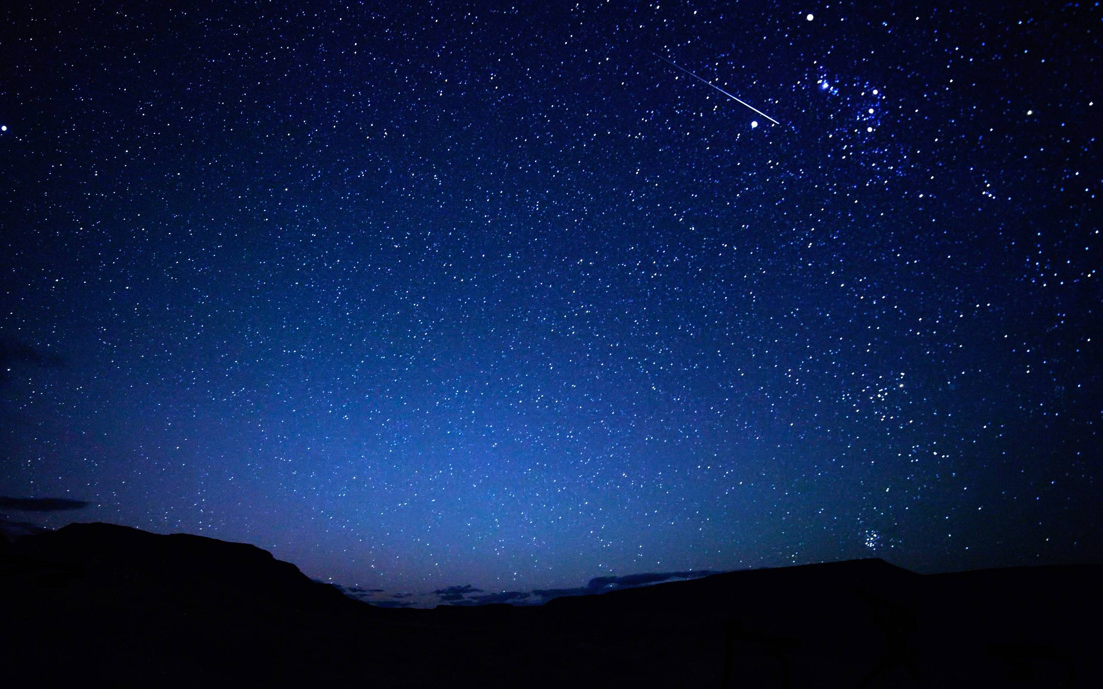
Thankfulness
Psalm 107

Slide 3
A description of the distress.
A prayer to the Lord.
A description of the deliverance.
An expression of thanks.

Slide 4
107 Oh give thanks to the Lord, for he is good, for his steadfast love endures forever! ² Let the redeemed of the Lord say so, whom he has redeemed from trouble ³ and gathered in from the lands, from the east and from the west, from the north and from the south.

Slide 5
⁴ Some wandered in desert wastes, finding no way to a city to dwell in; ⁵ hungry and thirsty, their soul fainted within them. ⁶ Then they cried to the Lord in their trouble, and he delivered them from their distress. ⁷ He led them by a straight way till they reached a city to dwell in. ⁸ Let them thank the Lord for his steadfast love, for his wondrous works to the children of man! ⁹ For he satisfies the longing soul, and the hungry soul he fills with good things.

Slide 6
¹⁰ Some sat in darkness and in the shadow of death, prisoners in affliction and in irons, ¹¹ for they had rebelled against the words of God, and spurned the counsel of the Most High. ¹² So he bowed their hearts down with hard labor; they fell down, with none to help.

Slide 7
¹³ Then they cried to the Lord in their trouble, and he delivered them from their distress. ¹⁴ He brought them out of darkness and the shadow of death, and burst their bonds apart. ¹⁵ Let them thank the Lord for his steadfast love, for his wondrous works to the children of man! ¹⁶ For he shatters the doors of bronze and cuts in two the bars of iron.

Slide 8
¹⁷ Some were fools through their sinful ways, and because of their iniquities suffered affliction; ¹⁸ they loathed any kind of food, and they drew near to the gates of death.

Slide 9
¹⁹ Then they cried to the Lord in their trouble, and he delivered them from their distress. ²⁰ He sent out his word and healed them, and delivered them from their destruction. ²¹ Let them thank the Lord for his steadfast love, for his wondrous works to the children of man! ²² And let them offer sacrifices of thanksgiving, and tell of his deeds in songs of joy!

Slide 10
²³ Some went down to the sea in ships, doing business on the great waters; ²⁴ they saw the deeds of the Lord, his wondrous works in the deep. ²⁵ For he commanded and raised the stormy wind, which lifted up the waves of the sea. ²⁶ They mounted up to heaven; they went down to the depths; their courage melted away in their evil plight; ²⁷ they reeled and staggered like drunken men and were at their wits' end.

Slide 11
²⁸ Then they cried to the Lord in their trouble, and he delivered them from their distress. ²⁹ He made the storm be still, and the waves of the sea were hushed. ³⁰ Then they were glad that the waters were quiet, and he brought them to their desired haven. ³¹ Let them thank the Lord for his steadfast love, for his wondrous works to the children of man! ³² Let them extol him in the congregation of the people, and praise him in the assembly of the elders.

Slide 12
³³ He turns rivers into a desert, springs of water into thirsty ground, ³⁴ a fruitful land into a salty waste, because of the evil of its inhabitants. ³⁵ He turns a desert into pools of water, a parched land into springs of water. ³⁶ And there he lets the hungry dwell, and they establish a city to live in; ³⁷ they sow fields and plant vineyards and get a fruitful yield. ³⁸ By his blessing they multiply greatly, and he does not let their livestock diminish.

Slide 13
³⁹ When they are diminished and brought low through oppression, evil, and sorrow, ⁴⁰ he pours contempt on princes and makes them wander in trackless wastes; ⁴¹ but he raises up the needy out of affliction and makes their families like flocks. ⁴² The upright see it and are glad, and all wickedness shuts its mouth.

Slide 14
⁴³ Whoever is wise, let him attend to these things; let them consider the steadfast love of the Lord.

Slide 15
The wanderers.

Slide 16
⁴ Some wandered in desert wastes, finding no way to a city to dwell in; ⁵ hungry and thirsty, their soul fainted within them.

Slide 17
⁹ For he satisfies the longing soul, and the hungry soul he fills with good things.

Slide 18
The prisoners.

Slide 19
¹¹ for they had rebelled against the words of God, and spurned the counsel of the Most High.

Slide 20
¹⁴ He brought them out of darkness and the shadow of death, and burst their bonds apart.

Slide 21
The sick.

Slide 22
¹⁷ Some were fools through their sinful ways, and because of their iniquities suffered affliction…

Slide 23
²⁰ He sent out his word and healed them, and delivered them from their destruction.

Slide 24
The sailors.

Slide 25
²⁷ they reeled and staggered like drunken men and were at their wits' end.

Slide 26
²⁹ He made the storm be still, and the waves of the sea were hushed.

Slide 27
The point.

Slide 28
¹ Oh give thanks to the Lord, for he is good, for his steadfast love endures forever!

Slide 29
⁸ Let them thank the Lord for his steadfast love, for his wondrous works to the children of man! (repeated in vs 15, 21, & 31)

Slide 30
³² Let them extol him in the congregation of the people, and praise him in the assembly of the elders.

Slide 31
⁴³ Whoever is wise, let him attend to these things; let them consider the steadfast love of the Lord.

Slide 32
Lead off with praise & thanksgiving in prayer (ACTS format).
Make a list of the times God has “redeemed” you (spiritual or physical).

