Slide 3
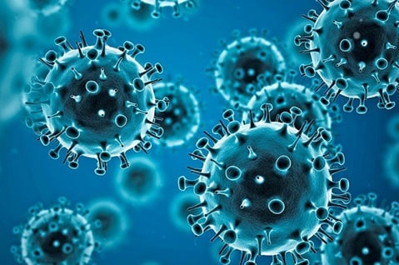
The Disease
Sin Exists
Rom 3:9-10; Eccl 7:20
Time Won’t Heal It
2 Tim 3:13
Deceptive
John 8:44
Not Inherited
Ezek 18:20; Eccl 7:29
Degenerative
Rev 3:17
Contagious
1 Cor 15:33
Fatal
Jas 1:14-15
SIN

Slide 4
The Patient
Accept He Is Sick
Heb 3:13
Honest About Symptoms
John 8:31-34
Accept The Cure
John 9:40-41

Slide 5
The Physician
Qualifications
Eph 1:4; 3:11
Understanding
John 2:25
Personal Experience
Heb 4:15
Ability
Heb 4:12
Will Take Our Case
Matt 11:28
Never Lost A Case
1 John 5:18

Slide 6
The Cure
The Gospel
1 Cor 15:3
Requirements
Believe – Rom 1:4,16
Repent – Luke 13:3
Confess – Rom 10:9
Baptism – Mark 16:16

