Slide 2
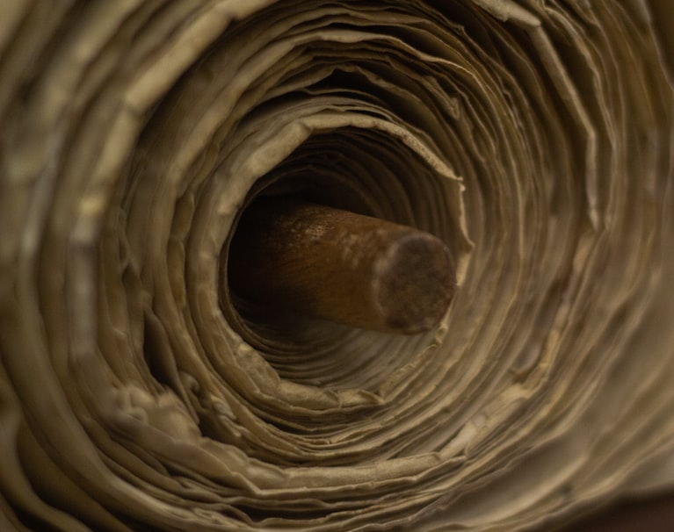
REQUEST
Create a Curiosity
REVERENCE
Who God Is
REMINDER
What God Says
REJOICING
Rejoice with Them
Nehemiah 8

